Slide 1


PAMUKKALE UNIVERSITY
ORIENTATION PROGRAM
21ST OCTOBER 2025
International Students Office & PADAM
www.pau.edu.tr/yurtdisi
www.pau.edu.tr/padam

Slide 2
Welcome to Pamukkale University.
This presentation was prepared for you, our valuable students, by the Pamukkale University Psychological Counseling and Guidance, Education, Application and Research Center (PDREM) as part of the 2025 Orientation Program AND translated into English and edited for your needs by International Students Office.
PDREM Website: www.pau.edu.tr/pdrem

Slide 3

Our unıversıty
General Information
Establishment Date: 1992
Rector: Prof. Dr. Mahmud GÜNGÖR
Website: www.pau.edu.tr
Students: 45,794
Academic Staff: 2,069
Administrative Staff: 1,906
Faculties: 20
Vocational Schools: 17
Higher Schools: 1
Graduate Schools /Institutes : 6
Research Centers: 45

Slide 4

Kınıklı CAMPUS MAP
AVAILABLE IN
ORIENTATION
BOOKLET

Slide 5
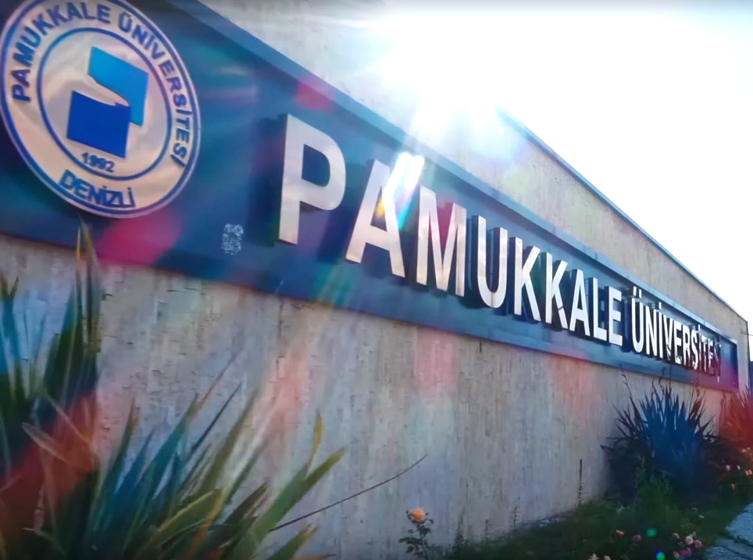
UNIVERSITY ADMINISTRATION
RECTOR
Prof. Dr. Mahmud GÜNGÖR
VICE RECTOR
Prof. Dr. Mehmet İNEL
VICE RECTOR
Prof. Dr. Ersan ÖZ
VICE RECTOR
Prof. Dr. İbrahim TÜRKÇÜER
VICE SECRETARY GENERAL
Bilal BOZOĞLU
DEPUTY SECRETARY GENERAL
Serdar Selman SAVRAN
SECRETARY GENERAL
Fatih IŞIK

Slide 6

FACULTIES
Faculty of Dentistry
Faculty of Education
Faculty of Humanities and Social Sciences
Faculty of Science
Faculty of Physiotherapy and Rehabilitation
Faculty of Economics and Administrative Sciences
Faculty of Law
Faculty of Theology
Faculty of Communication
Faculty of Architecture and Design
Faculty of Engineering
Faculty of Music and Performing Arts
Faculty of Health Sciences
Faculty of Sport Sciences
Faculty of Technical Education
Faculty of Technology
Faculty of Medicine
Faculty of Tourism
Faculty of Applied Sciences
Faculty of Agriculture

Slide 7
VOCATIONAL SCHOOLS
Acıpayam Vocational School
Bekilli Vocational School
Bozkurt Vocational School
Buldan Vocational School
Çal Vocational School
Çameli Vocational School
Çardak Organized Industrial Zone Vocational School
Çivril Atasay Kamer Vocational School
Denizli Health Services Vocational School
Denizli Social Sciences Vocational School
Denizli Technical Sciences Vocational School
Honaz Vocational School
Kale Vocational School
Sarayköy Vocational School
Serinhisar Vocational School
Tavas Vocational School
Tavas Health Services Vocational School

Slide 8

Graduate schools
Graduate School of Archaeology
Graduate School of Educational Sciences
Graduate School of Science and Engineering
Graduate School of Islamic Studies
Graduate School of Health Sciences
Graduate School of Social Sciences

Slide 9

Hıgher schools
School of Foreign Languages

Slide 10

Research centers
Alcohol and Substance Addiction Application and Research Center
Language and Cultures of Altay Communities Application and Research Center
Atatürk's Principles and History of Revolutions Research and Application Center
Plant Genetics and Agricultural Biotechnology Application and Research Center
Botanical Garden Application and Research Center
Child and Youth Education Application and Research Center
Experimental Surgery Application and Research Center
Sea Turtles Research and Application Center
Earthquake and Building Application and Research Center
Language Teaching Application and Research Center
Education and Training Technologies Application and Research Center
Economic and Econometric Application and Research Center
Career Planning Application and Research Center
Flora and Fauna Research Development Application and Research Center
Geropsychiatry Application and Research Center
Power Systems Application and Research Center

Slide 11

Research centers
Materials Research and Application Center
Menderes Basin Agricultural Application and Research Center
Mufti Ahmet Hulusi Efendi Application and Research Center
Animal Breeding and Genetics Application and Research Center
Advanced Technology Application and Research Center
Occupational Health and Safety Education, Application and Research Center
Geothermal Application and Research Center
Women's Issues Application and Research Center
Quality Management and Data Evaluation Application and Research Center
Clinical Application and Research Center
Cancer Application and Research Center
Stem Cell Application and Research Center

Slide 12

Research centers
Obesity and Diabetes Application and Research Center
Obesity and Obesity Surgery Application and Research Center
Pre-school Education Application and Research Center
Psychological Counseling and Guidance Education, Application and Research Center (PDREM)
Health Research and Application Center
Water and Environmental Problems Application and Research Center
Continuing Education Application and Research Center
Sport Sciences Technology Research and Application Center
Turkish Language and Culture Application and Research Center
Turkish Culinary Culture Research and Application Center
Seed Breeding and Genetics Application and Research Center
Social Economic and Political Research and Application Center
University Industry Collaboration Application and Research Center
Reproductive Health-Infertility Application and Research Center
Distance Education Application and Research Center

Slide 13

UNIVERSITY GENERAL ORGANIZATION CHART
University
(Rector)
Graduate Schools
(Enstitü Müdürü)
Faculties
(Dekan)
Departments
(Bölüm Başkanı)
Programs
(Anabilim Dalı Başkanı)
Research Centers
(Müdür)
Higher Schools
(Müdür)

Slide 14

Unıversıty lıfe
Higher education is different from the 12-year compulsory education system in many ways.
You will find the most options in terms of academic, social, sports, and cultural opportunities during your university years.
Taking advantage of these opportunities will be beneficial to you.
Be curious. Ask questions. Share your opinion.
Don't let the anxiety of being judged that prevent you from using these opportunities.

Slide 15

Unıversıty lıfe
Every faculty member at the university has dozens of other students besides you.
Keep in mind that faculty members may have scientific studies, joint work with academic and administrative units, projects they manage, and meetings they must attend, outside of class.
If possible, ask your question via e-mail first.

Slide 16

Unıversıty lıfe
.
Be sure to read the email you write at least once before sending it. Send it after ensuring you have expressed yourself clearly.
If the matter is too urgent to communicate via e-mail, you can consider going to the faculty member's office.
When entering the office, you should first knock on the door and ask if they are available.
For healthy communication, prepare your question in advance and strive to express yourself as briefly and clearly as possible.

Slide 17

Key support unıts
Research Assistant: This is the first unit to apply to for information regarding the operation of the relevant department/major.
Advisor (Danışman): This is the first unit to apply to for solving academic issues such as course registration and add/drop control.
Head of Department (Anabilim Dalı Başkanı): This is the authorized
person who distributes courses, prepares the course schedule,
and manages affairs (such as taking a leave of absence or freezing registration)
through the advisor when problems cannot be resolved with the advisor.

Slide 18

Key admınıstratıve unıts
Department Secretariat (Bölüm Sekreterliği): This is the unit where petitions for issues such as
excused registration, excused exams, taking external courses for summer school,
and course coding errors are submitted.
Registry Office (Yazı İşleri): This is the unit responsible for following up on documents that need to be submitted to the administrative board
(such as exemption, course deletion/addition, and grade corrections) and submitting petitions related to surname changes.

Slide 19

Undergraduate and Associate Degree Regulations
For detailed information, visit: http://www.pau.edu.tr/oidb/tr/sayfa/yonetmelik (Undergraduate and Associate Degree Regulations)

Slide 20

Academıc calendar
The Academic Calendar contains information on university renewal of registration, add/drop deadlines, orientation programs, final application dates for academic matters, exam start/end dates, and official holidays. Available in this link: https://www.pau.edu.tr/oidb/tr/sayfa/akademik-takvim-3

Slide 21

PUSULA Informatıon System
Pusula Information System is a common authentication platform that provides access to all applications with a single username and password.
You can use this system to select your courses, check your grades
(Student Information System),
and access your e-mail.
Login: https://pusula.pau.edu.tr/
You can browse student clubs under the SKS sub-menu and select the ones you want to join.
Don't forget to follow the clubs on social media and attend their introductory meetings after you become a member.

Slide 22
Our unıversıty
* Please download Pau Mobil app on your phone to get updated about announcements and to authenticate your login Pusula.
(App store or Google play)

Slide 23

Regıstratıon renewal
Students must complete their first course registration themselves.
They must renew their registration at the beginning of the Fall and Spring semesters throughout their studies, within the period specified in the academic calendar.
Registration Renewal Period (08-12.09.2025):
Payment of student contribution/tuition fee (6-12.09.2025).
Course Registration: After logging in with your username and password
at https://pusula.pau.edu.tr/, you can register for courses from the appropriate menu.
You can watch the video on how to register for courses on the Pamukkale University Youtube Channel: https://www.youtube.com/watch?v=cQ2n1IOMPoY
The process consists of add-delete-approve steps. (15-19.09.2025)

Slide 24

remınders
If possible, do not register for courses with a mobile phone (your registration may
fail due to an internet interruption).
Update your contact information, such as your email and mobile phone number,
by entering it into the Pusula system.
Following the university (@pauedutr), SKS (@pausks) and
PDREM (@paupdrem) and @ paupadam_20 Instagram accounts will help you
stay informed about current developments instantly.

Slide 25

Tuıtıon fees
The student contribution fee/tuition fee varies according to the department, type of education, and the student's status.
Detailed information: https://www.pau.edu.tr/pau/tr/duyuru/2025-2026egitimogretim-yili-guz-doneminde-universitemize-yenikayit-yaptiran-ve-ogrenimine-devam-edecek-olanogrencilerin-katki-payiogrenim-ucreti-odeme-islemlerineiliskin-duyuru
https://www.pau.edu.tr/yurtdisi/tr/sayfa/2025-2026-akademik-yili-ogrenim-ucretleri
Students who do not pay the fee on time cannot register.
Fall Semester Fee Payment Dates: September 6-12, 2025

Slide 26

Course regıstratıon
At the beginning of the semester, students must add the courses they failed and are required to retake to their program.
This process is done through the Student Information System in PAÜ Pusula, and the courses must be approved by the advisor after selection.
If you miss the regular course registration period, you must submit a petition during the add/drop period.

Slide 27

Course selectıon order
The following order is taken into account when selecting courses:
Courses failed from previous semesters.
Courses not taken before from previous semesters.
Courses failed from the current semester.
Courses not taken before from the current semester.
Courses failed from a semester above the current semester.
Courses not taken before from a semester above the current semester.
It is mandatory to take a minimum of 20 credits of courses in the Fall and Spring semesters.
To select a prerequisite course, the student must have previously taken the prerequisite course(s) and received at least a conditionally passing grade.

Slide 28

Course selectıon
The maximum number of credits a student can take each semester is determined based on their academic average if the required number of credits is above 30:
For students with an academic average below 2.25: maximum 30 credits.
For students with an academic average between 2.26 and 2.99: maximum 36 credits.
For students with an academic average above 3.00: maximum 42 credits.
If the student's required number of credits in the semester is below 30, they can take a maximum of 30 credits.
A student who has not duly registered for a course within the time limit cannot attend that course or take its exam; if they do, the grade will be canceled.

Slide 29

Attendance ın lessons
The attendance requirement for courses and applications is determined by the course instructor at the beginning of the semester.
In repeated courses, if the attendance requirement was met in the previous semester, attendance is not required, provided the student takes the midterm exams.
Attending classes regularly directly affects your academic success.

Slide 30
Attendance ın turkıye bursları
Turkish Preparatory Education Commitment Form
If a total of 100 hours of unexcused absence is accumulated in Turkish language and Academic Turkish courses, the “Scholarship Cancellation” procedure will be applied.
If 20 hours of unexcused absence occur in a month, a 25% deduction will be applied to your scholarship for 3 months.
If you cannot attend Turkish language classes due to illness, you must submit an official medical report from your doctor to YTB and the TÖMER (PADAM) authorities. Otherwise, your absence will be counted as unexcused, and your scholarship status will be at risk.
If you leave the country without permission while Turkish language classes are ongoing, except for official holidays, your scholarship will be suspended.
Academic Turkish courses are mandatory.

Slide 31
Attendance ın turkıye bursları
Turkish Preparatory Education Commitment Form
To ensure effective communication with our institution, your contact information, such as phone number and email, must be updated in the Türkiye Bursları Information System (TBBS).
If you hold a C1 certificate, you must upload it to the Turkish Language Certificate section under the Language Proficiency tab in TBBS.
You must not purchase your airline ticket before your leave request has been approved by the Presidency.
Leave requests to extend the holiday period immediately before or after official holidays will be rejected.
Students who successfully complete the Turkish preparatory education, obtain the C1 certificate, and finish the Academic Turkish program may return to their home countries without submitting a leave request.

Slide 32

exams
Exams are divided into two main groups: in-semester exams (midterm-vize) and general exams (finals). In-semester exams (small exams, midterms, and make-up exams) are held to evaluate the student's work during the semester.
General exams (semester/year-end exam, make-up exam, three-course exam, additional exam, and exemption exam) are held to determine the student's overall success in the course. General exam results, except for the semester/year-end and make-up exams, determine the course success score on their own.

Slide 33
exams
These exams may be written, oral, or both written and oral, and/or practical.
If you fail a course, you can choose the Make-up Exam or Summer School option according to the Academic Calendar.
According to the Higher Education Institutions Student Disciplinary Regulation, cheating or allowing someone to cheat results in a one-semester suspension from the university.

Slide 34

Course Success Grade
A student's success in a course is determined by the 'Course Success Grade’. The course success grade is obtained by evaluating the student's performance during the semester (midterms, assignments, practical work, etc.) and the general exam together.

Slide 35

Course success grade
The total contribution of each in-semester grade to the course success score is determined by the relevant faculty member at the beginning of the semester, provided it is between 30% and 50%.
The contribution of the semester-end exam to the course success score is determined by the relevant faculty member at the beginning of the semester, provided it is between 50% and 70%.

Slide 36

Course success grade
If the class size is less than 20, an absolute evaluation will be directly applied.
If the class size is 20 or more, the grading system will be determined by considering the class success average.
If the class average is 60 or above, absolute evaluation will be applied.
If the class average is less than 60, relative evaluation will be applied.

Slide 37
Absolute Grading Table
(For those registered in 2018 and after)
For conditionally passing grades (D1, D2) to be considered successful, the student's academic average must be at least 2.25 before graduation.
F2 means 'absent' and is evaluated as failing with a 0.00 success coefficient.
Başarı Notu | Başarı Puanı | Başarı Notu Katsayısı
A1 | 95-100 | 4.00
A2 | 90-94 | 3.75
A3 | 85-89 | 3.50
B1 | 80-84 | 3.25
B2 | 75-79 | 3.00
B3 | 70-74 | 2.75
C1 | 65-69 | 2.50
C2 | 60-64 | 2.25
D1 | 55-59 | 2.00 * Koşullu geçer
D2 | 50-54 | 1.75 * Koşullu geçer
F1 F2 | 0-49 Devamsız | 0.00 * Başarısız 0.00 *Başarısız

Slide 38

Course grade
A student who receives an F1 or F2 grade must retake that course in the first semester it is offered.
However, if the repeated courses clash in the semester course schedule, the student may choose not to take one of them with the decision of the relevant administrative board.
It is not mandatory to retake uncredited courses or their equivalents that were failed.
A course with a passing grade cannot be retaken.

Slide 39

Course grade
Courses with a conditionally passing grade (D1, D2) are not mandatory to retake in the first semester they are offered.
Students who have passed all courses (with a passing or conditionally passing grade) but whose academic average is below 2.25
must retake a number of courses of their choosing (from those they conditionally passed) until they achieve the minimum academic average required for graduation (2.25).

Slide 40

EDUROAM:
ınternet Access on campus
You can install Eduroam on your laptop or desktop computer, and on your mobile phone (iOS or Android).
For step-by-step installation with screenshots, visit: https://www.pau.edu.tr/eduroam/tr

Slide 41

Educatıon support system (EDS)
This system allows you to access course documents uploaded by the faculty member teaching the course.
You can access EDS from the PAÜ Pusula Information System.

Slide 42

Student affaırs
  You can apply to the Student Affairs unit in your faculty/school/vocational school for the following:
  Student certificate
  Transcript (grade report)
  Loss of student ID card
  Remember that Student Affairs personnel handle the official procedures for hundreds of students like you, and sometimes you may have to wait for this reason..

Slide 43



Student Exchange programs
Detailed information for International Relations Office: http://www.pau.edu.tr/uluslararasi/tr

Slide 44














Student communıtıes

Slide 45

Student communıtıes
What kind of events?
They organize many events, from camping training to salsa classes, film screenings to social responsibility projects, mountain climbing to tree planting.Concerts
Shows
Conferences
Workshops
Courses
Meetings
Picnics,
Gatherings
Social Responsibility Projects
TO BE INFORMED ABOUT EVENTS, FOLLOW THE NOTICE BOARDS IN YOUR FACULTY
ETKİNLİKLERDEN
HABERDAR OLMAK
İÇİN FAKÜLTENİZDEKİ
PANOLARI TAKİP EDİN.

Slide 46

ÖĞRENCİ TOPLULUKLARI
PAÜ has a total of 141 student clubs established and managed by students in many areas, from dance to informatics, social sciences to communication, and music to art.
How to apply: Log in to the PAÜ Pusula Information System and follow these steps: SKS Information System > Club Procedures > Club Application. Select the club you want and complete the application process.You can find out about events by following the clubs' social media accounts.List of Clubs: http://www.pau.edu.tr/sks/tr/sayfa/topluluklar
Some Clubs:Western Literature and Art Club, Folk Dances Club, Gastronomy Club, Red Crescent Club, Rock Club, Community Volunteers, Chess and Intelligence Games Club, Dance Club, AKUT (Search & Rescue) Student Club, Young TEMA, Poetry Club, Turkish Folk Music Club.
http://www.pau.edu.tr/sks/tr/sayfa/topluluklar

Slide 47




HASAN KASAPOĞLU culture center
(DENİZLİ state theatre)
İzmir
Ankara
Discount for students
İstanbul
Antalya

Slide 48


Prof.dr. Hüseyin yılmaz
Congress and culture center

Slide 49

Prof.dr. Fuat sezgin lıbrary
You can borrow 5 books for a period of 15 days with your student ID card.
If the book you want is checked out by another user, you can place a reservation and reserve the book to borrow when it is returned.
You can access published articles and papers by typing the topic you are looking for in the top section of http://kutuphane.pau.edu.tr/.
With the Union Catalog (Toplu Katalog), you can borrow any book from another university's library by paying the shipping fee.
You can fill out the Off-Campus Access Form at the library to access online articles and journals from anywhere.

Slide 50

Dısabled Student Unıt
The goal of the Pamukkale University Disabled Student Unit is to ensure that everyone can access all venues, services, and information resources on campus.

Slide 51

hospıtals
Pamukkale University Education, Application and Research Hospital: Detailed information at http://www.pau.edu.tr/hastane.
You can make an appointment in person, by phone, or online.
Pamukkale University Habib Kızıltaş Psychiatry Hospital: Detailed information at http://www.pau.edu.tr/psikiyatri.
Pamukkale University students can make an appointment in person, by phone, or online.
Pamukkale University Faculty of Dentistry: Has started accepting patients. Contact: 0 258 296 76 06

Slide 52

Medıko socıal center
All PAÜ students can use Mediko on weekdays between 08:00 and 17:00.You can receive a free medical examination, whether you have social security or not.
The Mediko building is on your right after passing Gölbahçe (Lake garden).

Slide 53

Psychological Counseling and Guidance, Education, Application and Research Center (PDREM)
Where is PDREM? It is located between the Faculty of Education and the State Theater, opposite the Faculty of Engineering.
PDREM Team: Consists of 1 Ph.D. Psychological Counselor and 1 Expert Psychological Counselor.
Discussions held at PDREM are conducted within the framework of the confidentiality principle.

Slide 54








Psychological Counseling and Guidance, Education, Application and Research Center (PDREM)
Why PDREM? It is a unit established to help students cope with issues such as adaptation to university life, family, peer relationships, and personal problems.
Services:
Individual Psychological Counseling
Group Psychological Counseling
Orientation Program
Scientific Research and Publications Psychoeducation
Workshops
Contact: You can contact the PDREM Secretary on weekdays between 08:00-12:00 / 13:00-17:00: +90 258 296 13 42

Slide 55




Psychological Counseling and Guidance, Education, Application and Research Center (PDREM)
We offer individual psychological counseling services face-to-face. To apply for individual psychological counseling, please visit the PDREM Secretariat.
For questions, please contact the PDREM Secretariat weekdays between 8:00 AM and 12:00 PM and 1:00 PM to 5:00 PM:
+90 258 296 13 42

Slide 56
Psychological Counseling and Guidance, Education, Application and Research Center
You can access our brochures on topics such as adapting to university life, effective time management, studying efficiently, living with a roommate, saying no, assertiveness, presentation anxiety, dating violence, depression, anxiety, etc., on our website. https://www.pau.edu.tr/pdrem

Slide 57
Student support unit (ODB)
What is ÖDB? A student-centered organization focused on supporting students in many ways and developing and maintaining projects in line with this goal.
It is an important asset that distinguishes our university from others, demonstrating our student-centered approach.
ÖDB aims to enable students to receive: Academic support
Psychological support
Social support
Access to social assistance services

Slide 58
Each faculty, school, or vocational school has a separate commission for the Student Support Unit.
Each unit is affiliated with the Student Support Unit Executive Board.
The board consists of faculty members who generally work in the field of mental health and administrative managers from various units who can play a role in administrative processes.
Student Support Units have added a separate tab on their websites, created social media accounts, and obtained email addresses to ensure communication with students.
In some academic departments, student representatives are elected and attend unit meetings to convey student demands and complaints.(NOTE: Each faculty/school/vocational school can write about its own ÖDB practices here.)

Slide 59
Career Planning and Application Center (KARMER)
Center's Goals:
To conduct research in the field of career counseling in cooperation with the relevant units and all academic programs of the university.
To assist university students in their career planning, adaptation to the working life after graduation, and finding jobs suitable for their characteristics through career psychological counseling.
To provide training to the University's students and graduates to increase their professional competence and follow new developments in their fields, in cooperation with the Pamukkale University Continuing Education Application and Research Center when necessary.
To create a communication unit and channel between the University and its graduates to enable work that will add value to graduates and the University.
To increase the number of institutions where university students can do internships and to ensure that students establish connections with institutions where they can do internships.
To conduct monitoring studies on the career development processes of university students and graduates.
Activities: https://www.pau.edu.tr/kariyer/tr

Slide 60


ŞEHİT ÖMER HALİSDEMİR SPORts center
Membership:
Pamukkale University students can use the Sports Center "daily" with their PAÜ identity cards. Membership packages are also prepared for those who want to use the Sports Center more frequently throughout the year.
The purpose of these packages is to offer a more affordable price option to regular users.
Detailed information: http://spormerkezi.pau.edu.tr/
Phone: 0 258 296 28 68

Slide 61

ŞEHİT ÖMER HALİSDEMİR SPOrts center
Facilities: Swimming pool, fitness, squash, tennis courts, climbing wall, spinning bike studio, step-aerobics and pilates studio, astro-turf pitches, wet areas.
Courses: Swimming, football, tennis, step-aerobics-pilates-zumba, squash, scuba-diving, climbing, karate, gymnastics, spinning, basketball, and volleyball courses are available.

Slide 62

haırdresser
On-Campus Services
Men's and Women's Hairdresser: Located on the entrance floor of PAÜ Hospital, it serves between Monday and Saturday.
Pamukkale Store: Sells t-shirts, shorts, sweatshirts, tracksuits, towels, hats, bathrobes, shoes, and sports equipment with the Pamukkale University logo.
Location: Inside the Şehit Ömer Halisdemir Sports Center and next to PAÜ Cafe.

Slide 63
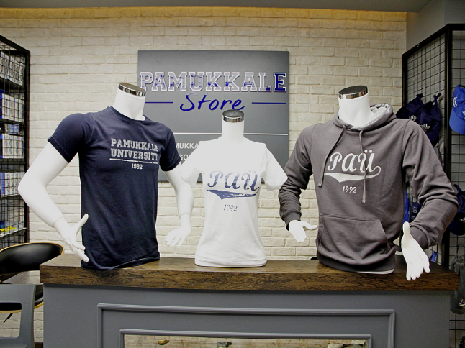

PAMUKKALE STORE
Pamukkale Stores stock Pamukkale University logo T-shirts, shorts, sweatshirts, tracksuits, towels, hats, bathrobes, shoes, and various sports equipment. The Pamukkale Store is located within the Şehit Ömer Halisdemir Sports Center, next to the PAU Cafe.

Slide 64

Dıgıtal prınt center (baskı merkezi)
Graphic design services, post-press operations with digital printing machines, and binding services are provided at the center, which has opened in the Kınıklı Central Campus.
You can have mass printing of products such as brochures, posters, magazines, books, business cards, and invitations.
Address: Pamukkale University Kınıklı Campus next to Education Faculty= Eğitim Fakültesi
Contact: 0 533 890 9809 / 0 258 296 2560
E-mail: paubaskimerkezi@gmail.com

Slide 65
Contactless Payment on Campus
HALKBANK KAMPÜSTE app
HALKBANK KAMPÜSTE Application: You can make all payments at locations such as dining halls, cafes, canteens, and social facilities on campus with the QR code in the mobile application.
The application also includes information about the PAÜ dining hall menus, real-time occupancy rates, reservation options, health, culture, sports, and art-related content, events, announcements, and instant on-campus notifications.
The process is automatically completed by downloading the Halkbank Kampüste application and approving the Contactless Payment text via the link on the Pusula Information System.
Link: https://pusula.pau.edu.tr/yemekOnay.aspx

Slide 66

PAU central dınıng halls
Service is provided in two halls, the green hall and the white hall, for students in the Pamukkale University Kınıklı Campus dining hall building.
If you have reserved your meal in advance via the Halkbank Kampüste application (by 22:00 the previous day), the price is 25 TL. If you do not have a reservation, you must pay 50 TL.

Slide 67



Pau central dınıng halls

Slide 68



Food & drınk alternatıves
MORFOLOJİ YEMEKHANESİ
HAVUZBAŞI KAFE & RESTAURANT
SOSYAL TESİSLER (KONUKEVİ RESTORAN)

Slide 69




Food & drınk alternatıves
PAÜ KAFE
AY KAFE
VİTAMİN KAFE
GÖL KAFE

Slide 70






Food & drınk alternatıves
YAKUT KAFE
TEKNO KAFE

Slide 71

Fınancıal Lıteracy
You are starting a period where you are in control of your finances, just as you are in control of many other things.
Based on the concept of financial literacy, we want to emphasize the importance of conscious credit card use and distinguishing between needs/wants in your spending.
You will need to manage your budget when making purchases you don't need.
Remember that you will have to pay for your spending, even if it's on a credit card, at the end of the month.
If you are going to make an installment purchase that exceeds your monthly budget, consider how paying installments for months will affect you before making a decision.

Slide 72

BOTANICAL GARDEN
The 'botanical garden', established on an area of 10,600 square meters, draws attention as it is the first and only in the region with 850 different plant varieties.
The goal of the garden, which is frequented by hundreds of visitors every day, is to increase diversity.
The indoor collections exhibited in a 140 square meter glass greenhouse are appreciated by those who see Hayrettin Karaca Oak Grove, medicinal and aromatic plant garden, coniferous plant collection, rock plants garden, palm island and endemic plant species growing in different climatic conditions.

Slide 73


Zero waste on campus
In the name of a greener campus and a sustainable environment, Pamukkale University has placed "Mobile Waste Collection Units" at two points on campus: one in front of the Central Dining Hall and the other in the polyclinic area of the university hospital.
Furthermore, it is planned to prevent bad odors and visual pollution with hydraulic underground waste containers with a capacity of 2,200 liters, which are resistant to wear and abrasion and have 100% leak-proof features, placed at 22 separate points.

Slide 74


Zero waste on campus
You will be taking classes in different classrooms every day. However, you must not forget that many other students use these classrooms.
When leaving the classroom, you should throw away your trash (tea cups, etc.) in the trash can and not leave it on the desk.
Similarly, you can use the nearest trash can in the corridors, study areas, canteens, restrooms, and garden areas.

Slide 75

Pedestrıan prıorıty on campus
According to the campus traffic regulations, vehicles are required to stop completely behind pedestrian crossings and give priority to pedestrians wishing to cross. No vehicle can drive onto the sidewalk or pedestrian path, even for a short time, for transport or loading/unloading purposes.

Slide 76
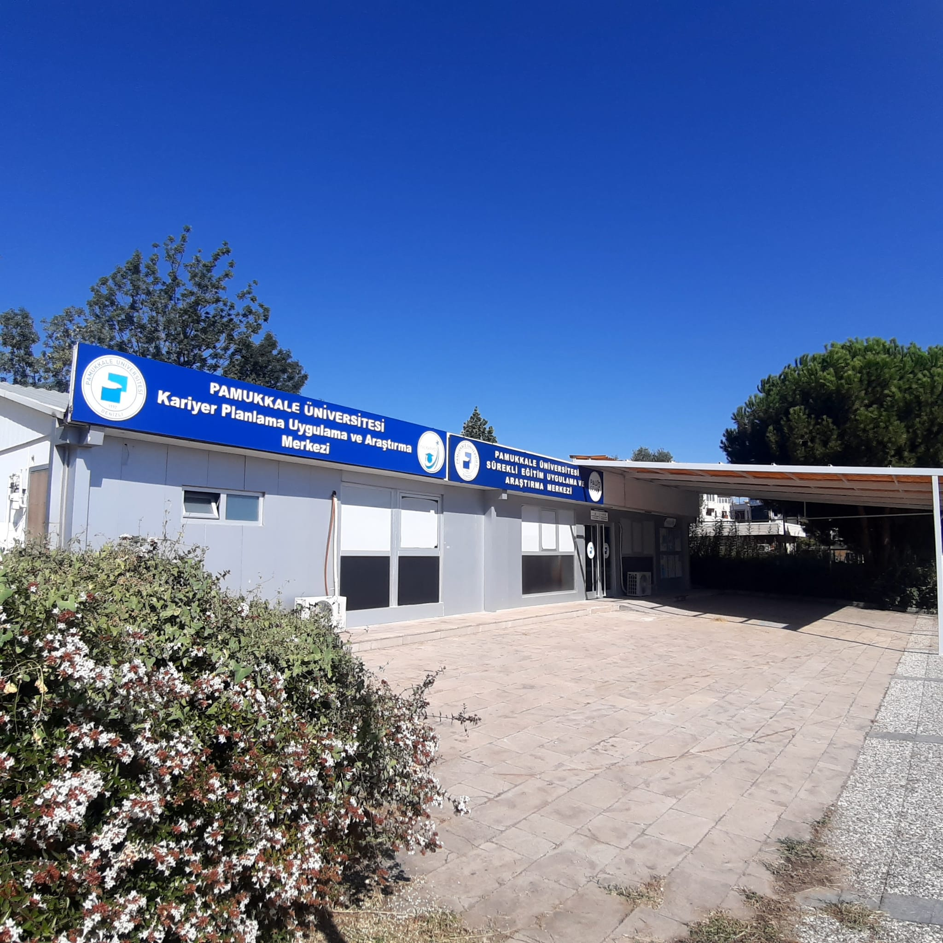
Career Planning Application and Research Center (KARMER):
Provides Career Support services within our university. You can receive Career Support service by making an appointment with KARMER after registering and applying through Yetenek Kapısı. KARMER's website also shares current career events and internship announcements.
For access: https://www.pau.edu.tr/kariyer

Slide 77


General Notıfıcatıon (Suggestıon) System
Genel Bildirim Sistemi
You can share your requests, satisfaction, suggestions, or complaints regarding your experiences at the university through General Notification System

Slide 78
RESIDENCE PERMIT
Online application at https://e-ikamet.goc.gov.tr/
Then you must bring the required documents to International Students Office
Required documents:
BELGELER:
(DOCUMENTS)
İkamet izni kayıt/başvuru formu (öğrenci tarafından ıslak imzalı şekilde)
(Residence permit registration/application form (wet-signed by the student)
Pasaport ya da pasaport yerine geçen belge (aslı görüldü şeklinde)
(Passport or passport substitute document (in the form of original seen))
Öğrencilik durumunu gösterir belge
(Document showing student status)
2 adet biometrik fotoğraf
(2 pieces of biometric photos)
Geçerli sağlık sigortası (GSS ya da ikamet izni talep süresini kapsayan özel sağlık sigortası)
(Valid health insurance (GSS or private health insurance covering the period of residence permit request))

Slide 79
RESIDENCE PERMIT
BELGELER:
(DOCUMENTS)
Kalacağı adres bilgilerini gösterir belge
(Document showing the address information where you will stay)
Kendi evinde kalıyorsa, tapu fotokopisi (uzatma başvurularında “yerleşim yeri belgesi ve fatura” yeterlidir)
(If you are staying in your own house, a copy of the title deed (for extension applications, “document showing the place of residence and a bill” is sufficient))
Kira sözleşmesi ile kalıyorsa, kira sözleşmesinin noter onaylı örneği
(If you are staying with a rental agreement, a notarized copy of the rental agreement)
Otel vb. konaklama yerlerinde kalınıyorsa, bu yerlerde kalındığına dair belge
(If you are staying in accommodations such as hotels, etc. proof of your stay in these places)
Öğrenci yurtlarında kalınıyorsa, yurtta kalındığına dair belge
(If you are staying in a student dormitory, document showing that you are staying in the dormitory)
Destekleyici yanında kalınıyorsa, yanında kaldığı kişinin noter onaylı taahhüdü (Destekleyici evli ise ayrıca eşinin de noter onaylı taahhüdü)
(If you are staying in a third person’s residence, the notarized undertaking of the host (if the host is married, also the notarized undertaking of the spouse))

Slide 80
RESIDENCE PERMIT
BELGELER:
(DOCUMENTS)
İkamet izni belge bedelinin ödendiğine dair makbuz
(Receipt showing that you have paid the residence permit document fee) (810 TL)
-Online payment is possible at https://dijital.gib.gov.tr/ Göç İdaresi İkamet Tezkeresi Harç Ödeme
18 yaşından küçük yabancılar için; vize muafiyetiyle ya da farklı amaca yönelik vizeyle gelenler için; veli/vasi bilgisini içeren belge (doğum belgesi, aile belgesi vb.) ve veli/vasi/yasal temsilcisi tarafından verilen muvafakatname (amacına uygun vizeyle ((öğrenim vizesi)) gelenler için; muvafakatname ve veli/vasi bilgisini içeren belge eklenmeyecektir.)
(For foreigners under 18 years of age; for those arriving with a visa exemption or with a visa for a different purpose; the document containing the information of the parent/guardian (birth certificate, family certificate, etc.) and the deed of consent given by the parent/guardian/legal representative (for those arriving with a visa suitable for the purpose ((education visa)); the deed of consent and the document containing the information of the parent/guardian will not be added).)
Ulusal elektronik tebligat sistemi adresi (sadece uzatma başvuruları için)
(National electronic notification system address (only for extension applications))-It can be obtained from PTT branches.

Slide 81

Diploma equivalency
First you must get residence permit in order to apply.
You must apply to Pamukkale District Directorate of National Education (Pamukkale İlçe Milli Eğitim Müdürlüğü) with your diploma (notary translated) and residence permit card.
You can also apply online at https://edenklik.meb.gov.tr/
You must submit it to International Students Office in one year.

Slide 82
General Health Insurance (GSS)
YTB students already have a GSS. They can download the document (müstehaklık belgesi) from e-devlet=e-state digital official procedures app. After you get your residence permit, you can get it from PTT.
If you are not a Türkiye Bursları scholarship holder, you must apply to SGK (Sosyal Güvenlik Kurumu) in Adliye within 3 months upon your registration with your student document and application form (which you can receive from there). In that way, you can have health insurance valid in almost all hospitals in Turkiye.

Slide 83
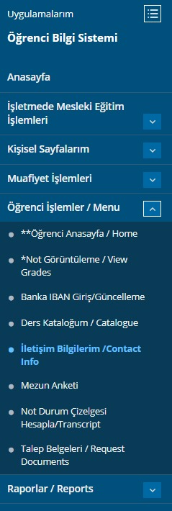
Address and Contact Info Change
You must inform Immigration Office and YTB and also our Office within 20 business days if there is such a change. Otherwise, you may have to pay a fine.
You must also update it in pusula information system as shown in the Picture.
Check your e-mails in pusula if there is any notification from Immigration Office.

Slide 84
We wish you a Successful and Healthy Academic Year!
For announcements: www.pau.edu.tr/yurtdisi
www.pau.edu.tr/padam
For detailed information about the Orientation Program: www.pau.edu.tr/pdrem
For your questions:
foreignstudent@pau.edu.tr
Oryantasyon programı
ile ilgili Ayrıntılı bilgi için
www.pau.edu.tr/pdrem

