Slide 1


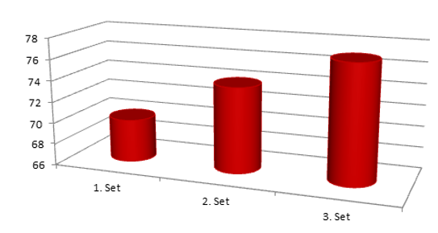
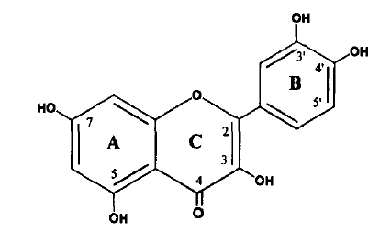
T.C.
PAMUKKALE ÜNİVERSİTESİ
MÜHENDİSLİK FAKÜLTESİ
KİMYA MÜHENDİSLİĞİ BÖLÜMÜ
BİTİRME TEZİ PROJESİ
POLİMER İÇERİKLİ MEMBRANLAR KULLANILARAK QUERCETIN TAŞINIMIN İNCELENMESİ
(TEZ KONUSU BAŞLIĞI)
Alime ŞENOCAK (Öğrenci Adı-Soyadı)
Danışman: Prof. Dr Necip ATAR(Öğretim üyesinin Unvanı- Adı-Soyadı)
POLİMER İÇERİKLİ MEMBRANLAR
QUERCETIN
PIMs are usually composed of an extractant (carrier), a base polymer (commonly poly(vinyl chloride) (PVC) or cellulose triacetate (CTA)) and a plasticizer or modifier. The carrier is essentially a complexing agent or an ion-exchanger, responsible for binding with the species of interest and transporting it across the PIM. This process relies on the concentration gradient of the species/carrier complex or ion-pair formed within the membrane, which acts as the driving force enabling transport across the membrane.
Quercetin is found in various food products and plants, including fruits, seeds, vegetables, tea, turnip, grape molasses, bracken fern, and natural dyes. In vitro experiments show that quercetin may be effective in treatment of various types of cancer and it may be combined with other anticancer drugs to reduce their doses and subsequently their side effects
Şekil 1: Quercetinin Kimyasal Yapısı
Şekil 2: Her deney için QR Taşınım Yüzdesi
Çizelge 1: Quercetin Taşınım Deneyleri için Donör ve Akseptör faz Derişim Değerleri
KAYNAKLAR
McCabe, W., L., Smith, J.,C., Harriott, P., Unit Operations of Chemical Engineering, New York: McGraw Hill, (1985).
Mulder, M., Basic principles of membrane technology, Netherlands : Kluwer, (1996).
Munro, T.,A., Smith, B., D., “Faciliated transport of aminoacid by fixed -site jumping” , Chem. Commun., 22, 2167-2168, (1997).
Nghiem, L. D., Mornane, P., Potter, I. D., Perera, J. M., Cattrall, R. W. and Kolev, S. D.,“Extraction and transport of metal ions and small organic compounds using polymer inclusion membranes (PIMs)”, J. Membr. Sci.,281, 7-41, (2006).
Noble, R.D., Stem, S.A., Eds. Membrane Separation Technology. Elsevier: New York, NY, (1995).

