Slide 1
The Computational Model
Notes:
In this chapter we investigate how to model application software, namely the distributed algorithm.
The middleware and the network that delivers the messages between the nodes of the distributed system.

Slide 2
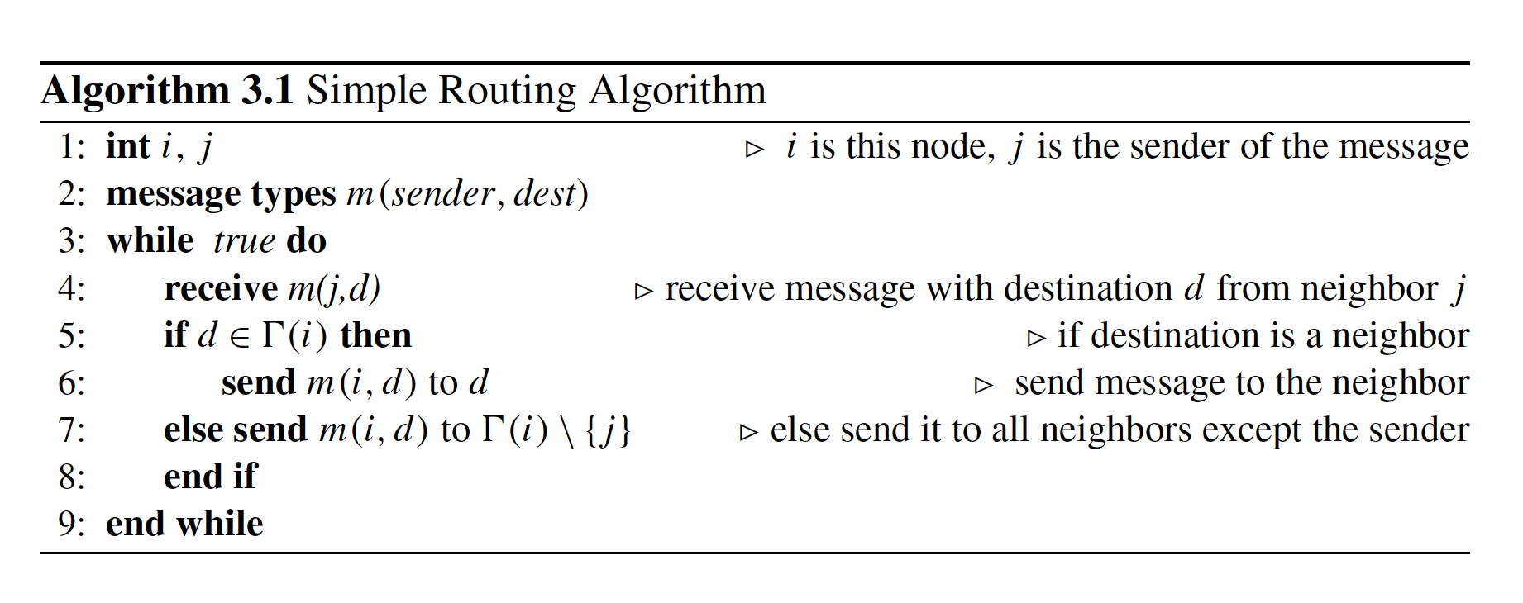
Notes:
The computational model depends on the network model and the software environment that the distributed algorithm executes. As noted before, graphs are frequently
used to model distributed systems. The vertex set V of a graph G represents the nodes of the network, and the edges show the communication links as shown in.
As an introductory example, let us attempt to design a simple routing algorithm for this network. In this network,
node s wants to send a message m(d) to node d . Nodes only know their neighbors, therefore, node i receiving m(d) simply forwards this message to all of its neighbors,
except the one it has received from, if the intended receiver d included in the header is not one of its neighbors.
If the network is connected, the message m(d) will eventually reach the destination node d in at most diam time steps, where diam is the diameter of the network

Slide 3
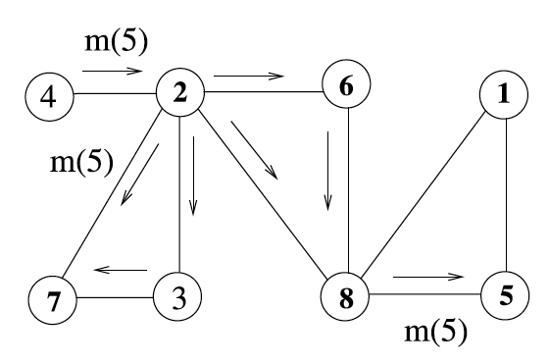
Simple Routing Operation
Notes:
This algorithm has a major problem where a node may receive and then send the same message more than once, and the network may be flooded with duplicate
messages.
In order to remedy this situation, we could incorporate sequence numbers with the messages; m(i, j, seq ).
A simple example has shown us that the contents of a message and where they are sent are crucial in the design of distributed algorithms.

Slide 4
Message Passing
Messages are crucial for the correct operation of a distributed algorithm.
  A process p_{i} at node i communicates with other processes by exchanging messages only.
  Each process pi has a state s_{i} ∈ S , where S is the set of all its possible states.
  A configuration of a system consists of a vector of states as C = [s₁, . . . , s_{n}] .
  The configuration of a system may be changed by either a message delivery event or a computation event .
Notes:
Messages are crucial for the correct operation of a distributed algorithm. We can define the widely accepted message passing model of a distributed system formally
as follows [1 , 3 , 4 ]:

Slide 5
Message Passing
Messages are crucial for the correct operation of a distributed algorithm.
  A configuration of a system consists of a vector of states as C = [s₁, . . . , s_{n}] .
  Distributed system continuously goes through executions as C0,φ1,C1,φ2, . . .
  where φi is either a computation or a message delivery event.
Notes:
Messages are crucial for the correct operation of a distributed algorithm. We can define the widely accepted message passing model of a distributed system formally
as follows [1 , 3 , 4 ]:

Slide 6
Message Passing Cont’
A typical distributed algorithm code segment involves receiving a message and, based on the type of this message, performs a specific action as shown in Algorithm 3.2 .
Typically, the distributed algorithm runs until some condition is met, for example, a specific message is received, or a boolean variable becomes true.

Slide 7
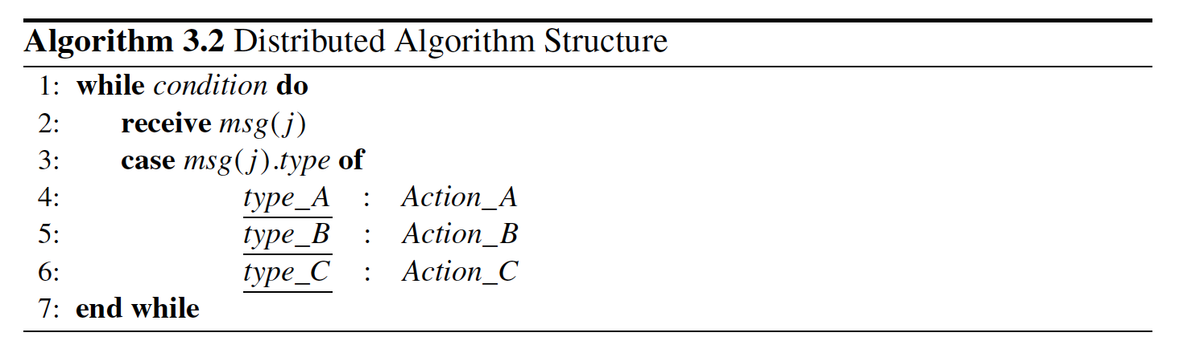

Slide 8
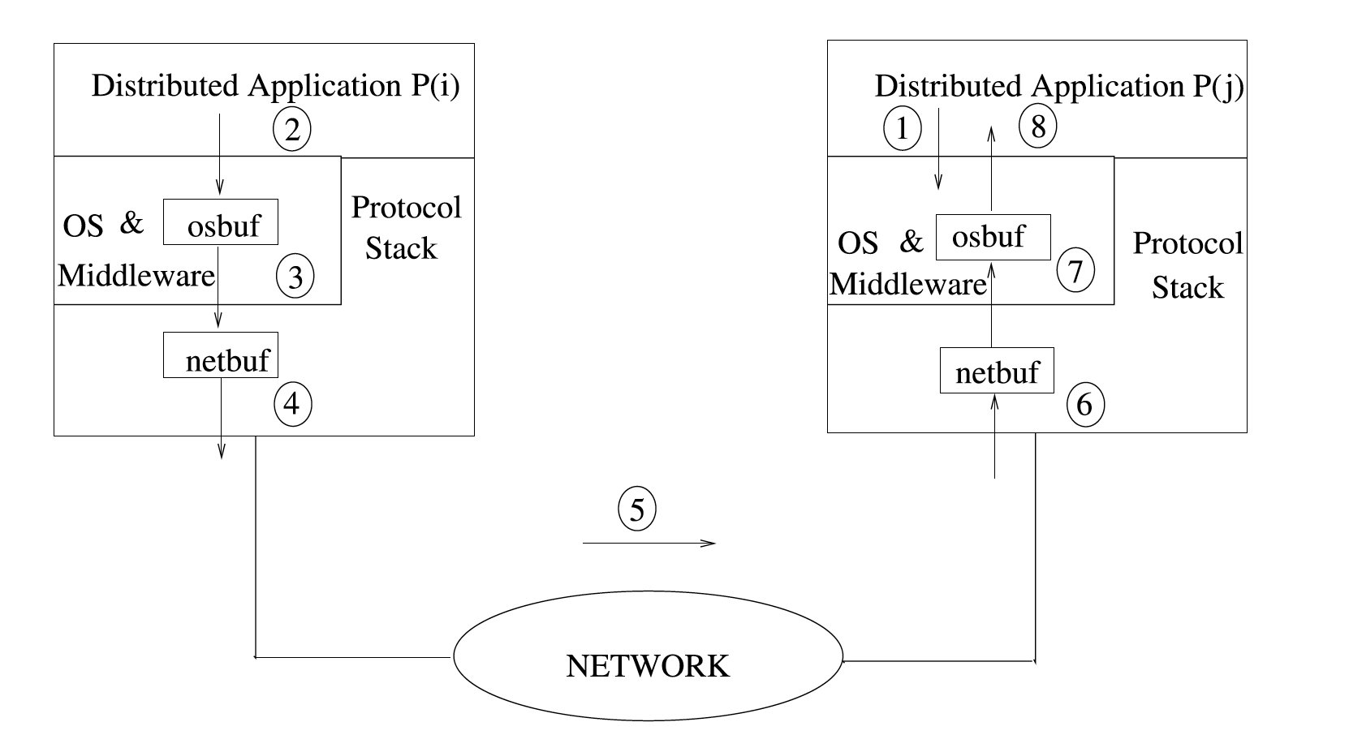

Slide 9
Message Passing Cont’
The following steps are typically performed when the message msg(j, type) is delivered from a distributed application process (algorithm) P(i) at source node i to a distributed application process P(j) at destination node j as shown in Fig. 3.2 .
1. Receiving process P(j) executes receive(msg) and is blocked by its local operating system at node j since there are no any messages.
2. Sending process P(i) prepares the message by filling data , destination process , node identifiers , and type fields and invokes operating system primitive send(msg, j) , which copies msg to the operating system buffer osbuf .

Slide 10
Message Passing Cont’
3. The operating system copies osbuf to the network buffer netbuf and invokes the communication network protocol.
4. The protocol appends error checking and other control fields to the message and provides the delivery of the message to the destination node network protocol by writing contents of netbuf to the network link.
5. The network delivers the data packet, possibly by exchanging few messages and receiving acknowledgements.

Slide 11
Message Passing Cont’
6. The receiving network protocol at node j writes the network data to its buffer netbuf and signals this event to the operating system.
7. The receiving node’s operating system copies data from netbuf to osbuf and unblocks the receiving process P(j) , which was blocked waiting for the message.
8. P(j) is awaken and proceeds its processing with the received data.
Notes:
If we consider messages m1 , m2 , m3 that are sent in sequence from i to j , there are two possibilities of delivery by the network, either delivering the messages in sequence
to the node j , in which case the network delivery is called First-In-First-Out (FIFO ), or the network delivers messages in random order and is called Non-First-
In-First-Out (Non-FIFO ).
We will assume a FIFO network structure in general. The above data transfer involved buffered communication by using buffers between the
application, operating system, and the network protocol. It is also possible to have unbuffered communication , where the message is written directly to the network and received directly from network to be written to the receiving application workspace; however, buffered communication in the receiving side is the only choice mostly as the receiving process may not have executed receive when the message arrives.

Slide 12
Finite-State Machines
A finite-state machine (FSM) or finite-state automaton is a mathematical model to design systems whose output depends on the history of their inputs and their current states, in contrast to functional systems where the output is determined by the current input only.
It can only be at one state at any time called its current state .
Upon a triggering by an event or a condition, an FSM may change its current state.
Notes:
States of an FSM are shown by circles, and the transitions from one state to another by directed edges. In this sense, an FSM is a
directed graph.
The edges of this graph are labeled as i/o , where i is the input in the form of an event or a condition, and o is the action performed by the FSM

Slide 13
Finite-State Machines
A deterministic FSM is a quintuple (I,S,S₀, δ,O ) where
• I is a set of input signals
• S is a finite nonempty set of states
• S0 ∈ S is the initial start state
• δ is the state transition function such that δ : S X I →O
• O ∈ S is the set of output states
Notes:
States of an FSM are shown by circles, and the transitions from one state to another by directed edges. In this sense, an FSM is a
directed graph.
The edges of this graph are labeled as i/o , where i is the input in the form of an event or a condition, and o is the action performed by the FSM

Slide 15
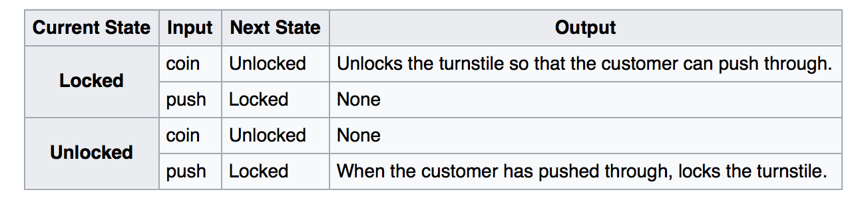
Turnstile State Table

Slide 16
Finite-State Machines
Moore Machine
Mealy Machine

Slide 17
Finite-State Machines
Moore Machine
  As an example of Moore Machine, let us design an FSM that inputs a binary stringof the form 001101010. . . and at any point, determines its state based on the number of 1s received up to that point as ODD if this number is an odd number and EVEN otherwise.

Slide 18
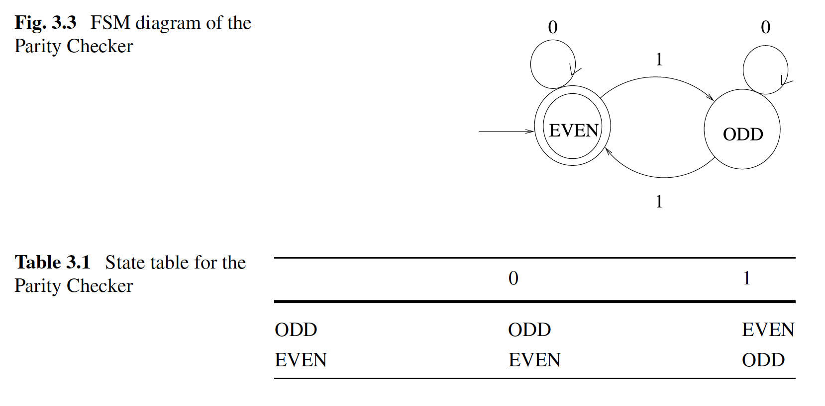

Slide 19
Finite-State Machines
Mealy Machine : ex. Data Link Protocol Design :Stop and Wait Automatic Repeat Request ( ARQ).
Notes:
In the Stop andWait ARQ protocol, the sender has to wait for an acknowledgment from the receiver before sending the next frame. There will be a single frame in transmission at a time, and to prevent the case where an acknowledgement from the receiver gets lost and the sender sends a duplicate packet that is received as a new frame by the receiver, odd and even sequence numbers are used.

Slide 20
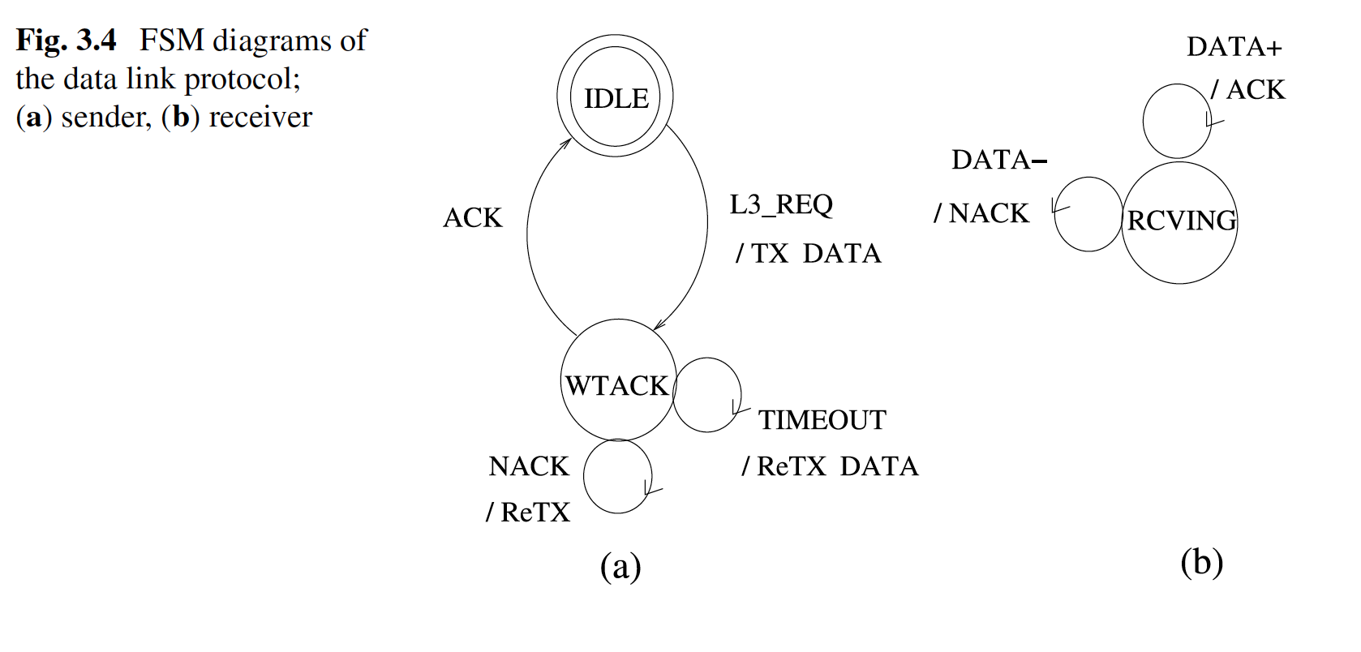
Finite-State Machines
Mealy Machine : ex. Data Link Protocol Design :Stop and Wait Automatic Repeat Request ( ARQ).

Slide 21
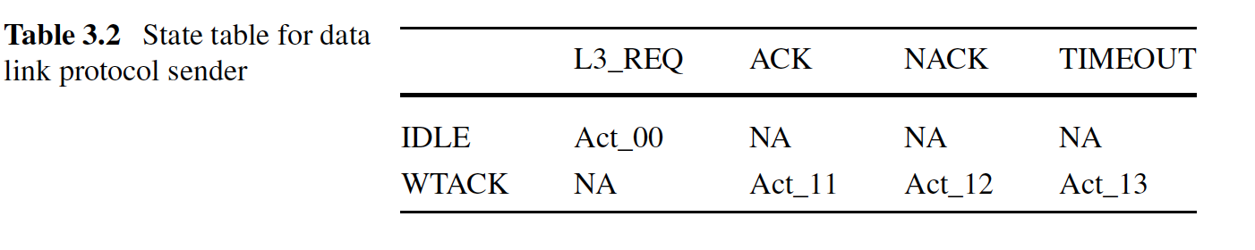
Finite-State Machines
Mealy Machine : ex. Data Link Protocol Design :Stop and Wait Automatic Repeat Request ( ARQ).

Slide 22
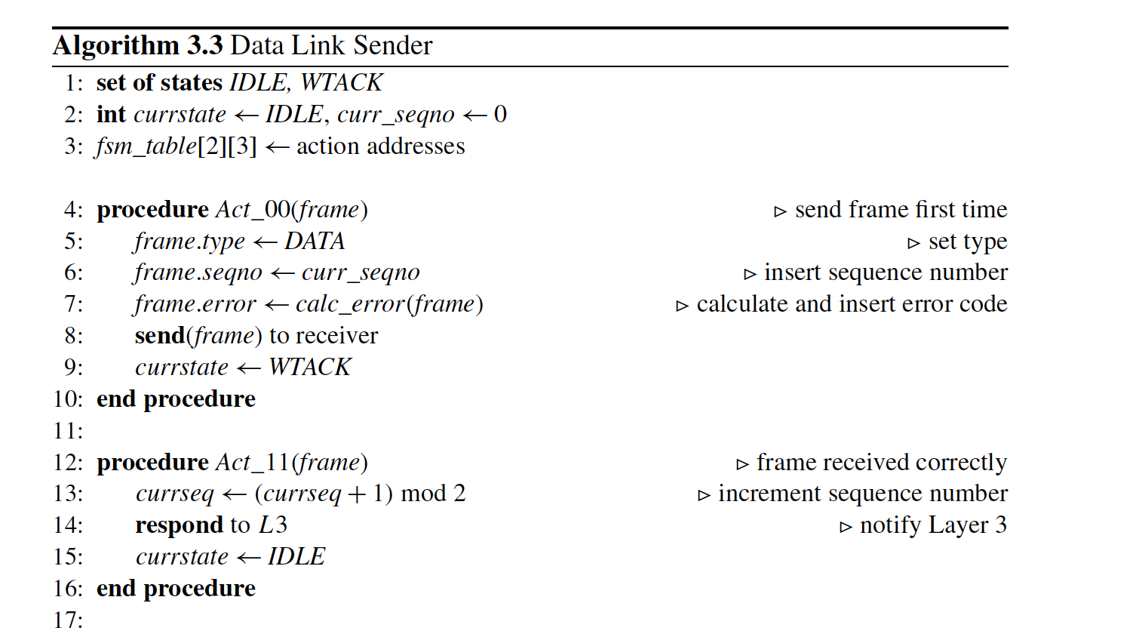

Slide 23
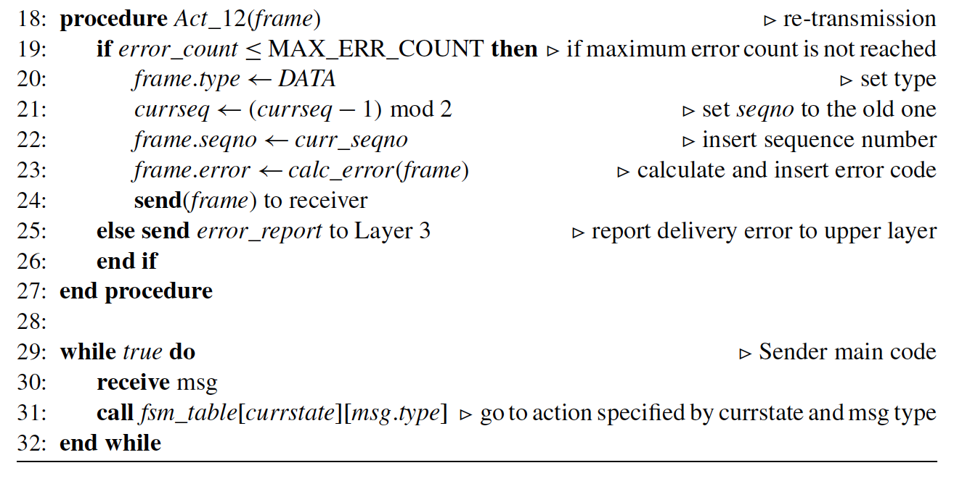

Slide 24
Synchronization
Hardware level
  Lock
    SIMD
Network Level
    MIMD
Network Itself
There are also possibilities of synchronization at operating system level, middleware level, or the distributed application level.

Slide 25
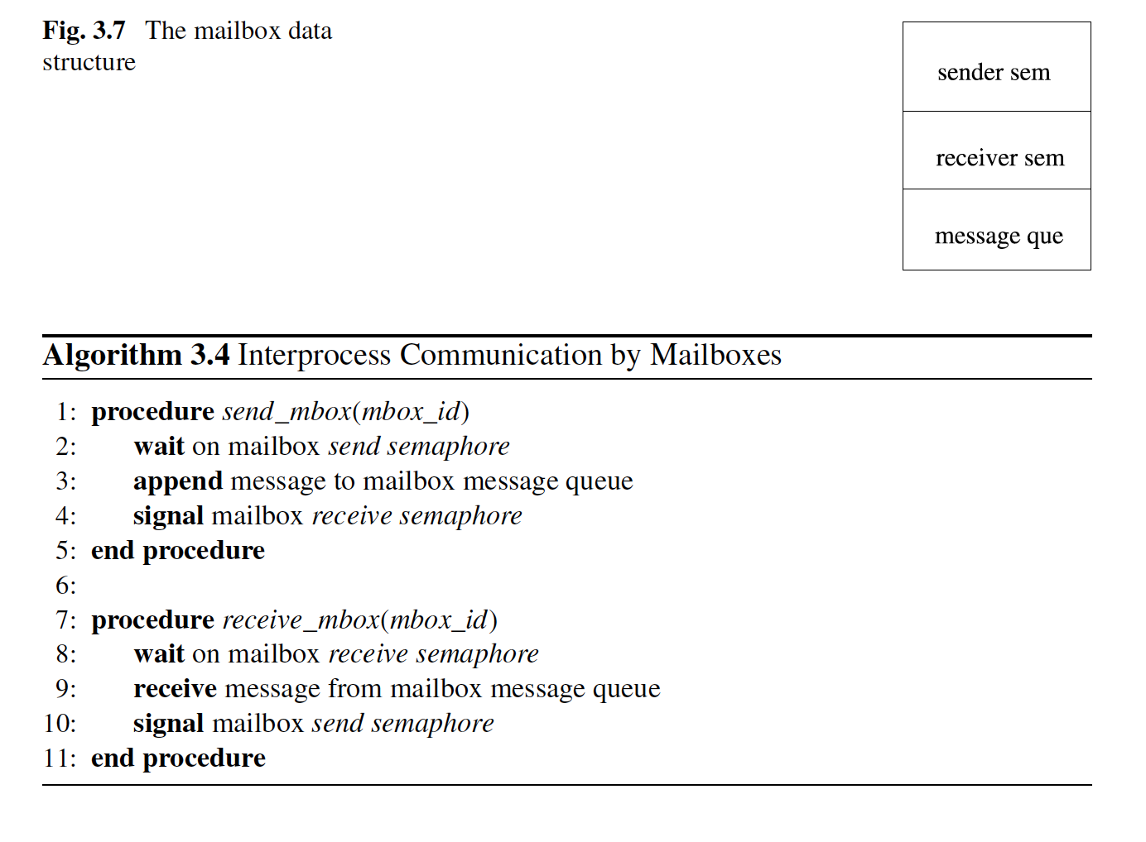

Slide 26
Communication Primitives
Synchrony at operating system level is accomplished by carefully designing the communication primitives so that the sender and the receiver may be blocked or not by the operating system to yield the required behavior.
  blocking send: The sending process is blocked by the operating system until an acknowledgement from the destination is received to confirm that the receiver has received the message, in which case the sender is unblocked.
  Non-blocking send: The sending process continues processing after sending the message.

Slide 27
Communication Primitives
blocking receive: The receiving process is blocked by the operating system if there are no messages available to it.
non-blocking receive: The receiving process checks if it has any pending messages, and if there is a message, receives it. In any case, it continues processing.

Slide 28
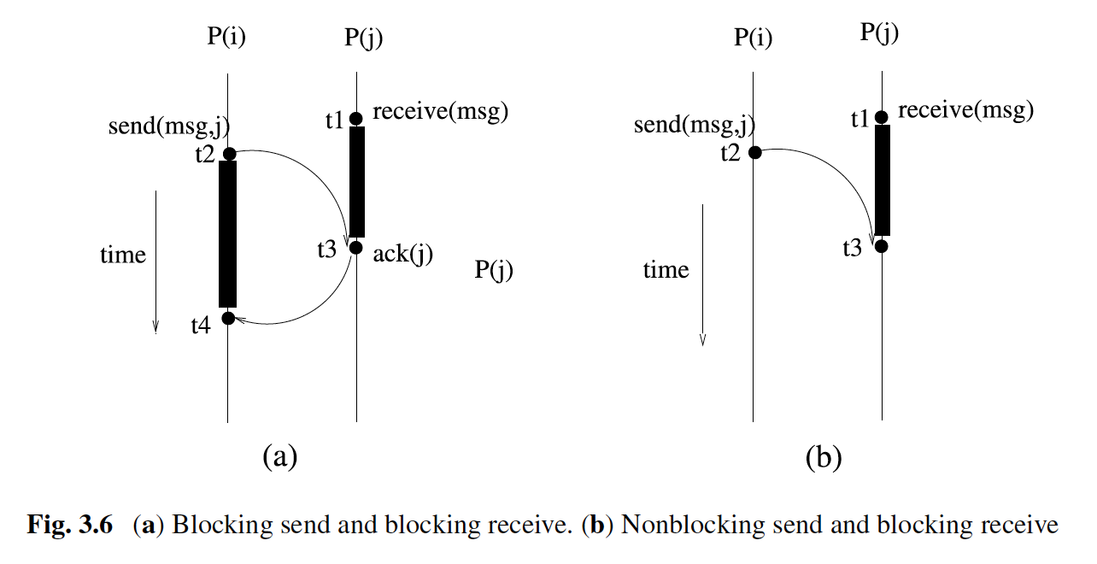
Blocking – Non blocking

Slide 29
Application Level Synchronization
We will look into the synchronization among all processes at the application layer, and we will call this synchronization the global synchronization, which does not have any support from the operating system or the hardware.
In some applications, support from hardware or a special middleware module called synchronizer , which provides synchrony among the processes, may be a better choice than a synchronizing protocol as in the case of concurrently initiated synchronous algorithms.
Notes:
Typically, a distributed algorithm sends a message, receives a message, and performs some computation in each round. The next round can only be started after all
messages from the previous round are delivered and all computations have been concluded. This seemingly strict control on the execution of processes usually requires
the control of a central process, which starts a round, and after ensuring that the round is over, it starts the next round. We will see that this control can be achieved
by a special message called round by a special node called the root that initiates a round, and after gathering special messages in an accumulated manner from all
nodes, the root starts the next round.

Slide 30
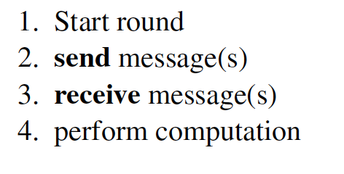
Application Level Synchronization
May be achieved with network messages

Slide 31
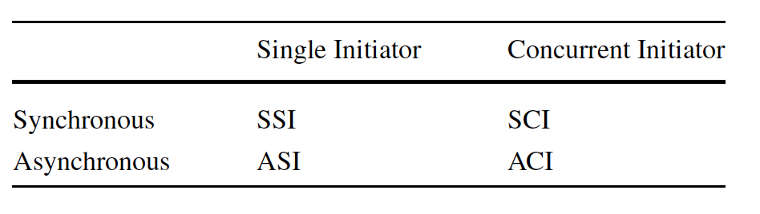
Classification of distributed algorithms

Slide 32
Performance Metrics
Time
Bit
Space
Message

Slide 33
Performance Metrics
Time
  Time(Seq _Alg)
  Time(Synch _Dist)
  Time(Asynch _Dist)
For example, sending a message in a network modeled by a graph G(V,E) may require (n − 1) steps for it to reach the farthest node.

Slide 34
Performance Metrics
Bit
  For a distributed algorithm, we will mostly be interested in the maximum length of a message communicated.
  In general, this will not be a problem unless the message is large or is enlarged as it traverses the network.

Slide 35
Performance Metrics
Space Complexity
  Space complexity of an algorithm specifies the maximum storage in bits required by the algorithm for local storage at a node.
  This may be important if a node holds large tables as in the case of routing algorithms.

Slide 36
Performance Metrics
Message Complexity
  Number of messages exchanged is a good indicator of the cost of communication for the distributed application.
  The cost incurred during the message communication of a distributed algorithm is often considered as the dominant cost of the algorithm since time spent in message transmissions is orders of magnitude higher than the time spent for local computations.
Notes:
A convenient method of evaluating communication
costs is to calculate the number of messages that traverse the edges of the
network graph.

Slide 37
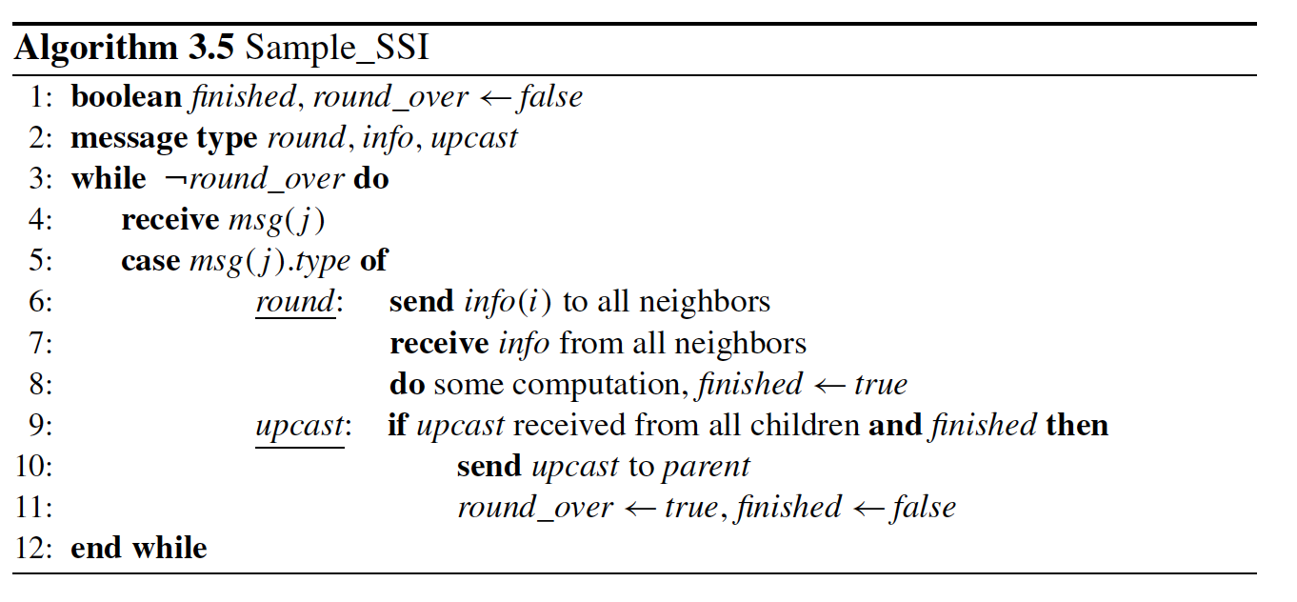

Slide 38
Analyses of Algorithm 3.5
Each round requires 2(m-n-1) messages;
Number of rounds depend on the diameter d. So in total 2d(m-n-1) messages
T may have n − 1 as its maximum depth.
2n(n − 1) time steps for n − 1 rounds
Notes:
There will be n − 1 time steps in each round to deliver round messages to all nodes; each node will require
two time units to send info message to neighbors and receive info message from the neighbors; and there will be further n − 1 steps for the accumulation of upcast
messages for a total of 2n steps in each round resulting in a total number of at most 2n(n − 1) time steps for n − 1 rounds.
However, the total number of rounds is a good indicator and sufficient for the time complexity of an SSI algorithm in general,
in which case Time(Sample _SSI) = O(d) for the sample algorithm.

