Slide 1
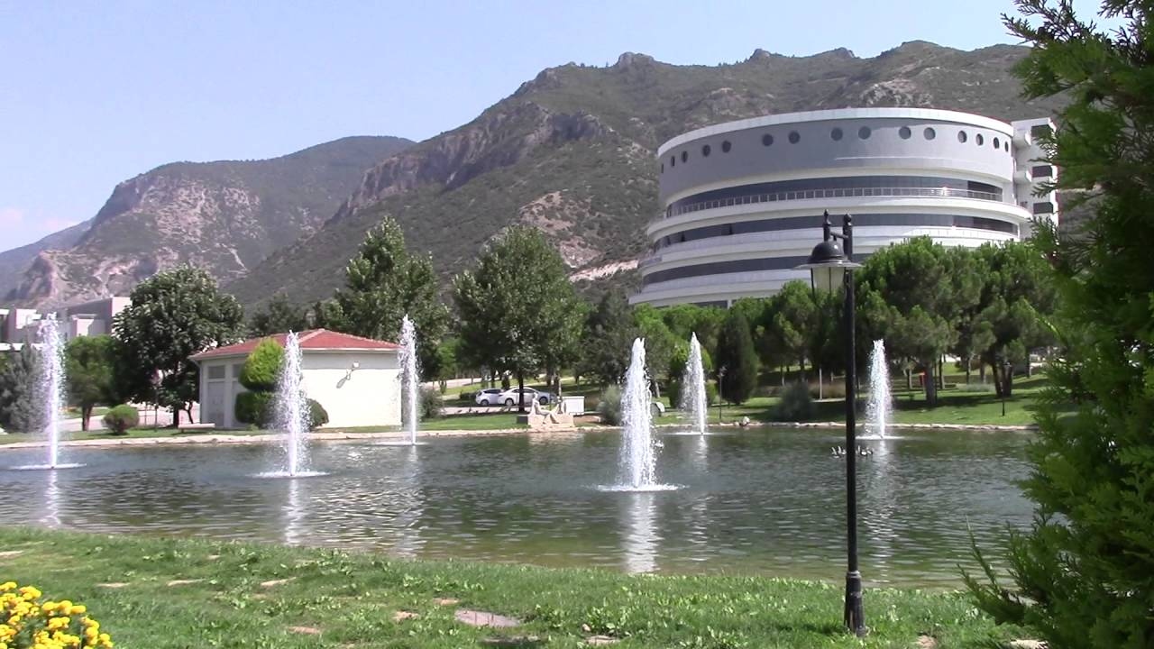

PAMUKKALE UNIVERSITY FACULTY OF ARTS AND SCIENCES
PHYSICS DEPARTMENT
Pamukkale – Denizli
http://pau.edu.tr/fizik/en
@PauFizik

Slide 2
History
1992 Department of Physics was founded.
1994 Undergraduate Program of Physics.
1994 The Graduate (M.Sc) Program of Physics.
1995 The Secondary Education Undergraduate program of Physics.
2008 PhD Program in Physics has started.

Slide 3
SubdIvIsIons of PhysIcs Dept.
Atomic and Molecular Physics
Solid State Physics
Nuclear Physics
General Physics
Mathematical Physics
High Energy and Plasma Physics

Slide 4
MIssIon and VIsIon
To give physics education and research at international level in the light of science and universal values.
To create a thematic department in the field of applied physics where graduates can easily find jobs.

Slide 5
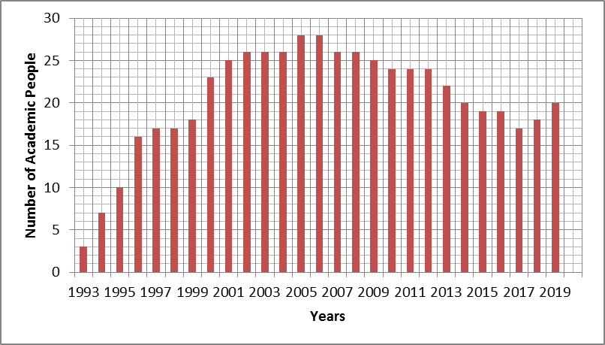
AcademIc Staff
Numbers of Positions:
Prof.Dr. : 6
Assoc. Prof.Dr. : 2
Assist. Prof.Dr: 4
Dr. Instructor : 1
Instructor: 2
Dr. Research Assist.: 1
Specialist: 2
Research Assist. : 3
TOTAL: 21
There would have been a total of 34 people if no one had never left.

Slide 6
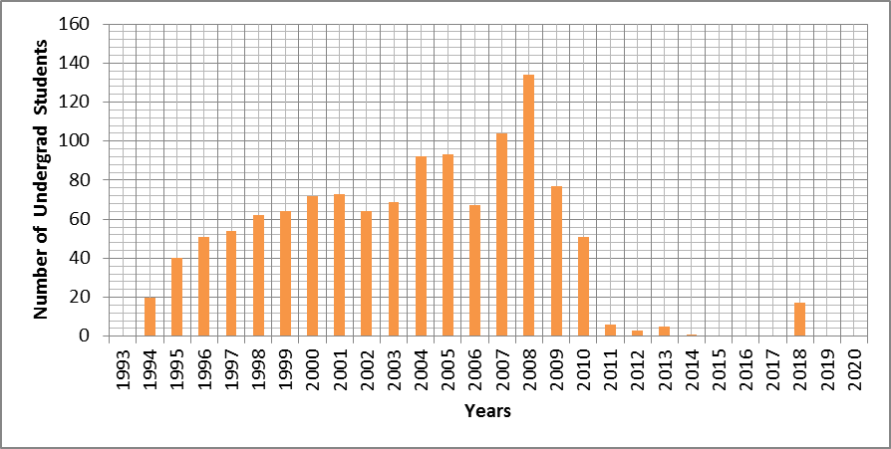
Number of Students (Undergraduate)
1994 (undergraduate) started
Secondary Educ. started in 1995
2010 SE section is closed
2014 Day time Undergraduate is closed
As of February 2019 there are 20 active students (60 students in total).
BUT, SERVICE COURSES!
EngF+TechF+FEF+Physics (Grad and Undergrad) = 3.305 different students
Number of Students / Number of Lecturer= 3.305 / 16 = 207 students / lecturer
As of March 2019

Slide 7
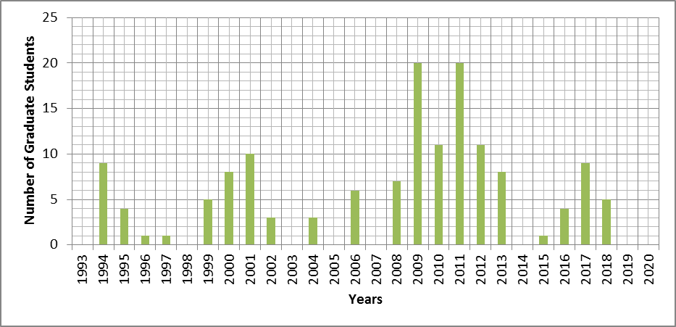
Number of Students (Grad)
1994 M.Sc started
2008 PhD started
As of March 2019 27 graduate students.

Slide 8
Weekly Course Loads
Lesson hours includes only in classroom courses!
NE: 186 + SE: 62 = 248 hrs/week (UG+Grad)
Course hrs/week/Nbr. of Lecturer
NE 186/16 = 12 hrs/(week per lecturer)
SE 62/13 = 5 (hrs/week per lecturer)
!!! Lab (Physics+ EngF + TechF) : 74 hrs/week (NE+SE) [2 RA+2 Specialist] !!!
[10 hours Lab load/week per RA/Specialist]

Slide 9
Student LaboratorIes
General Physics Lab. I
General Physics Lab II
Electrical Lab.
Optical Lab.
Magnetism Lab.
Electronic Lab.
Atomic and Nuclear Phys. Lab

Slide 10
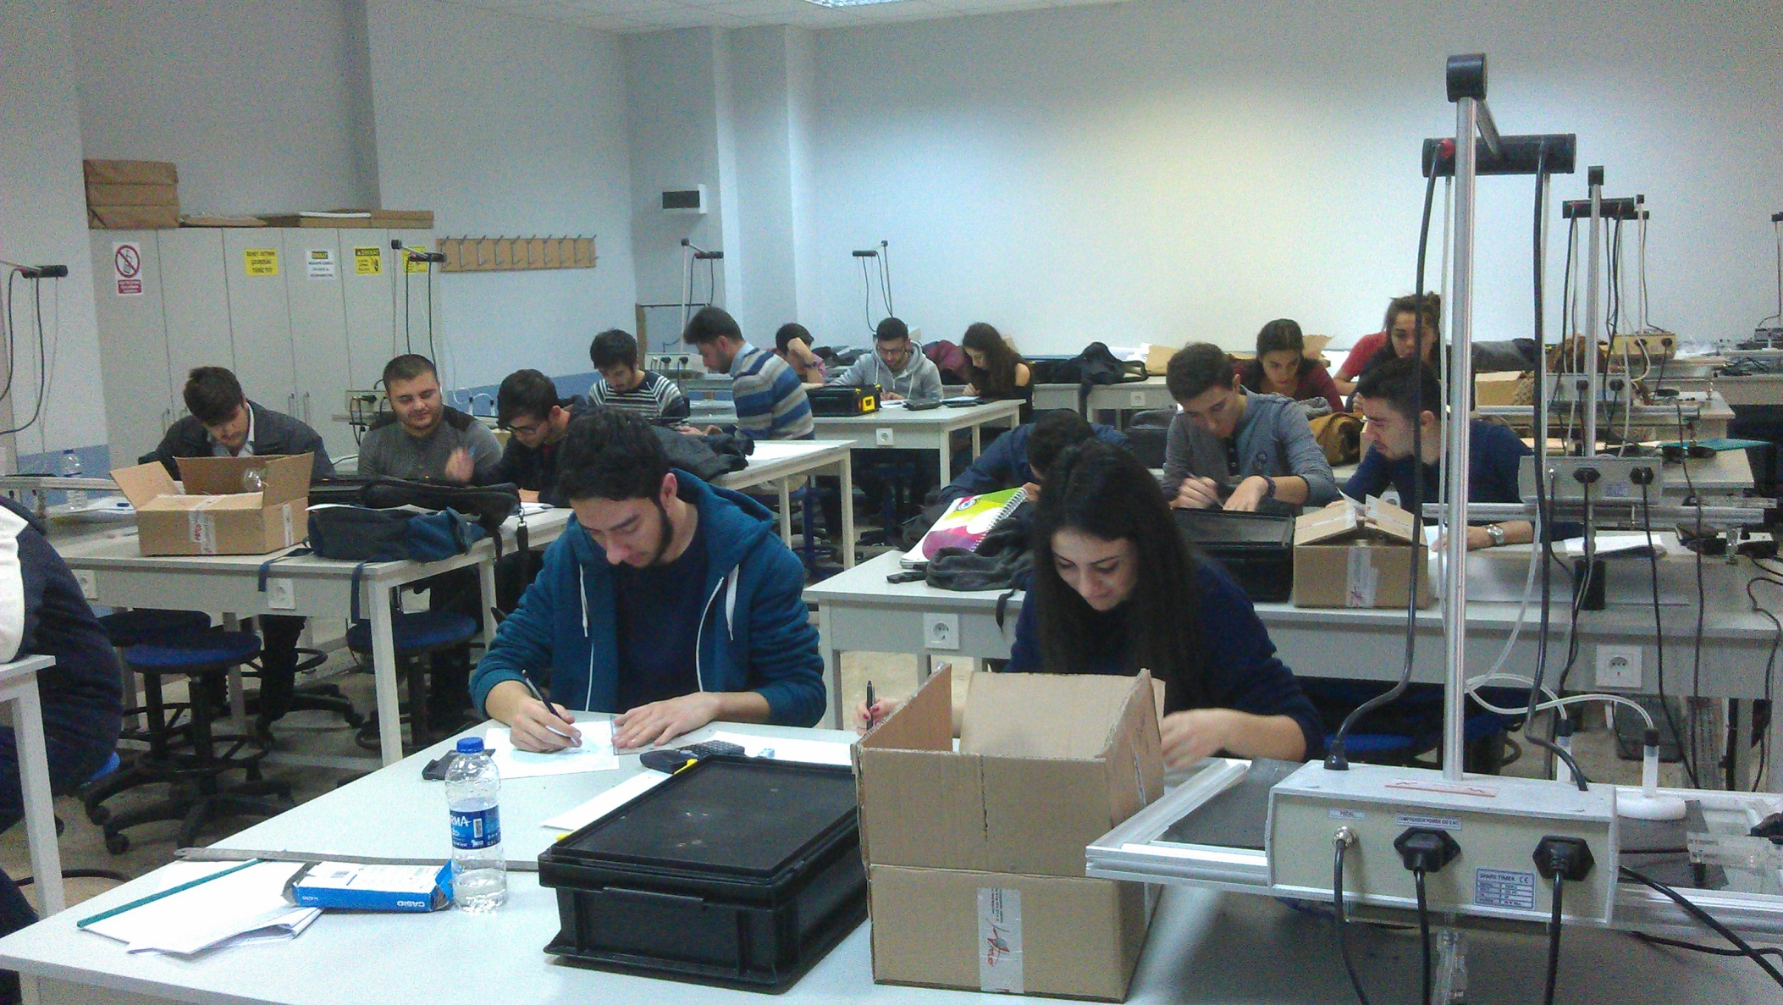
General PhysIcs-I Lab
All first year students of the Faculty of Engineering and the Faculty of Technology perform basic mechanical experiments.

Slide 11
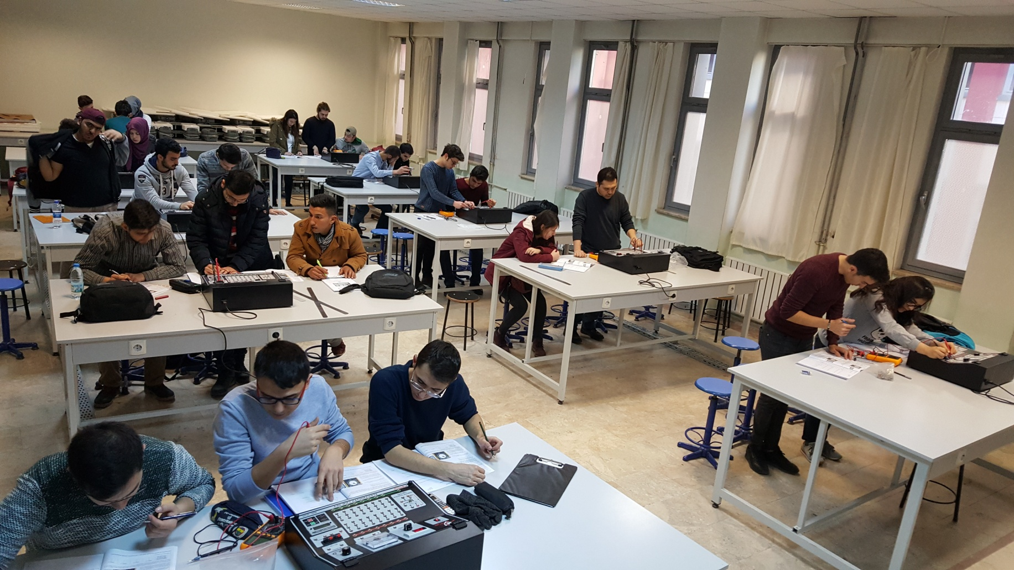
General PhysIcs-II Lab
All the first year students of the Faculty of Engineering and the Faculty of Technology perform electricity and magnetism experiments.

Slide 12
Research TopIcs
Investigation of electrical and magnetic properties of superconductors.
Spinor, dilaton and gravitation models in non-Riemannian space-time.
Investigation of thermodynamic and conduction properties of metals and alloys, semiconductor materials and nanostructures by molecular dynamics and ab initio method.
Age determination by optical stimulated luminescence method.
Crystal growth, electrical and optical properties.
Thermal evaporation of thin films, determination of electrical and optical properties.
Determination of radicals and radiation damage centers of gamma irradiation by electron paramagnetic resonance (EPR) spectroscopy.
Determination of structural, electrical and optical properties of nano materials, biological and chemical molecules and chemical reaction mechanisms. Theoretical validation of new substance synthesis. Physical and chemical mechanisms of biological molecules.

Slide 13
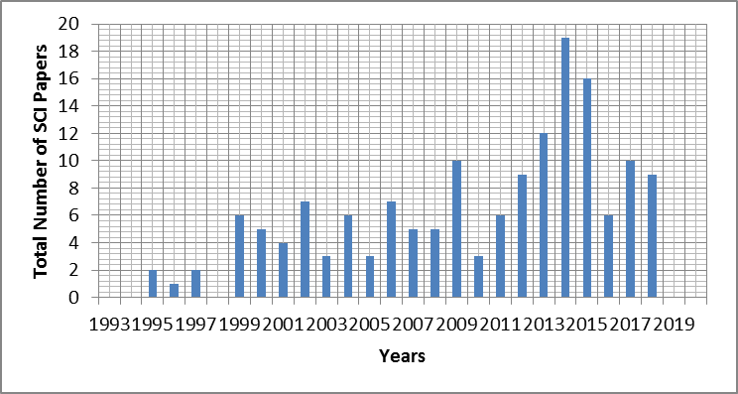
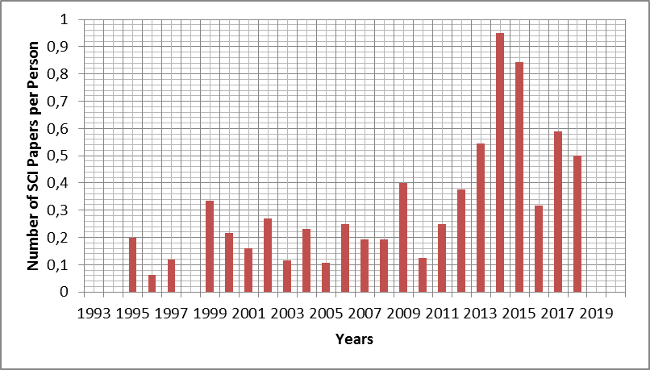
Number of PublIshed ArtIcles

Slide 14
Research LaboratorIes
Computational Physics Laboratory
Materials Physics Simulation Laboratory
Single Crystal Sample Preparation Laboratory
Semiconductor Growth and Characterization Laboratory
Luminescence (OSL) Laboratory
Superconductivity and Conductivity Measurement Laboratory

Slide 15
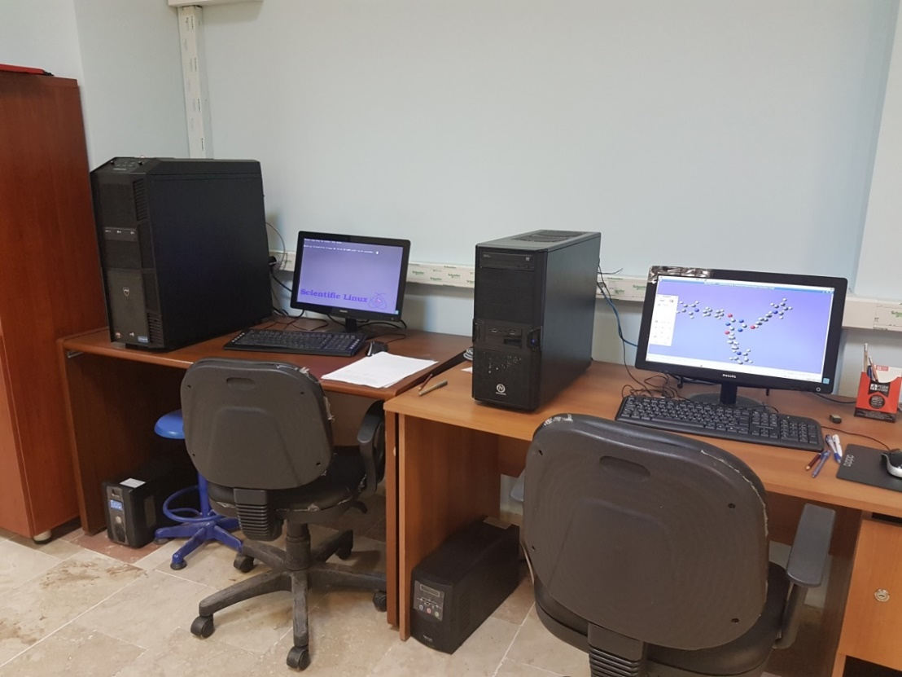
Computational Physics Laboratory
Simulation of Nano materials; the structural, electrical, optical properties and chemical reaction mechanisms of biological and chemical molecules.

Slide 16
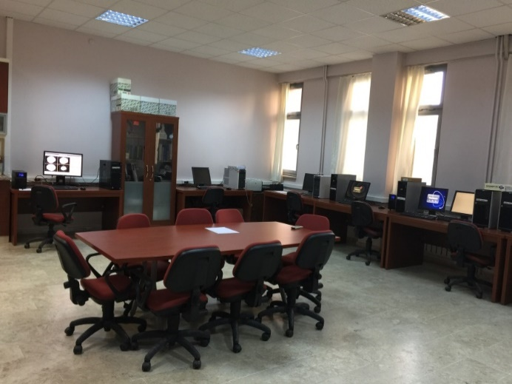
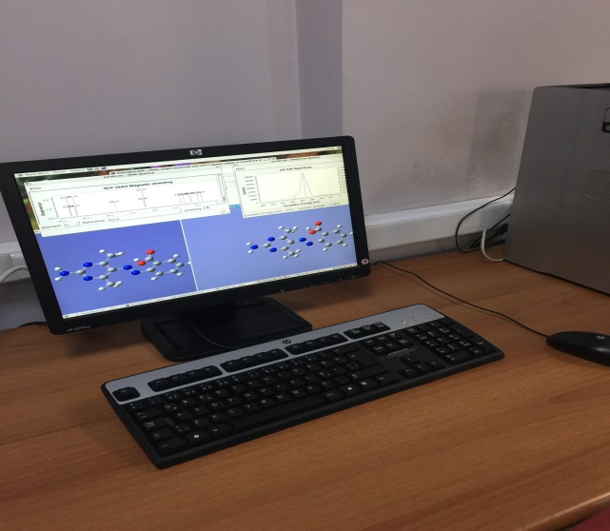
Materials PhysIcs SImulatIon Laboratory
Solid, liquid and glassy structures, thermodynamic and conduction properties of metal and metal alloys, nanoparticles and Core -Shell nano particles by Molecular Dynamic Method.
Analysis of structural, electronic, optical and magnetic properties of semiconductor and shape memory materials by Density Functional Theory Method,
Analysis of chemical and biological molecules by computational quantum chemical methods.
Investigation of stress-corrosion mechanism in metal and metal alloys with Density Functional Theory
.

Slide 17
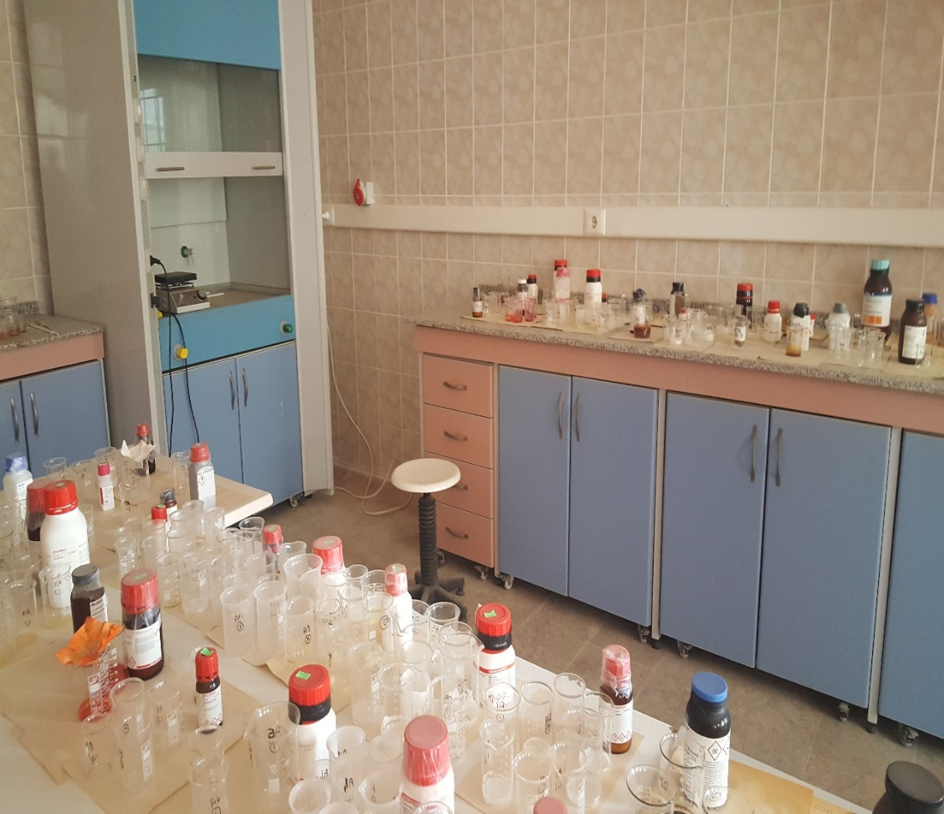
Single Crystal Sample PreparatIon Laboratory
Single crystal organic and inorganic samples are obtained by using various solvents. The resulting samples are irradiated by gamma irradiation source located at Turkish Atomic Energy Agency (TAEK) SANAEM. Thus, the analysis of the radiation damage centers of the paramagnetic samples by radiolysis is also carried out in the EPR Laboratory located in the same center.

Slide 18
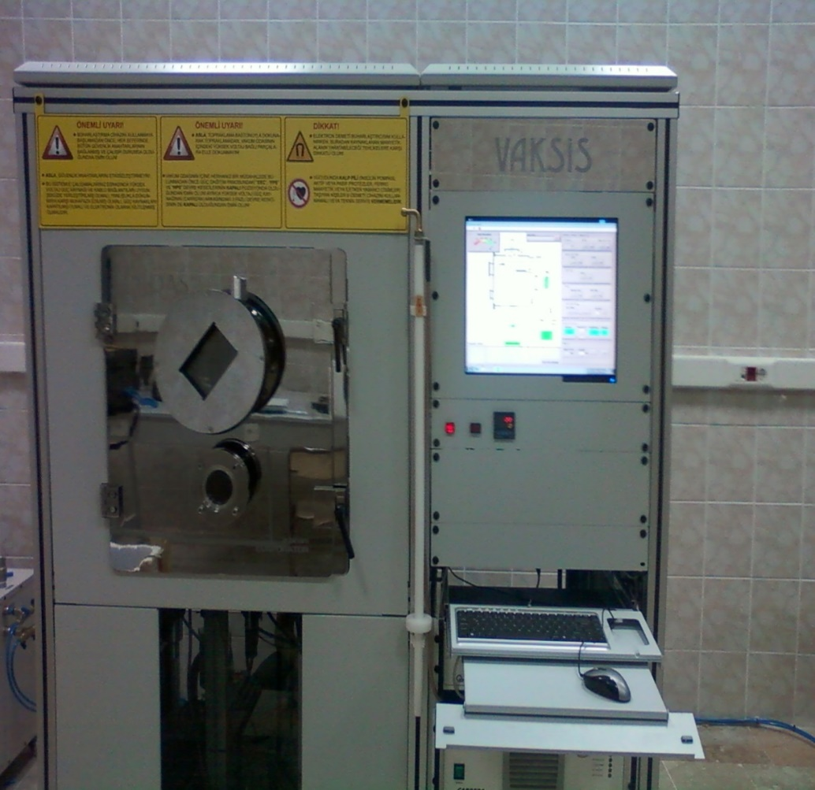
SEMICONDUCTOR GROWTH AND CHARACTERIZATION LABORATORY
In our laboratory; binary, ternary and quaternary semiconductor thin films belonging to II-VI, I-III-VI, II-III-VI and I-II-IV-VI groups are produced by E-beam and thermal evaporation techniques and their electrical and optical characterizations are determined.

Slide 19
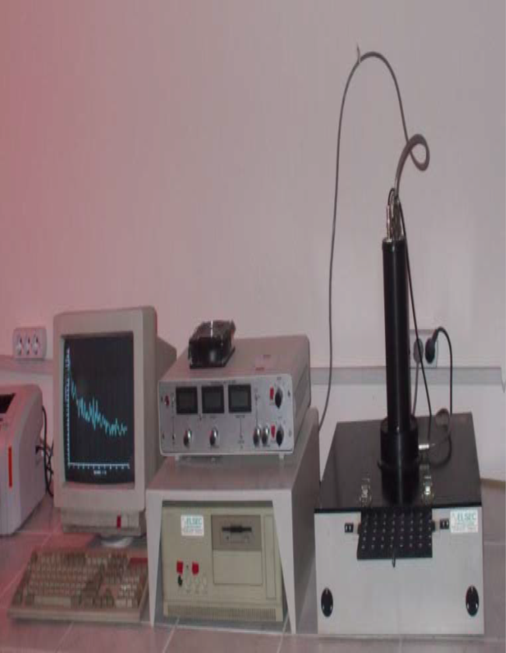
LUMINESCENCE (OSL) LABORATORY
Personal and environmental dosimeter studies can be carried out by using luminescence methods. Besides, dating of geological, archaeological materials, and the radiation dose determination of treatments or radiation therapy studies are performed in this lab.

Slide 20
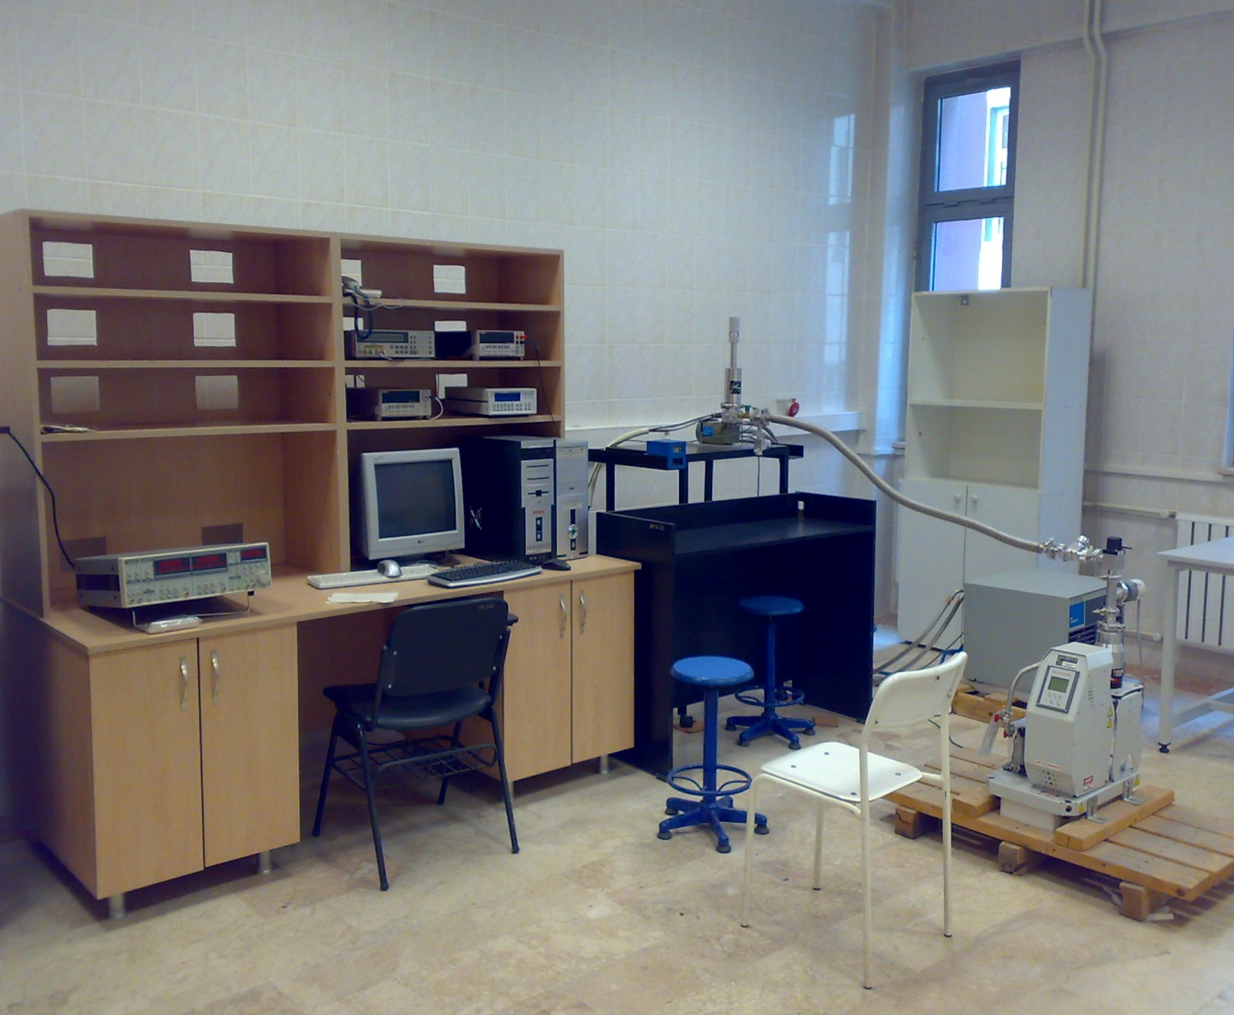
SUPERCONDUCTIVITY MEASUREMENT LABORATORY
In our laboratory, measurement and analysis of conductivity, inductance and levitation forces of YBCO(123), YBCO(358) and BSCCO high temperature superconductors are made by using various dopants and different production techniques.

Slide 21

THANKS!!!
http://pau.edu.tr/fizik/tr
@PauFizik

