Slide 1
Graph Traversals
Distributed Depth First Search
Distributed Breadth First Search
Dr. Elif HAYTAOĞLU

Slide 2
Breadth First Search
A breadth first search tree T of a graph G is a spanning tree of G such that for every node of G, the tree path is a minimum hop path to the root.
In an arbitrary graph G, it may be required to find the shortest distances of vertices from a source vertex r in terms of the number of links from r.

Slide 3
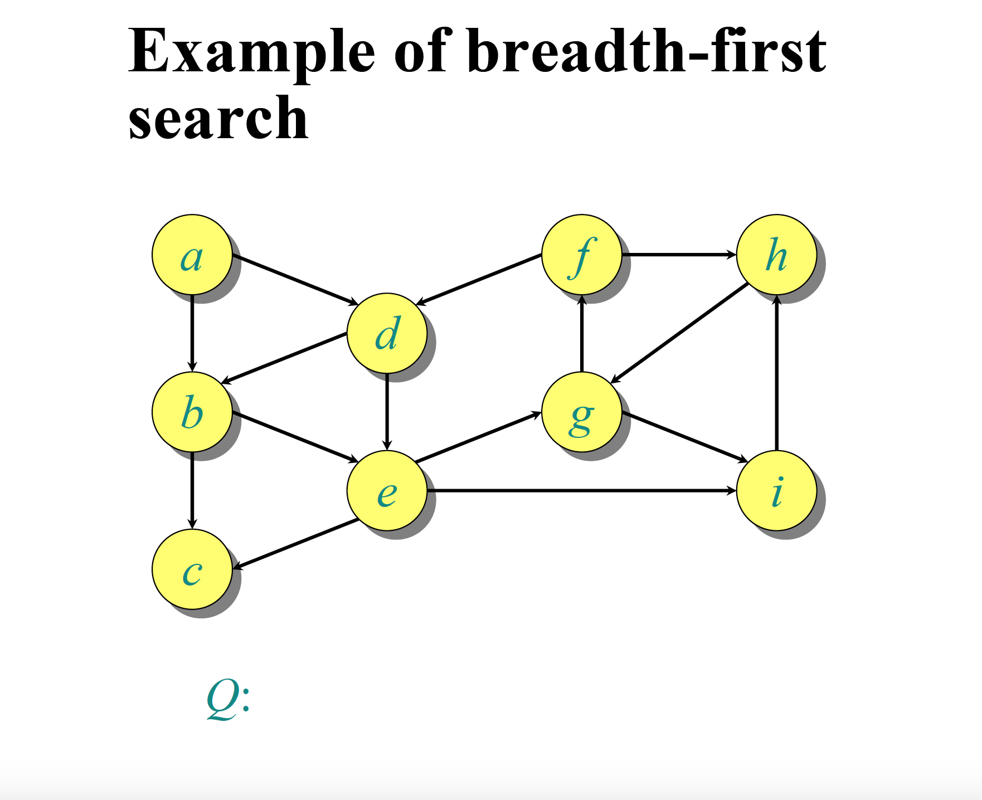

Slide 4
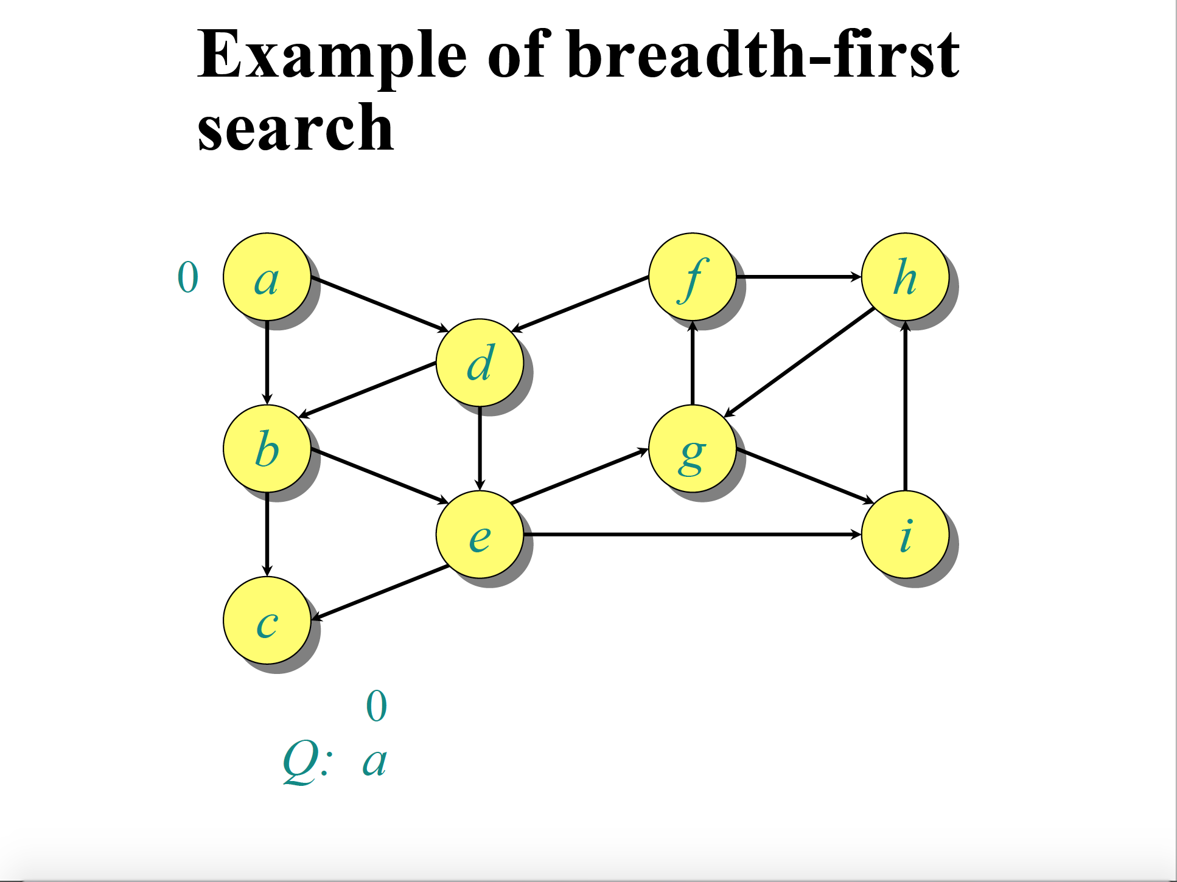

Slide 5
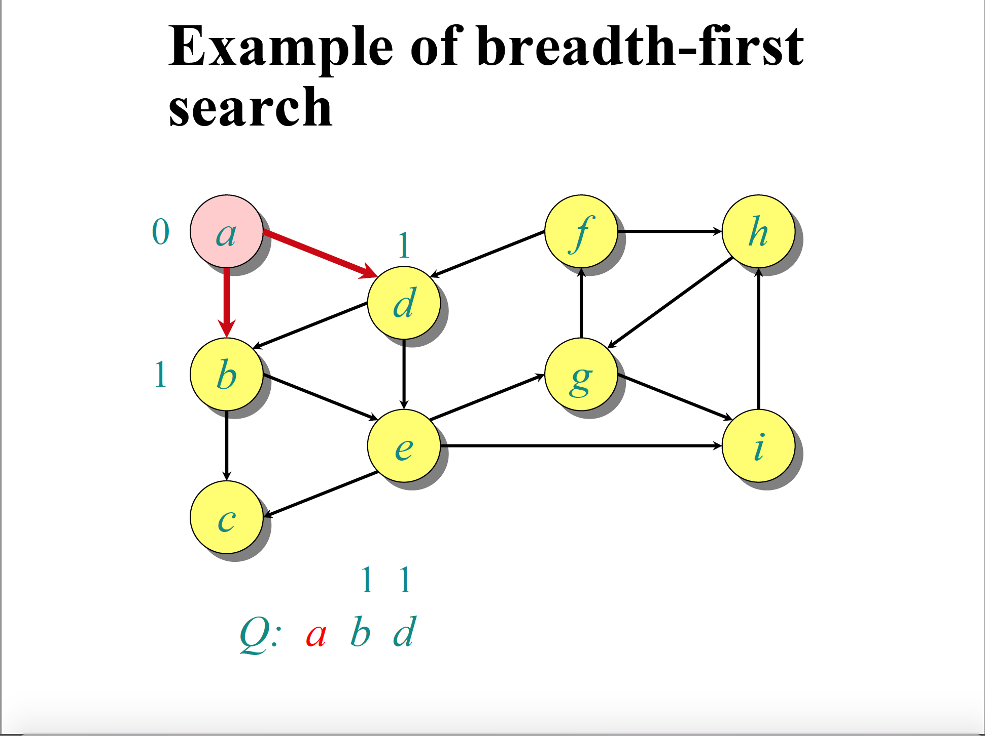

Slide 6
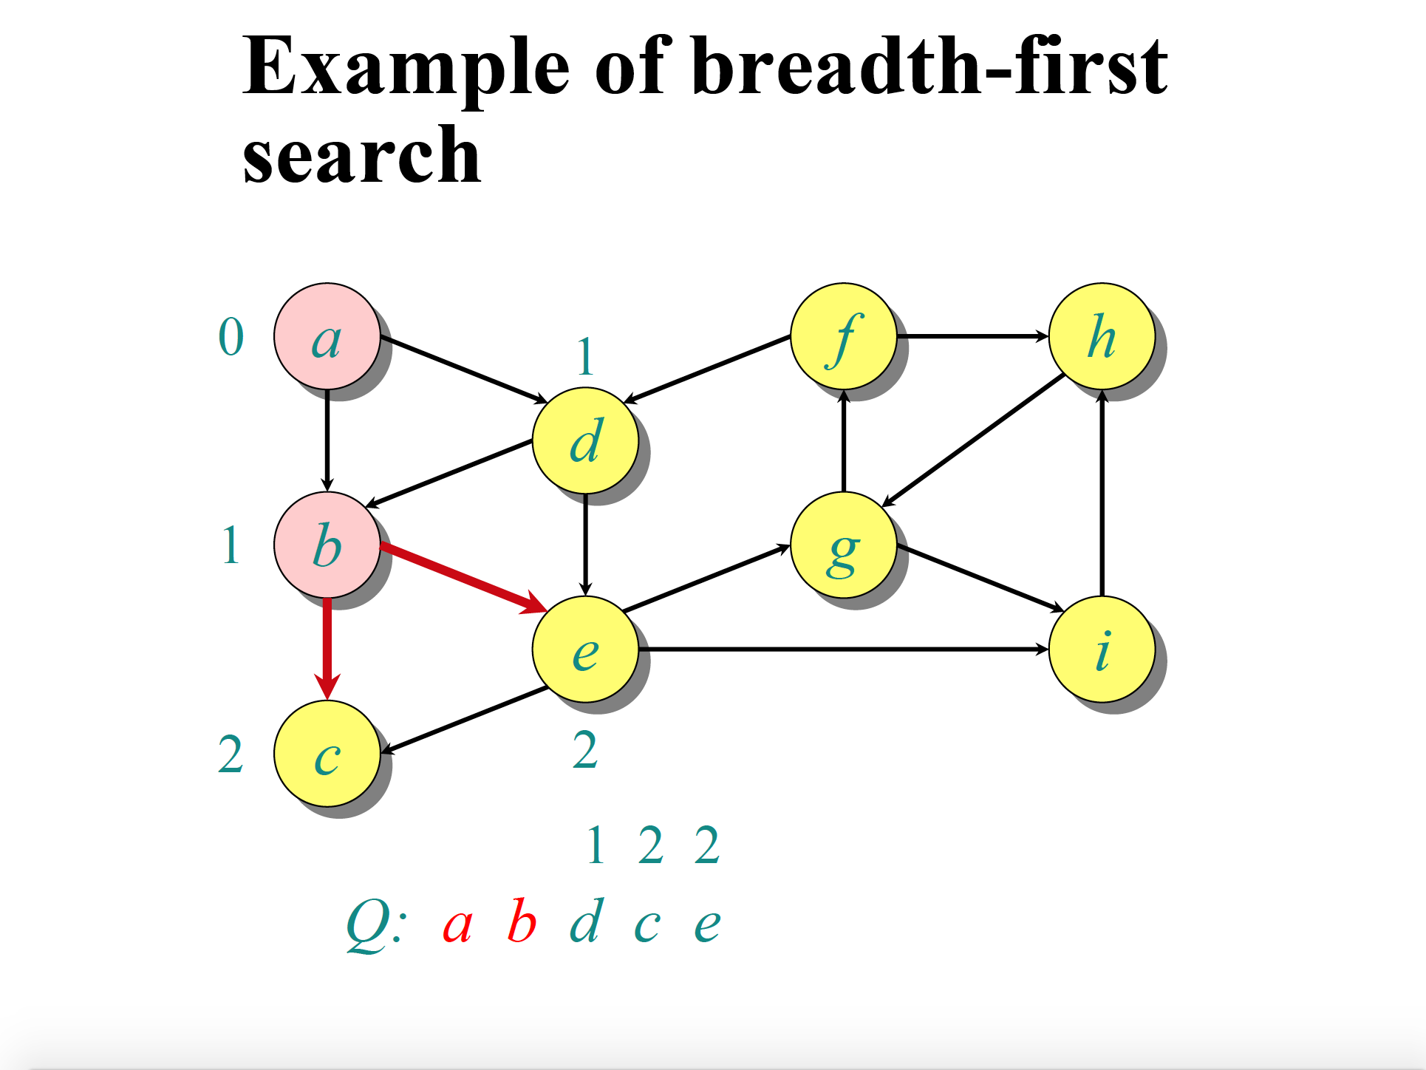

Slide 7
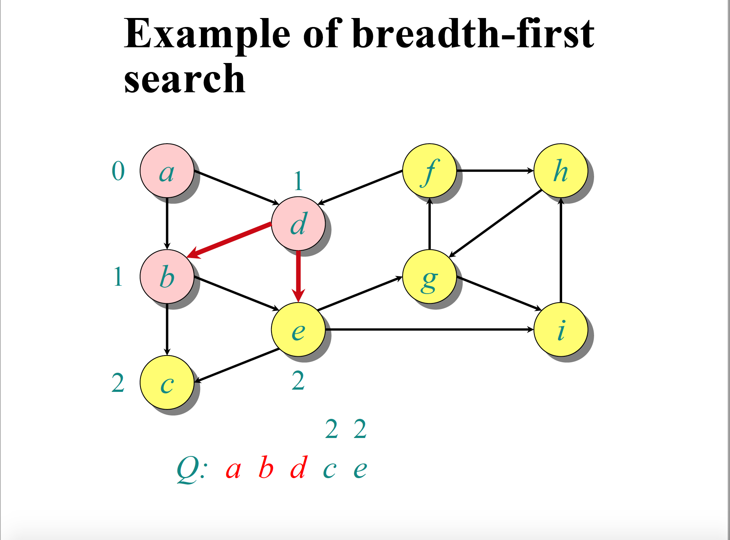

Slide 8
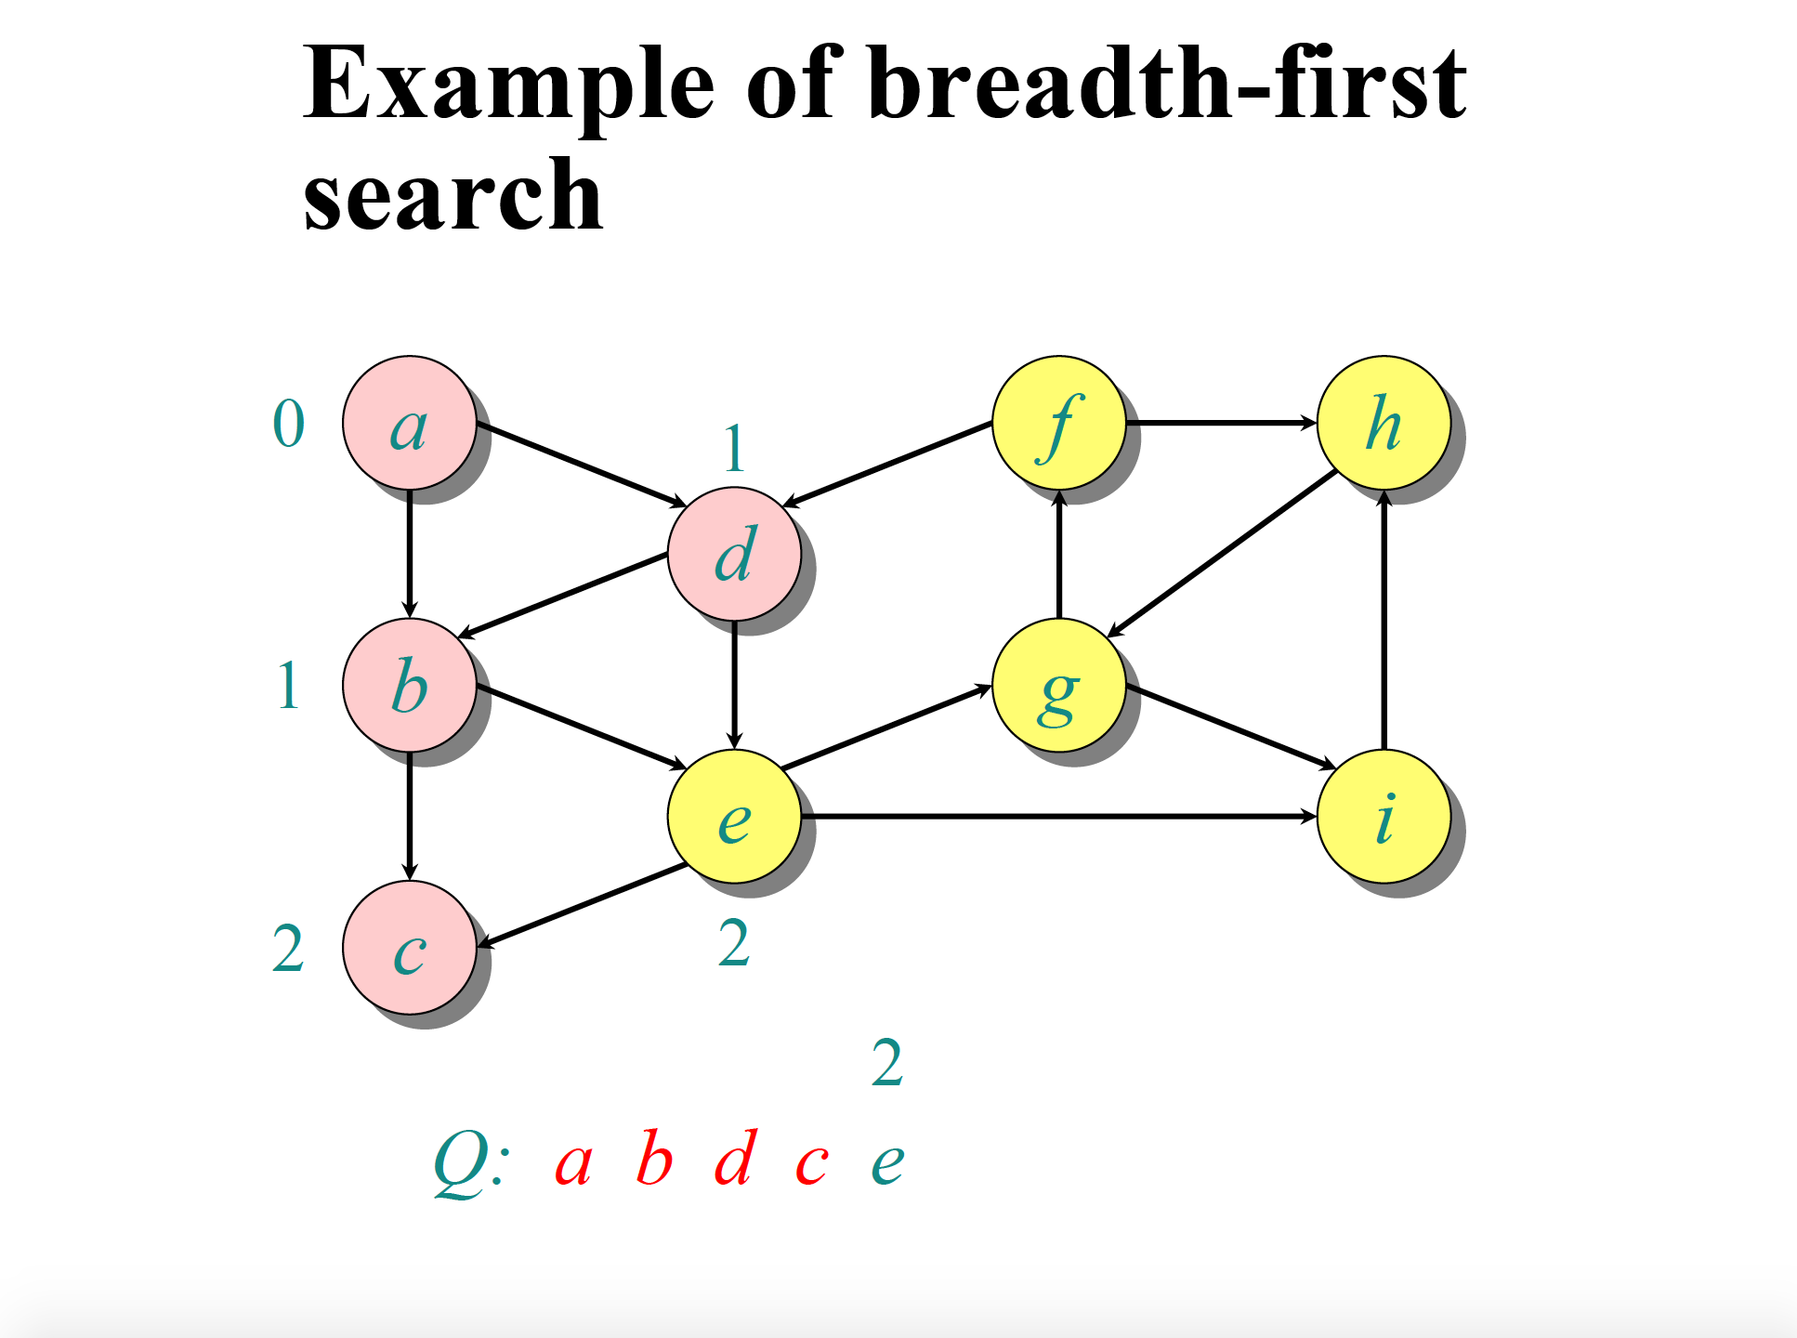

Slide 9
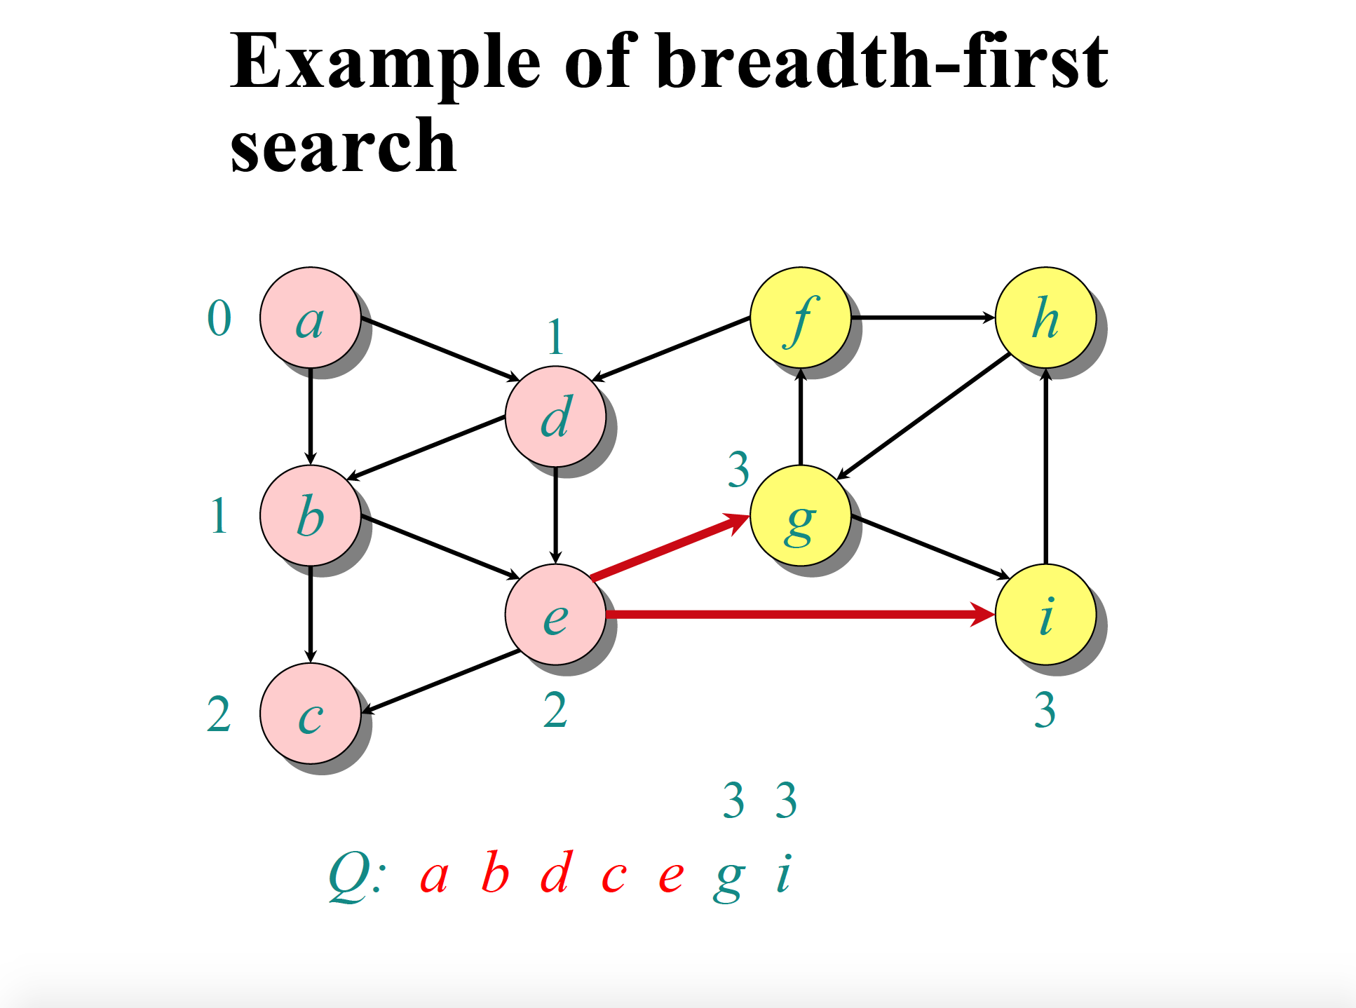

Slide 10
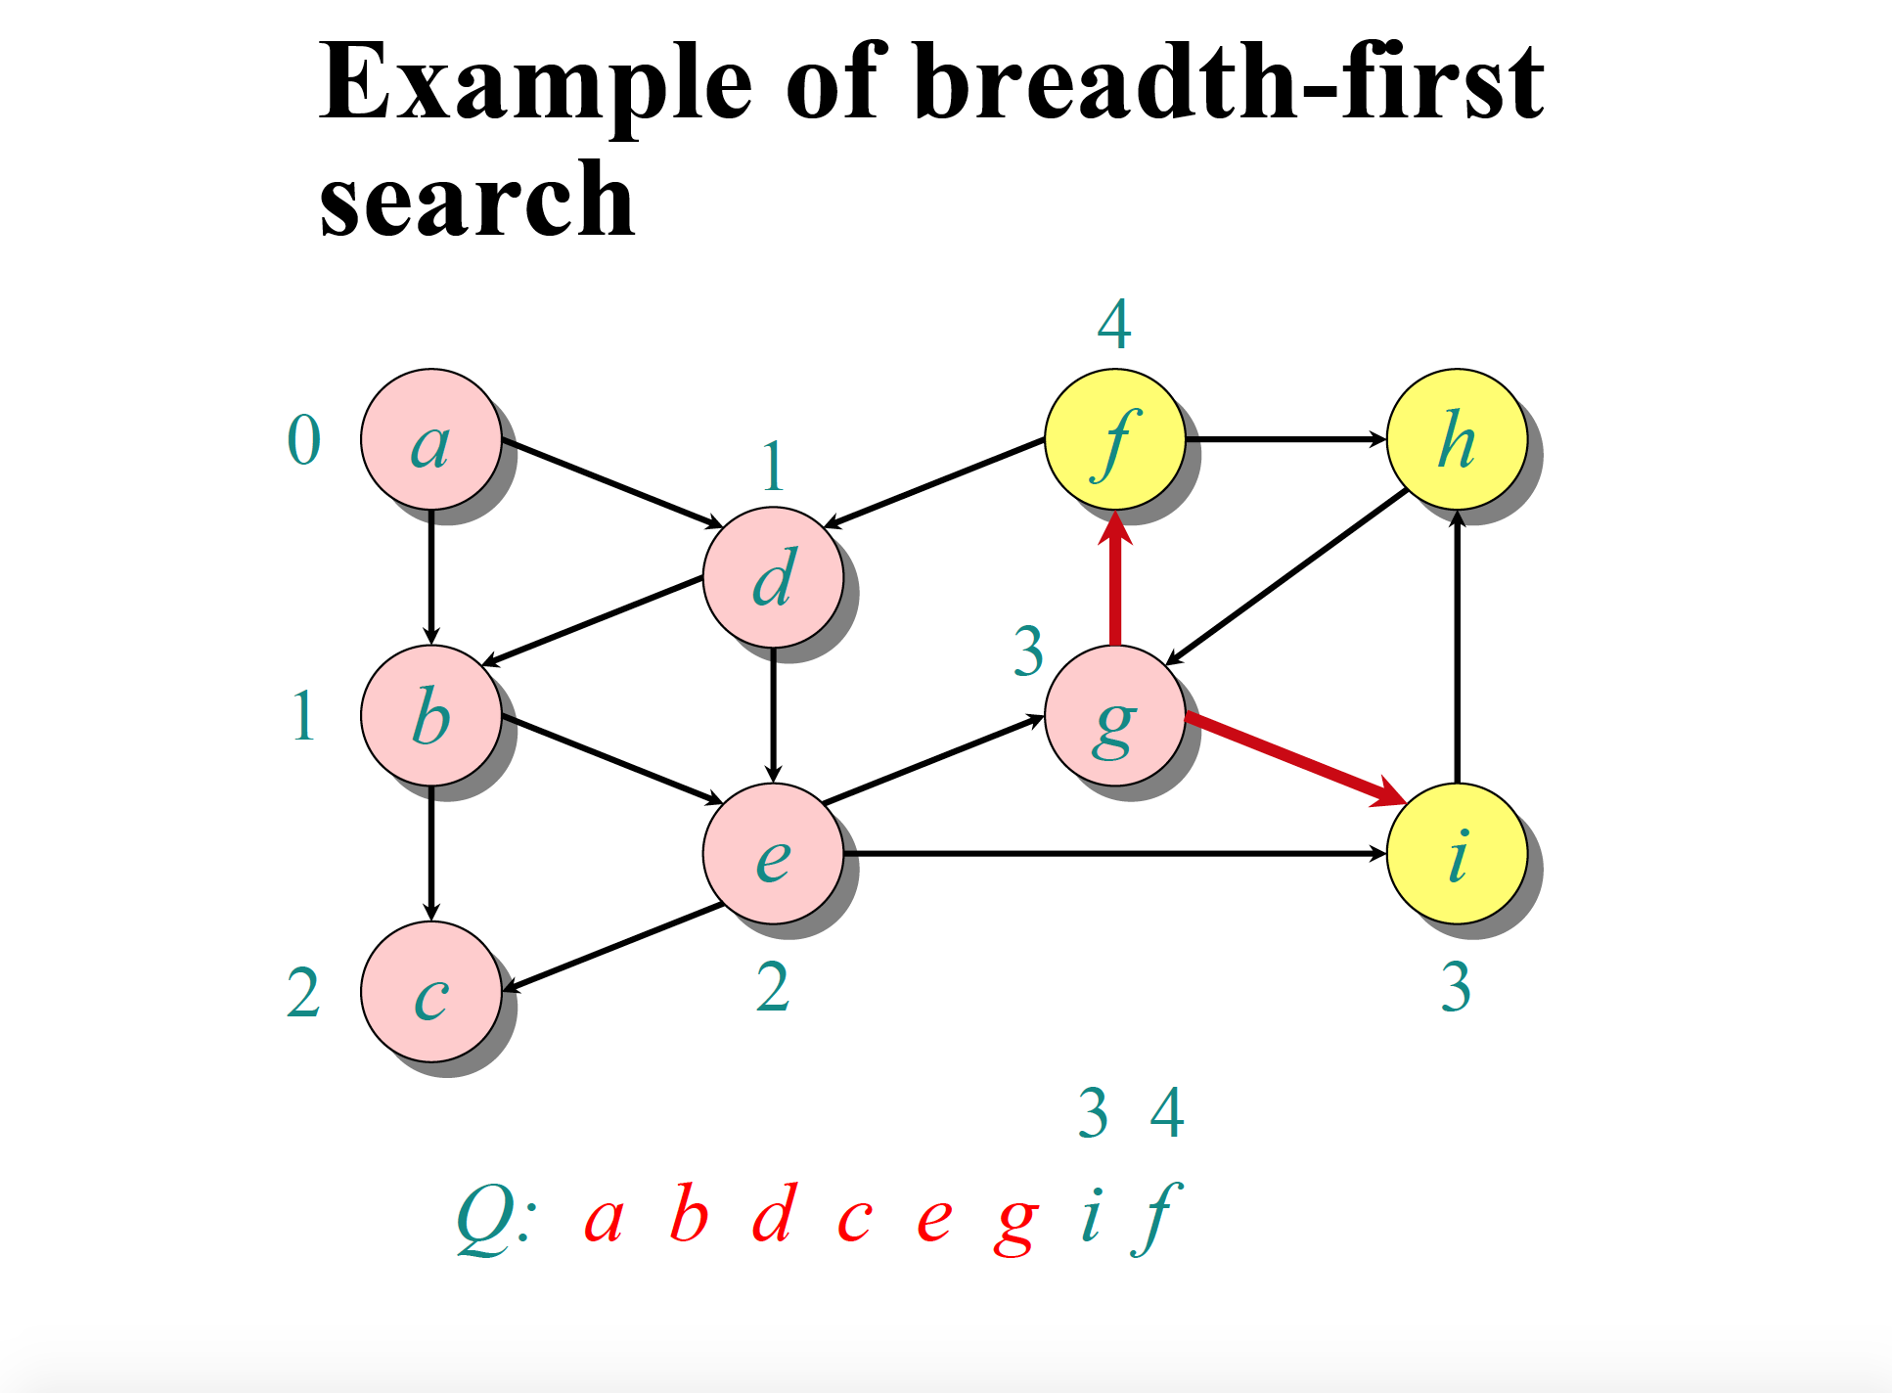

Slide 11
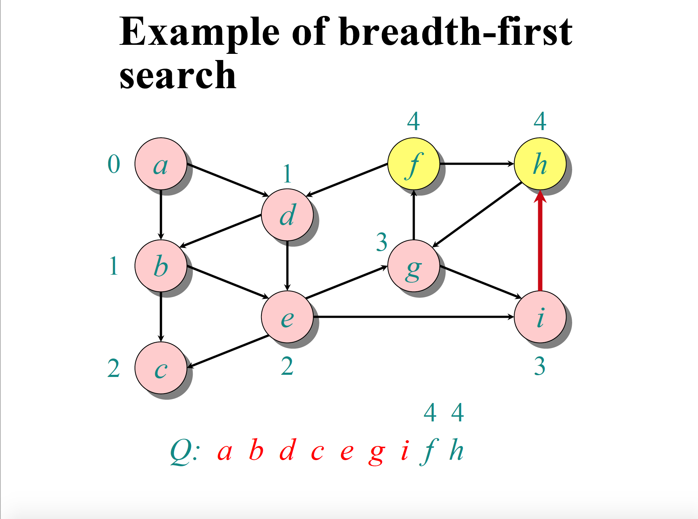

Slide 12
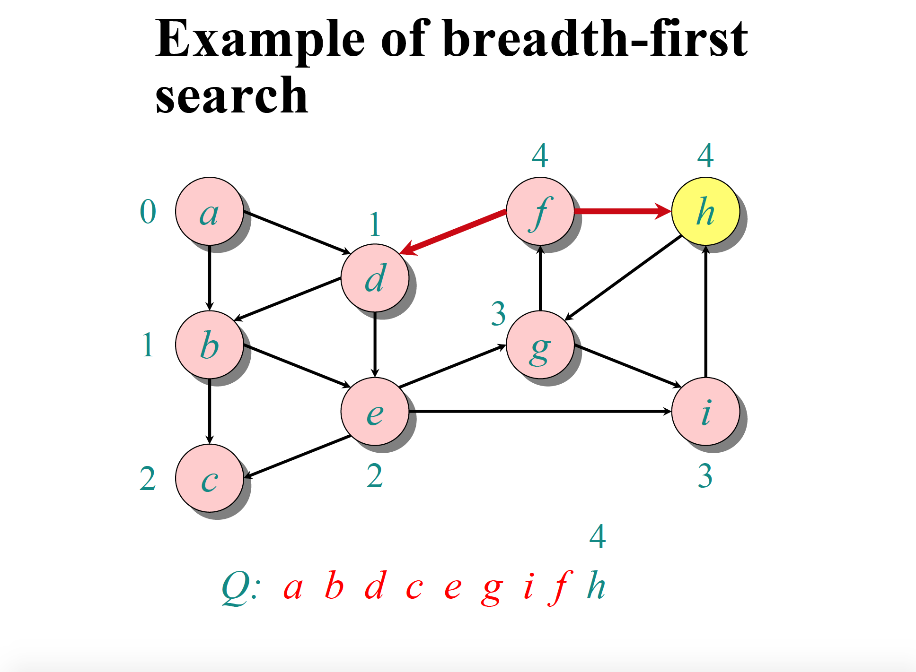

Slide 13
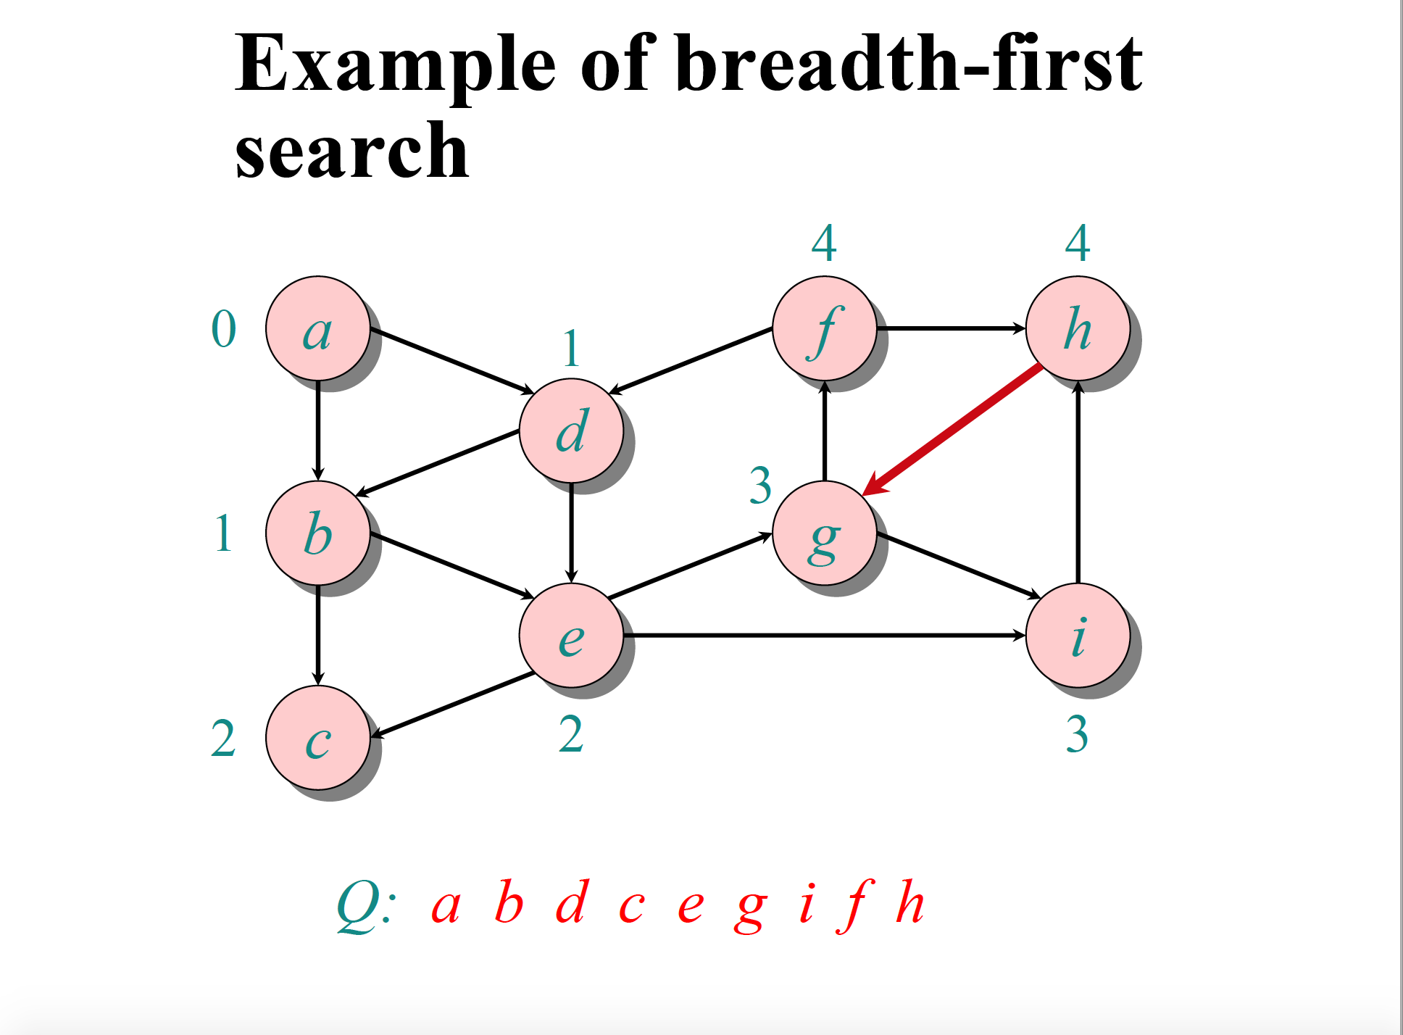

Slide 14
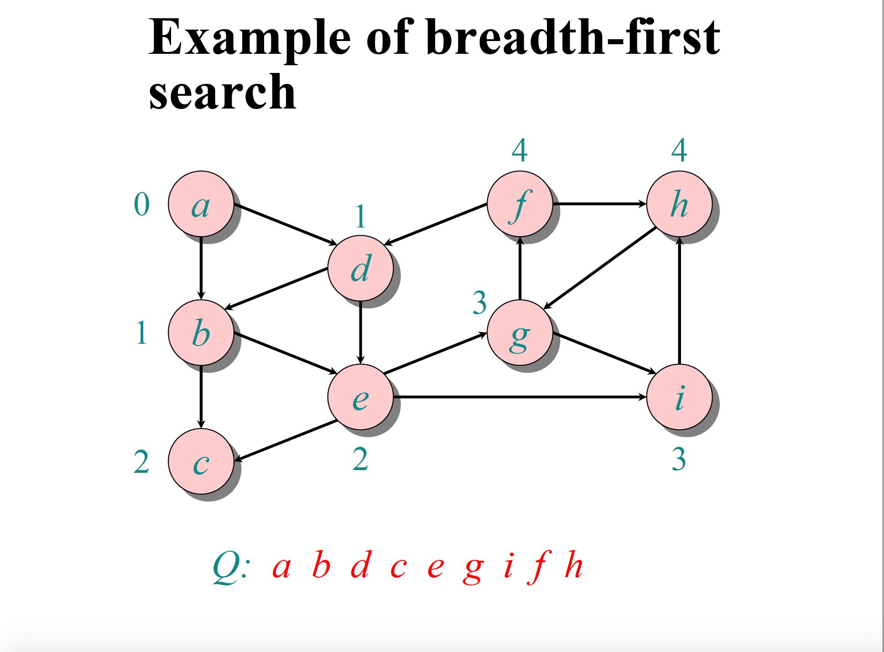

Slide 15
Synch BFS
Synch_ BFS is the synchronous distributed version of Dijkstra’s algorithm for the single-source shortest path problem.
Single Initiator
In each synchronous round, a partial BFS tree is formed,
Synchronization using special control messages,
Full termination detection is provided (all nodes).

Slide 16
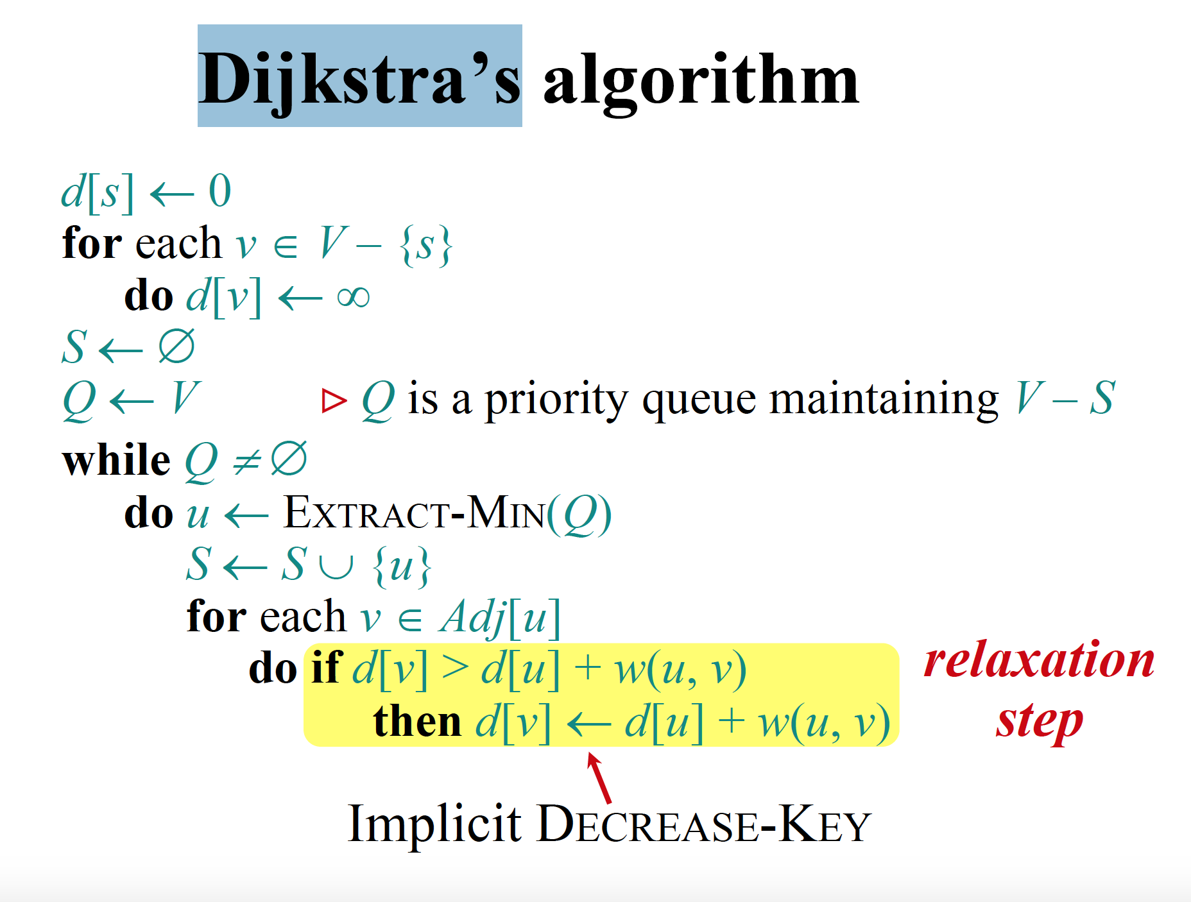

Slide 17
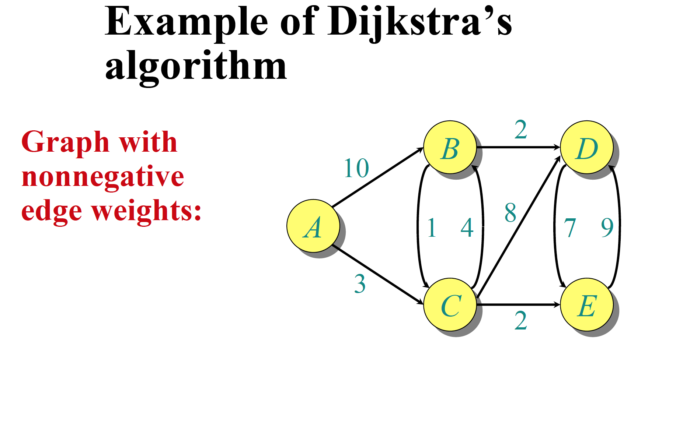

Slide 18
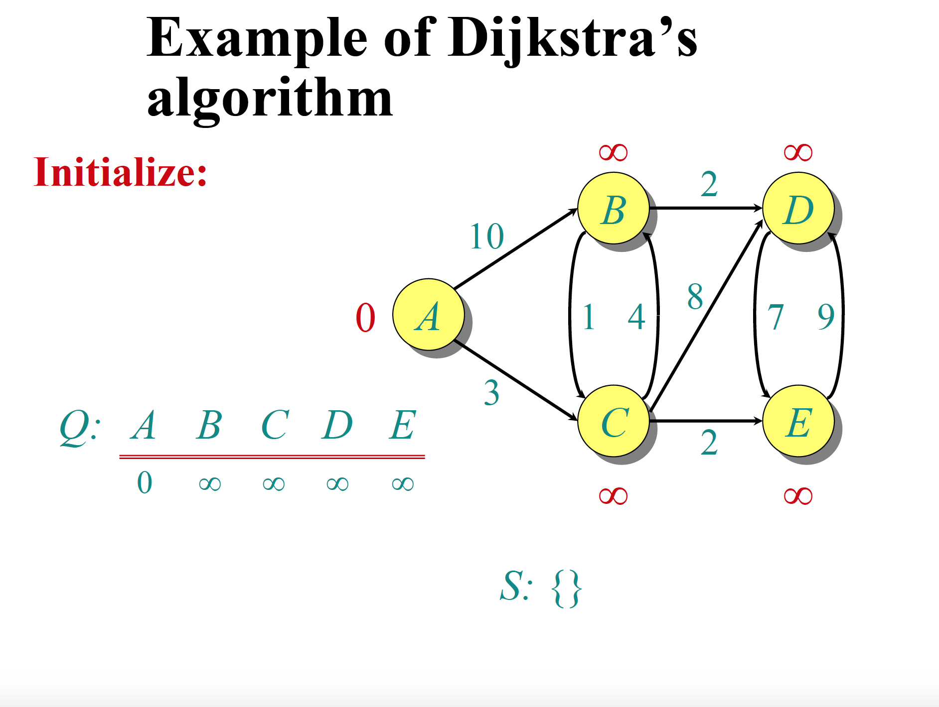

Slide 19
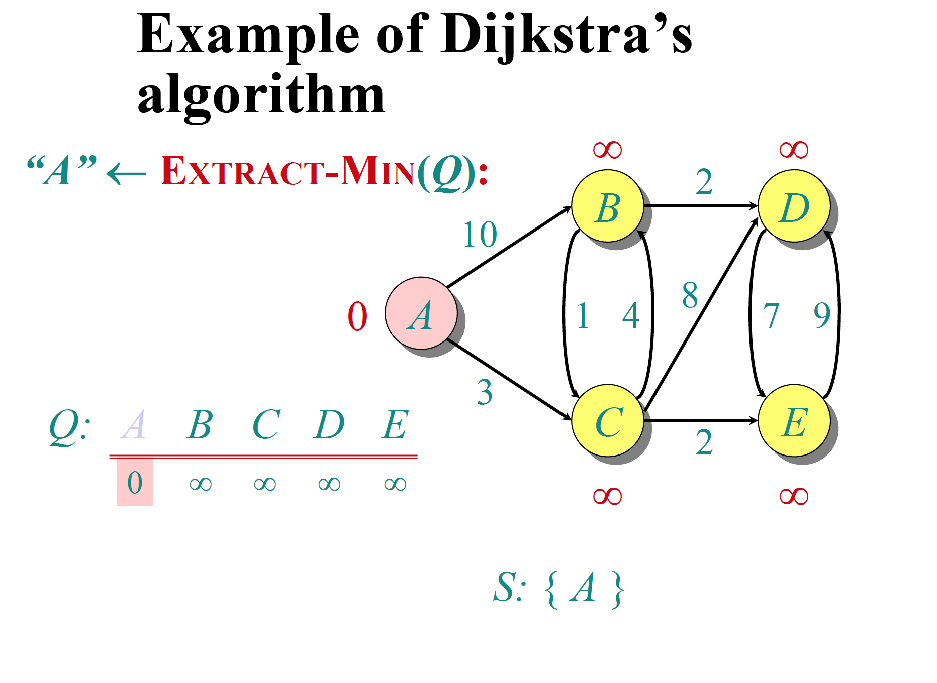

Slide 20
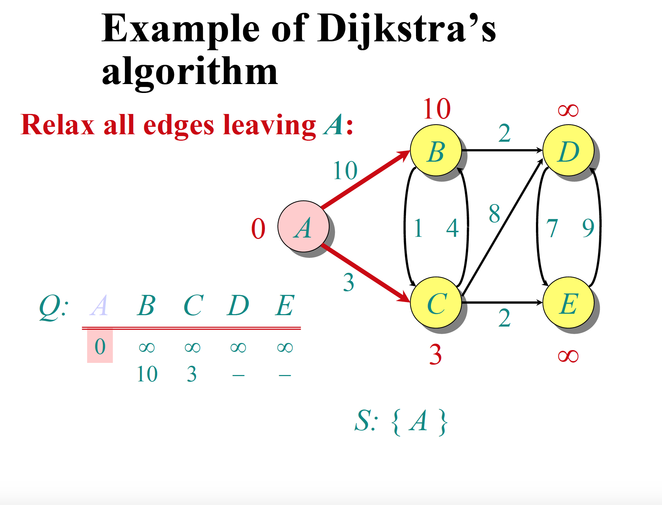

Slide 21
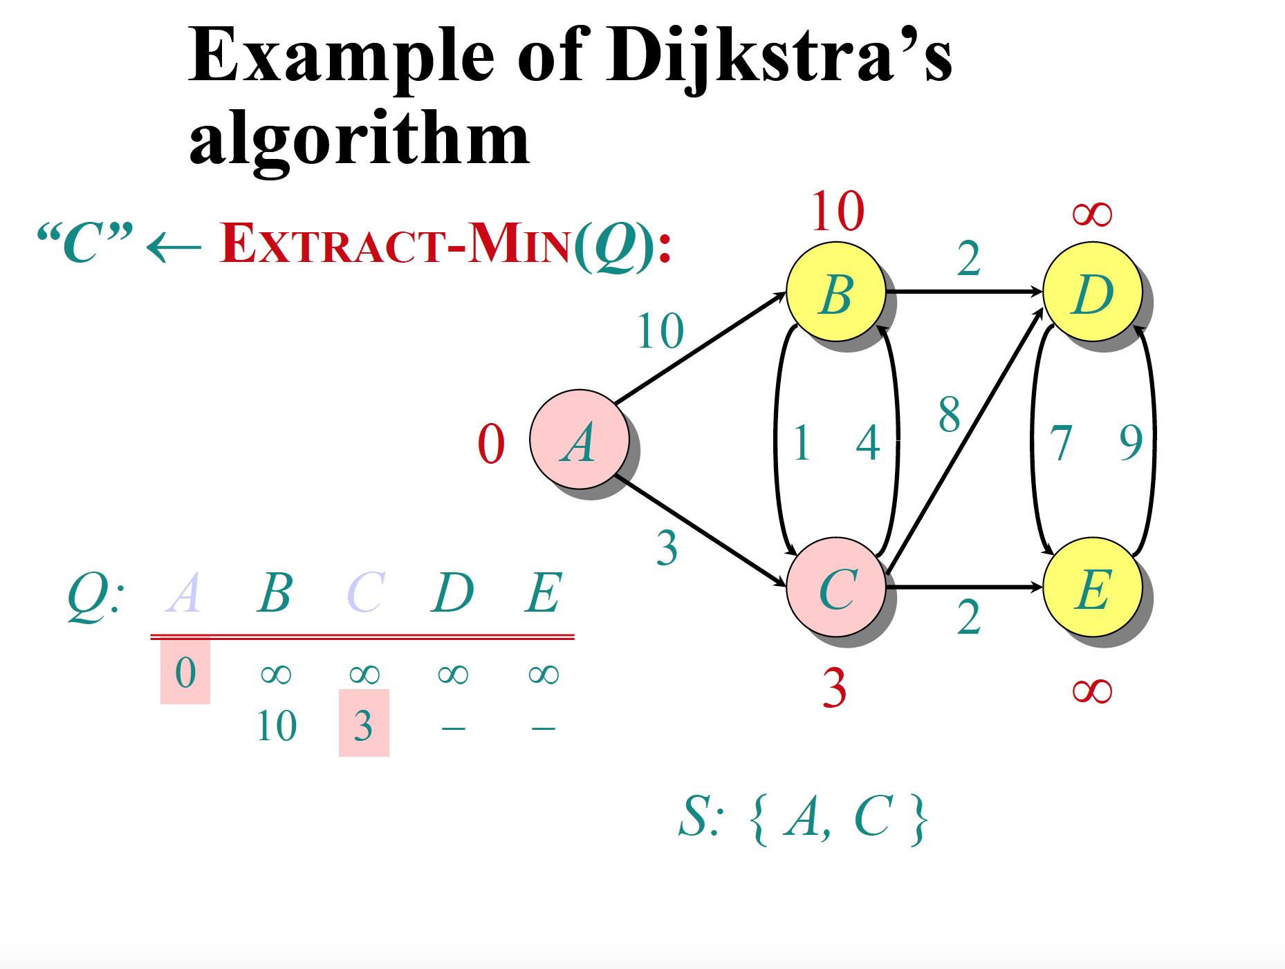

Slide 22
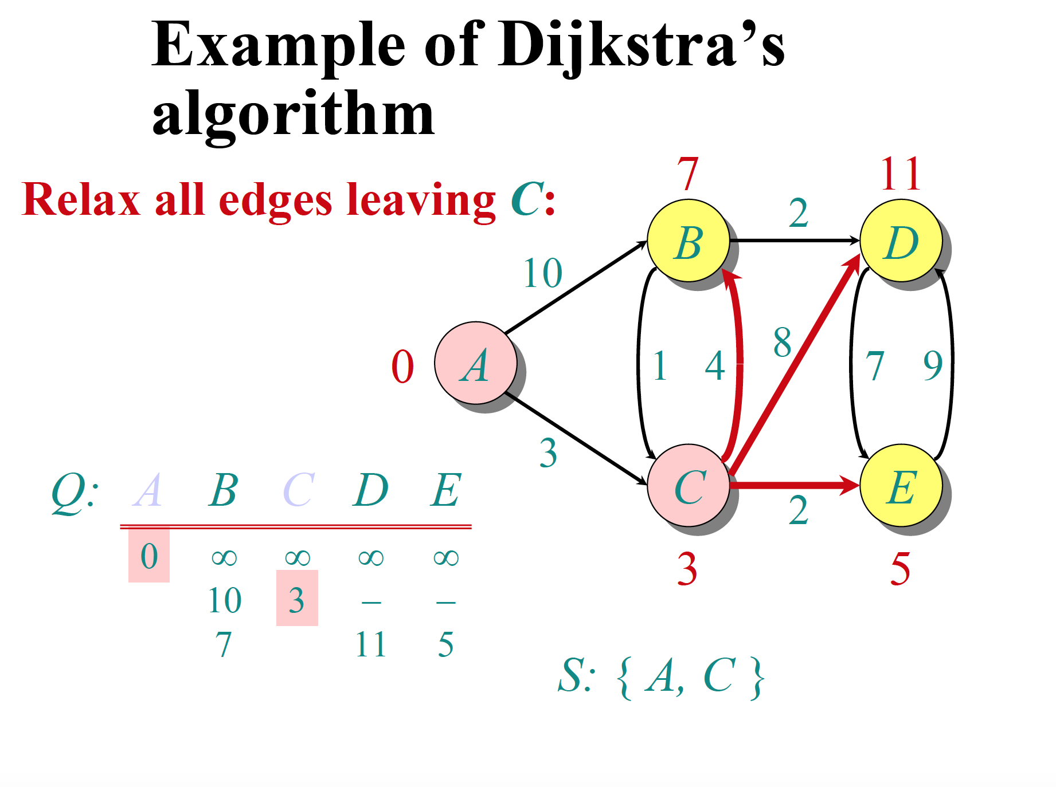

Slide 23
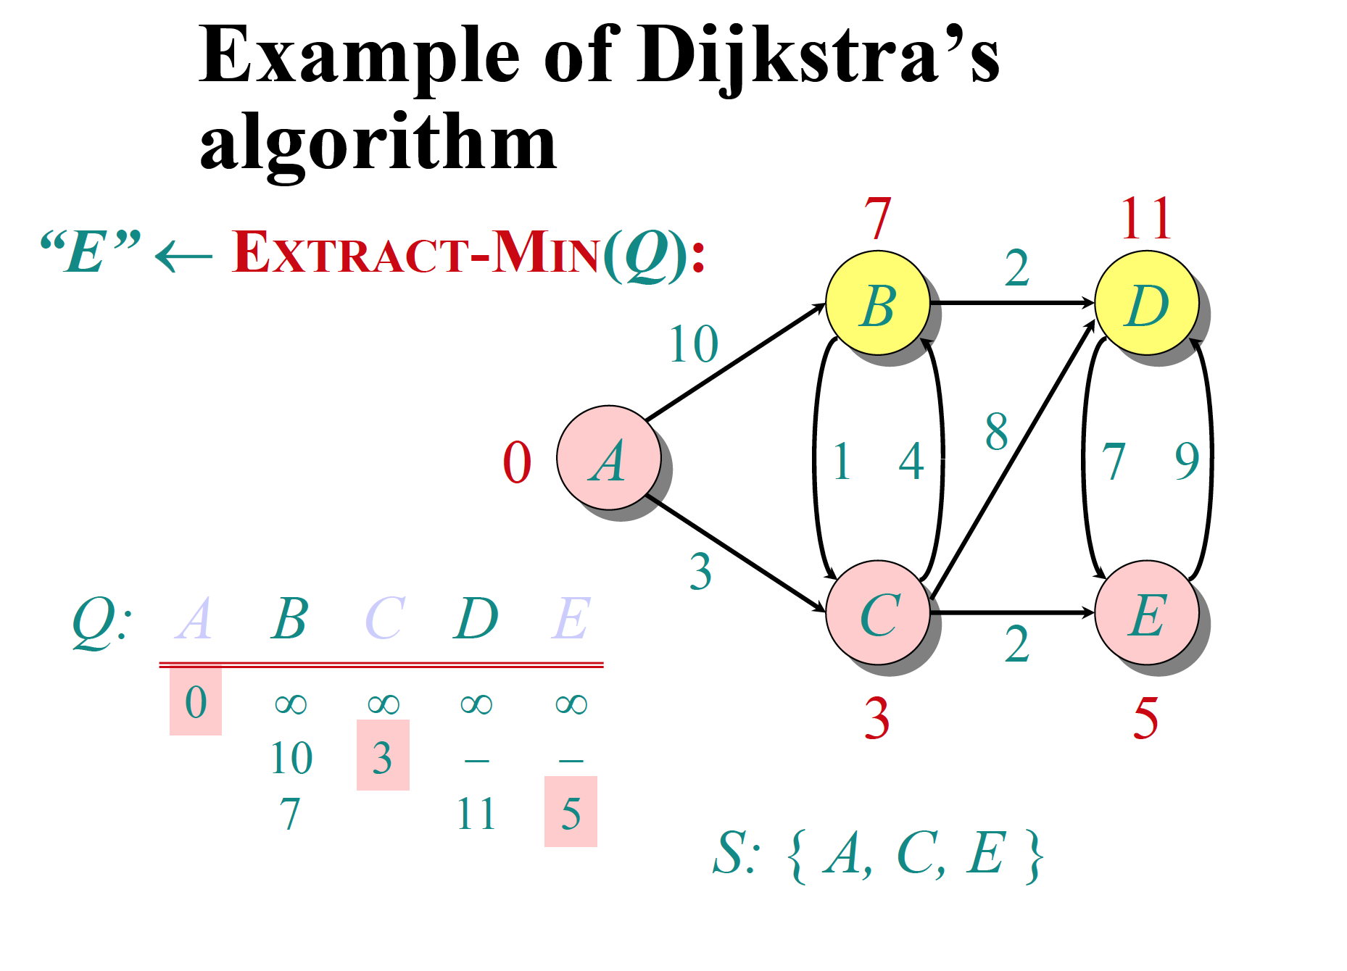

Slide 24
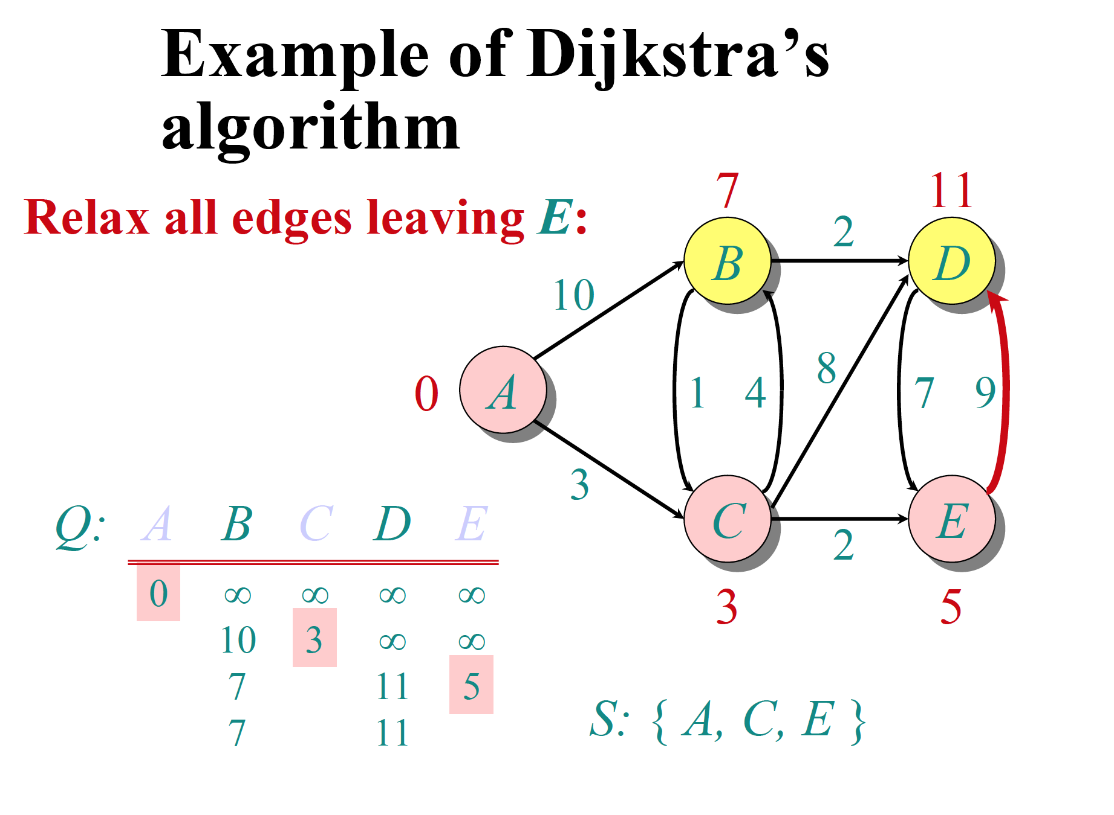

Slide 25
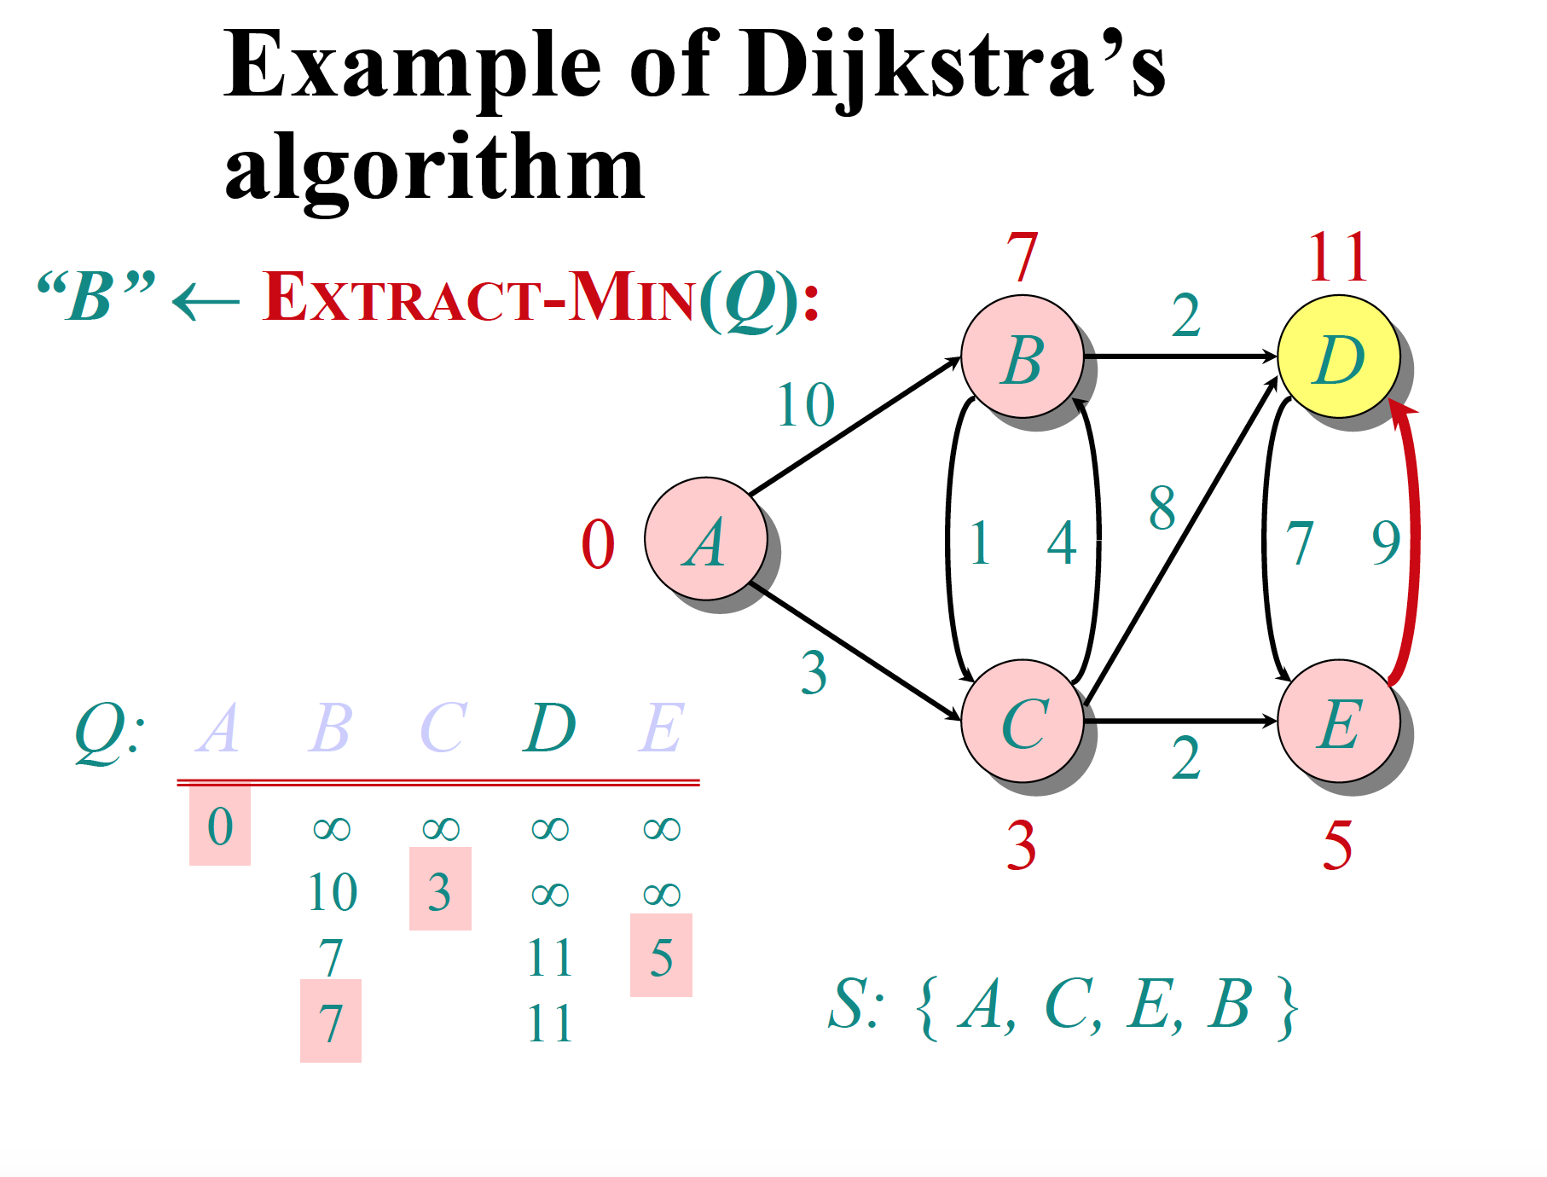

Slide 26
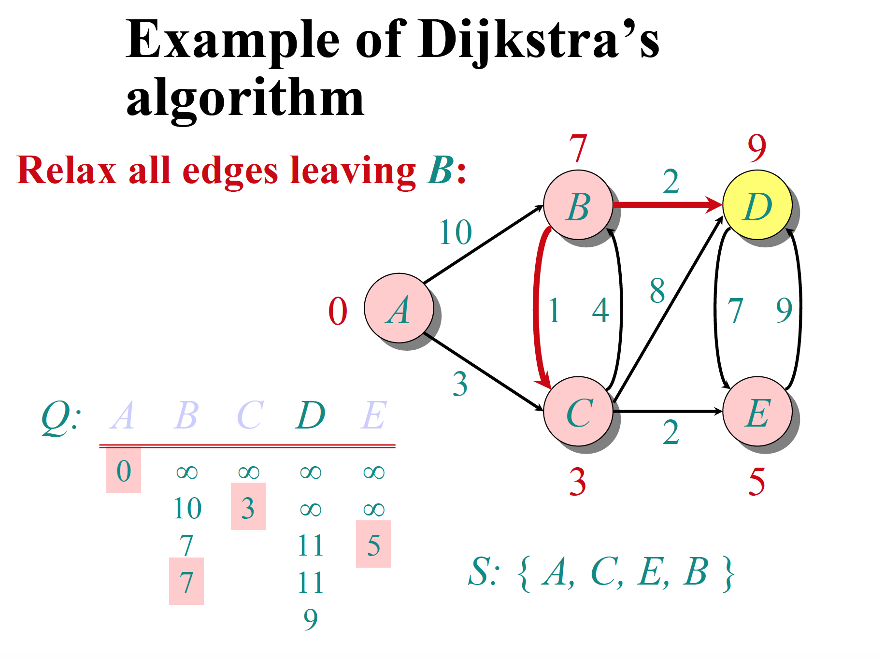

Slide 27
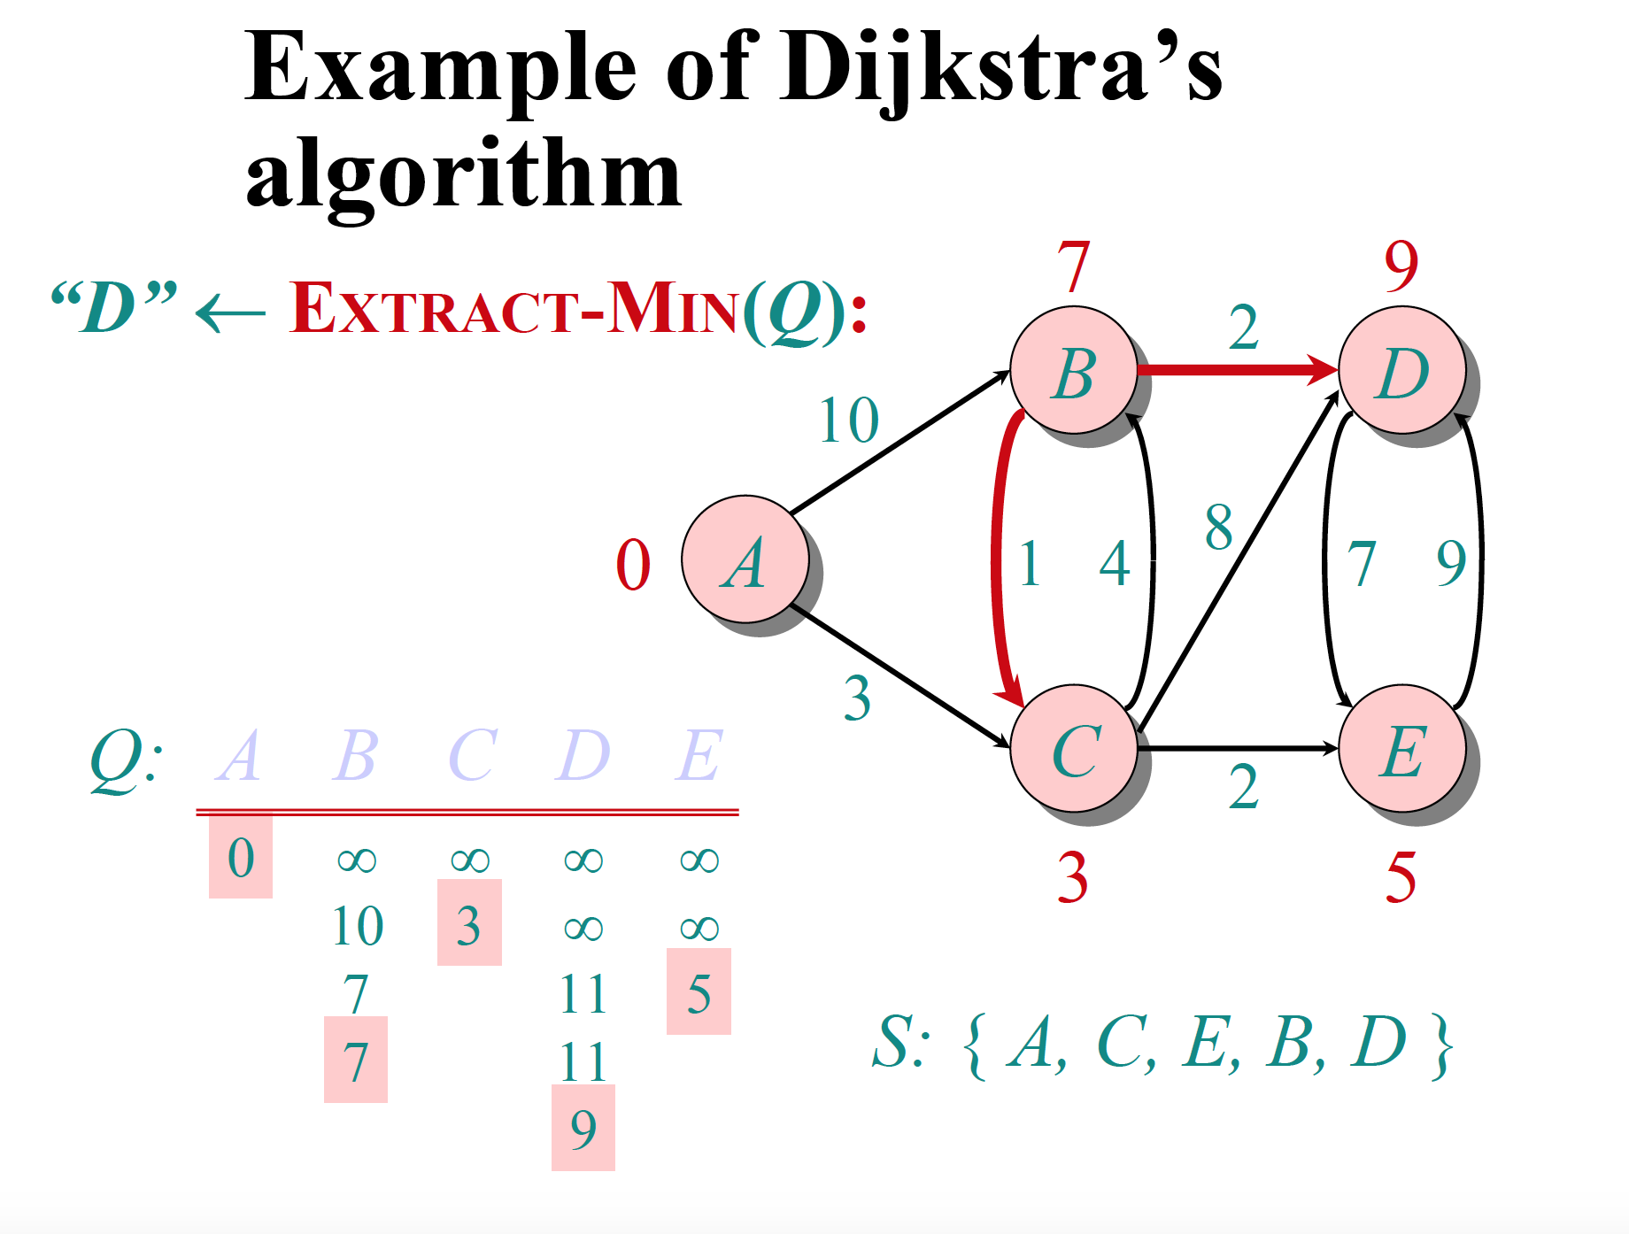

Slide 28
Synch BFS- Message Types
round(k): Sent by the root at the beginning of round p and is transferred by all of the member nodes of the partial BFS tree to their children.
probe(k): Sent by leaves of the partial BFS tree to unsearched neighbors.
ack(k)/reject(k): Sent by the searched node to accept/reject being a child of the sending leaf node.
upcast(k): Sent first by the leaf nodes of the partial BFS tree and then by the intermediate nodes to their parents, to signal the end of neighbor search and also the end of the round.

Slide 29
Synch BFS- Message Types
finish: Sent by the leaf nodes to their parents to signal that their part is over as either they have no neighbors other than parent or they do not have any children.
terminate: Broadcast by the root to all nodes to signal that the construction of the BFS tree is completed.

Slide 30
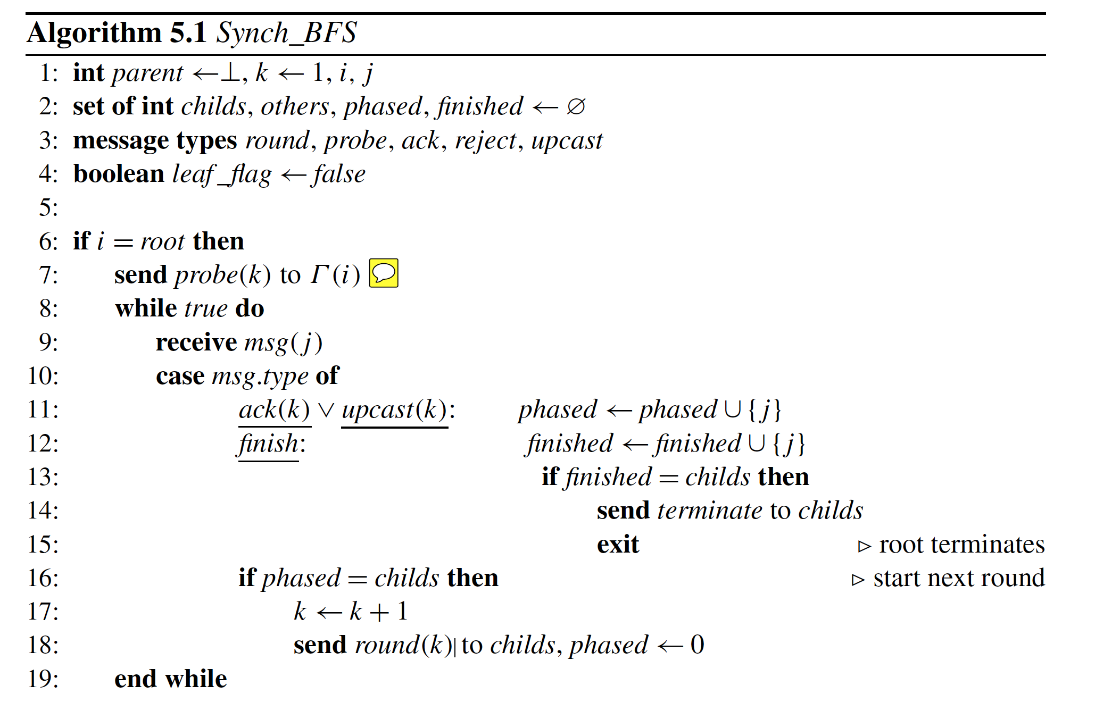

Slide 31
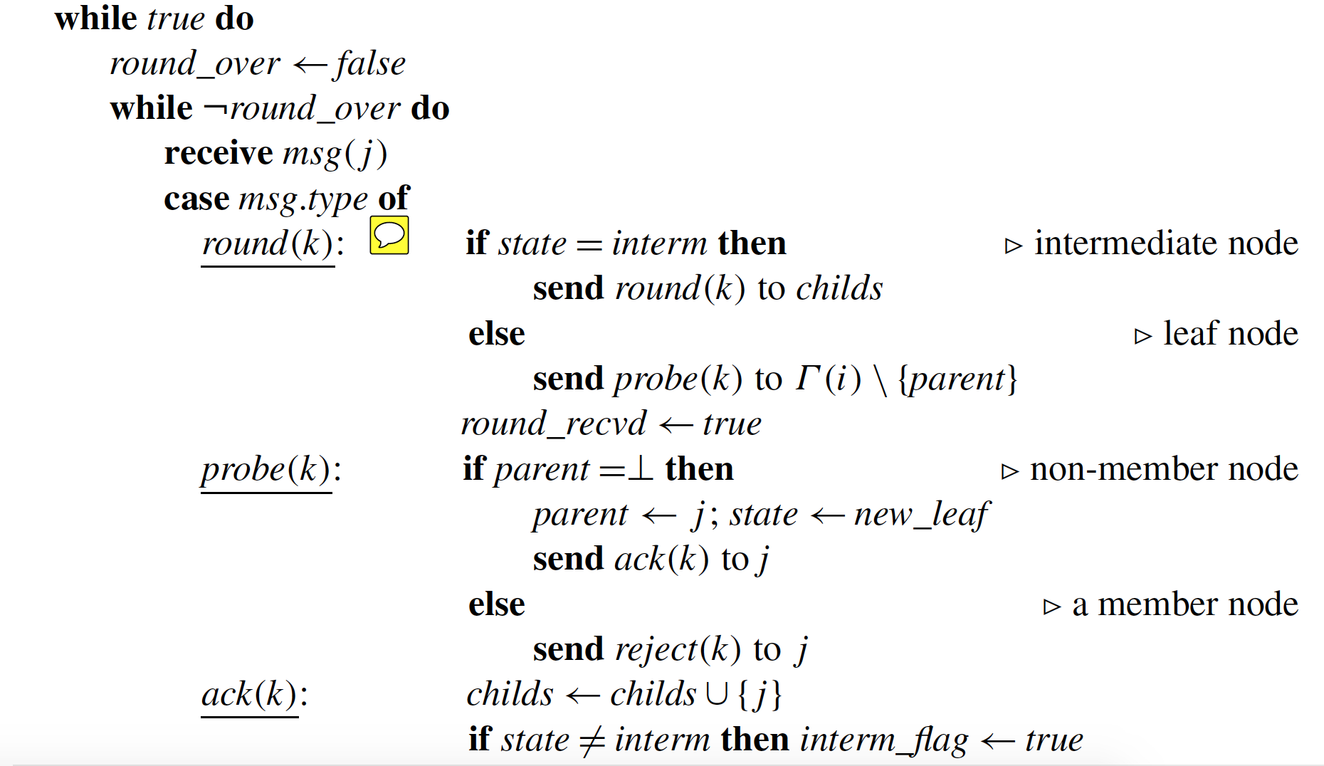

Slide 32
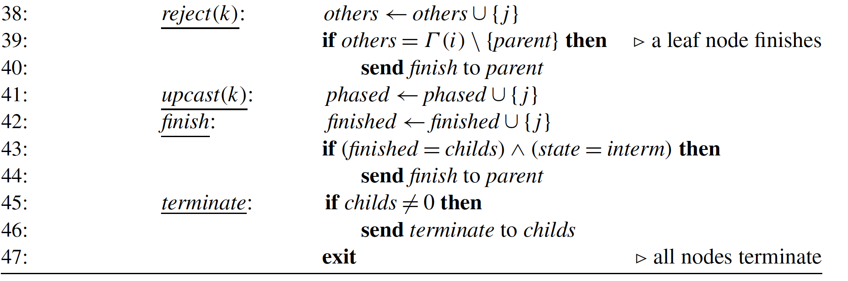

Slide 33
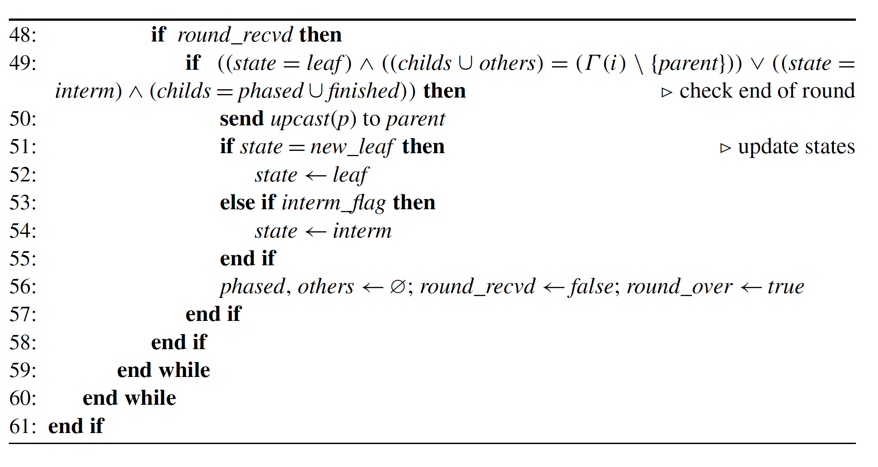

Slide 34
Synch BFS –Example Op
probe (1)
6
5
4
probe (1)
probe (1)
1
2
3

Slide 35
Synch BFS –Example Op
ack (1)
6
5
4
ack (1)
ack(1)
1
2
3

Slide 36
Synch BFS –Example Op
Round (1)
6
5
4
Round(1)
Round (1)
1
2
3

Slide 37
Synch BFS –Example Op
probe (2)
6
5
4
probe (2)
probe (2)
probe (2)
1
2
3
probe (2)
Probe (2)

Slide 38
Synch BFS –Example Op
ack (2)
6
5
4
ack (2)
reject (2)
reject (2)
1
2
3
reject (2)
reject (2)

Slide 39
Synch BFS –Example Op
Upcast (1)
6
5
4
Finish (1)
Upcast(1)
Finish(1)
Upcast (1)
1
2
3

Slide 40
Synch BFS –Example Op
Round (2)
6
5
4
1
2
3

Slide 41
Synch BFS –Example Op
Round (2)
6
5
4
Round(2)
1
2
3

Slide 42
Synch BFS –Example Op
6
5
4
Probe (3)
Probe (3)
1
2
3
Probe (3)

Slide 43
Synch BFS –Example Op
6
5
4
Reject(3)
1
2
3
Reject (3)

Slide 44
Synch BFS –Example Op
Finish (3)
Upcast (2)
6
5
4
Finish (3)
Upcast(2)
1
2
3

Slide 45
Synch BFS –Example Op
Finish (3), Upcast (2)
6
5
4
1
2
3

Slide 46
Synch BFS –Example Op
Terminate
6
5
4
1
2
3

Slide 47
Message & Time Complexity
Theorem. The time complexity of Algorithm 5.1, Time( Synch_BFS), is O(d^2). Its message complexity Msg( Synch_BFS) is O(nd +m) where d is the diameter and m is the number of edges of graph G.
Proof. Broadcasting of the message round(k) to current T_{k} takes k units and convergecast of message upcast similarly is performed in k units, where k is the depth. of Tk . There is also additional time for the probe and ack/reject messages at each step totalling 2k + 2 time for each step. Therefore, assuming that the final BFS tree will be at most of depth d.

Slide 48
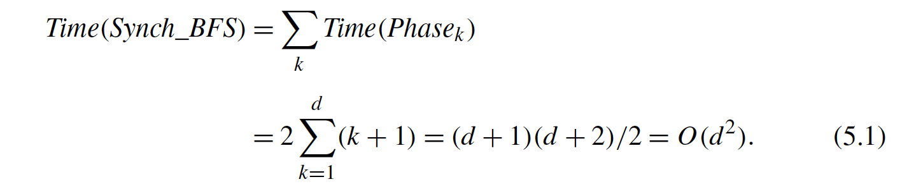

Slide 49
Message Complexity
For the message complexity, we need to consider the synchronization messages and tree forming messages separately.
In round p , if the tree formed has k nodes, there will be k − 1 round messages and k − 1 upcast messages for a total of 2k − 1 messages providing a maximum number of synchronization messages in a round as O(n) .

Slide 50
Message Complexity
In each round, new edges of the BFS tree will be determined by the probe and ack/reject messages, and therefore, the total traversals for discovery of these edges will be at most 2m. (4m)

Slide 51
Asynchronous BFS Construction
The second algorithm to build a BFS tree of a graph G is the distributed version of the Bellman–Ford algorithm called Update _BFS.
Any node receiving a layer(l) message compares the layer value l contained in the message with its known distance to the root.
If the new value is smaller, the sender of the layer message is labeled as the new parent, and the distance is updated to l.

Slide 52
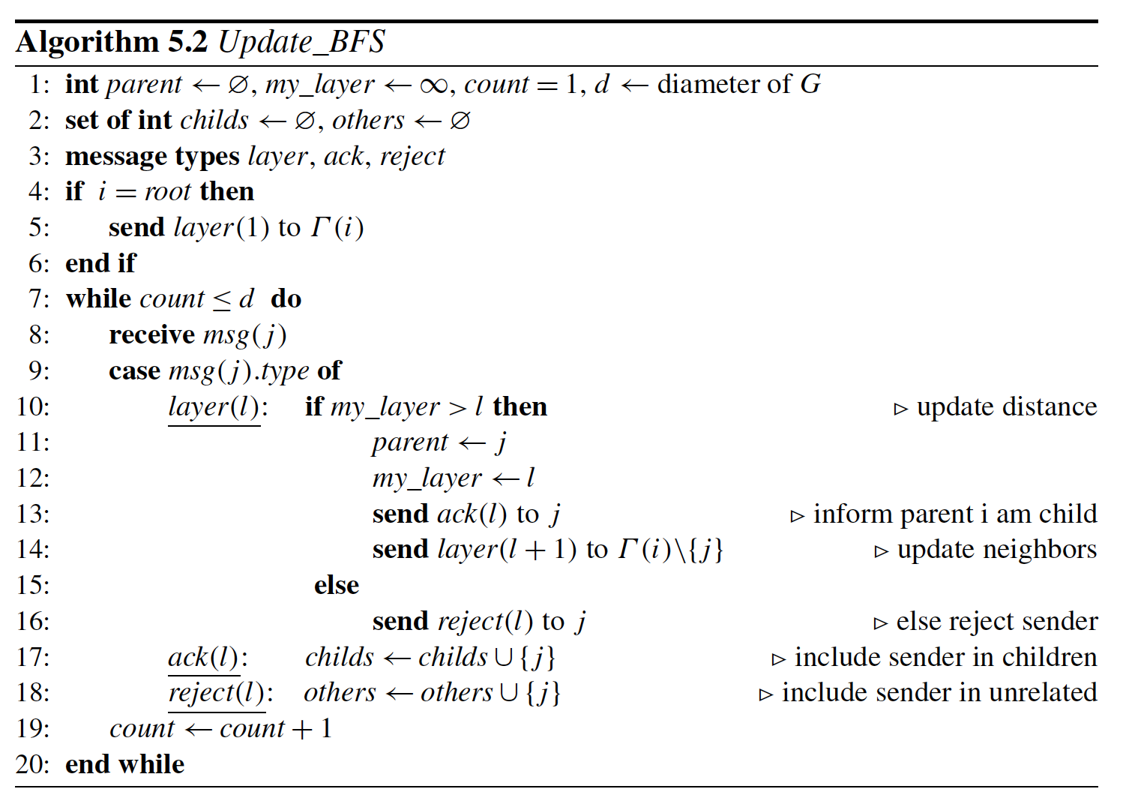

Slide 53
Asynchronous BFS -Example
layer (1)
6
5
4
layer (1)
1
2
3

Slide 54
Asynchronous BFS -Example
ack (1)
6
5
4
ack (1)
1
2
3

Slide 55
Asynchronous BFS -Example
layer (2,2)
6
5
4
layer (2,2)
1
2
3

Slide 56
Asynchronous BFS -Example
ack
6
5
4
Layer(3,3)
ack
Layer(1,3)
1
2
3

Slide 57
Asynchronous BFS -Example
6
5
4
Ack
Ack
Nack
1
2
3
Layer(2,4)

Slide 58
Asynchronous BFS -Example
6
5
4
Nck
1
2
3
Ack

Slide 59
Asynchronous BFS Complexities
Theorem. The time complexity of Algorithm 5.2 is O(d), and its message complexity is O(nm).
Since the diameter d of G is the longest distance between any two nodes in G , all the layer messages will have reached all nodes in O(d) time units.
Hence, Time(Update _BFS) = O(d) .

Slide 60
Asynchronous BFS Complexities
Theorem. The time complexity of Algorithm 5.2 is O(d), and its message complexity is O(nm).
Node v may have n− 1 as the first value it ever assignsto its distance to the root. After that, it will change its distance value at most n − 2 times as the longest path, and assuming each time it updates its distance to the root and sends layer messages to its neighbors in the worst case.
O(n*deg(v))=O(m) n node için O(nm)

Slide 61
Depth First Search
Definition 5.2 (Depth-First-Search Tree) A frond edge is an edge that does not belong to a spanning tree. For a rooted spanning tree T of a graph G, let us denote by S(u) all the nodes in the subtree of u, and P(u) denote all the vertices that exist between u and the root.
A depth-first-search tree of a graph G is a spanning tree T of G such that for every frond edge {u, v}, v ∈ S(u) ∨ v ∈ P(u).

Slide 62
DFS - Example
d
e
a
1/10
C
11/14
d
b
a
f
f
b
2/5
6/9
C
12/13
e
F
B
c
g
c
3/4
7/8
g
C
DFS imposes a tree structure (actually a collection of trees or a forest) on the structure of the graph
This is just the recursion tree, where the edge (u, v) arises when processing vertex “u” we call DFSVisit(v) for some neighbor v

Slide 63
Classical Distributed DFS
Tarry’s algorithm had two rules: a process never forwards the token twice through the same channel, and
A non-initiator forwards the token to its parent if it cannot forward it to any other neighbor with the first rule.
This algorithm is formed by the addition of the following rule:
R3: When a process receives the token, it sends it back through the same channel if this is allowed by Rules 1 and 2.

Slide 64
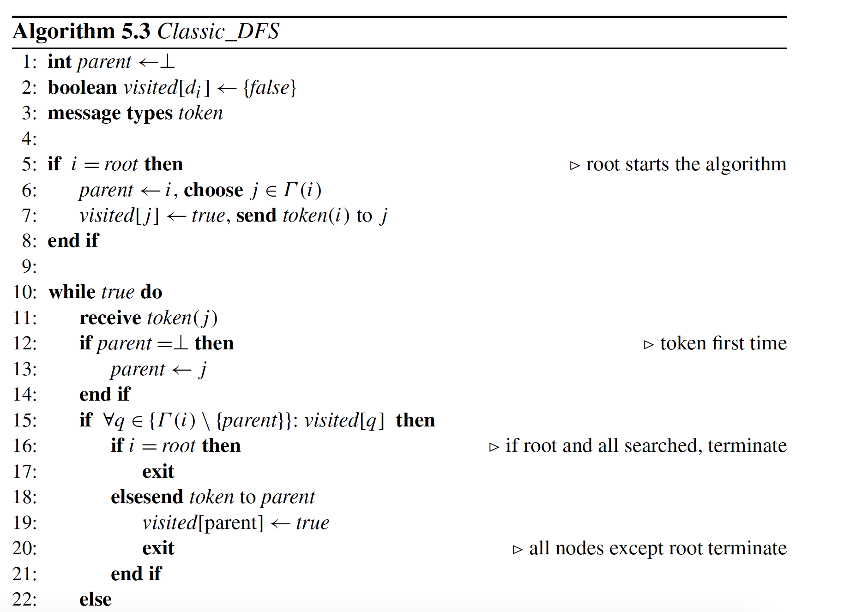

Slide 65
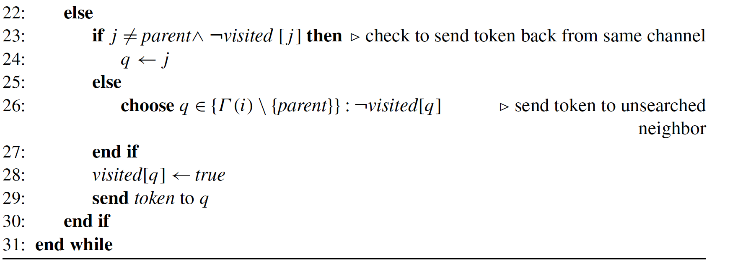

Slide 66
Classical DistributedDFS Example
6
5
4
1
2
3

Slide 67
Classical DistributedDFS Example
6
5
4
1
2
3

Slide 68
Classical DistributedDFS Example
6
5
4
1
2
3

Slide 69
Classical DistributedDFS Example
6
5
4
1
2
3

Slide 70
Classical DistributedDFS Example
6
5
4
1
2
3

Slide 71
Classical DistributedDFS Example
6
5
4
1
2
3

Slide 72
Classical DistributedDFS Example
6
5
4
1
2
3

Slide 73
Classical DistributedDFS Example
6
5
4
1
2
3

Slide 74
Classical DistributedDFS Example
6
5
4
1
2
3

Slide 75
Classical DistributedDFS Example
6
5
4
1
2
3

Slide 76
Classical DistributedDFS Example
6
5
4
1
2
3

Slide 77
Classical Distributed DFS Example
6
5
4
1
2
3

Slide 78
Classical Distributed DFS Example
6
5
4
1
2
3

Slide 79
Classical Distributed DFS Example
6
5
4
1
2
3

Slide 80
Classical Distributed DFS Example
6
5
4
1
2
3

Slide 81
Analysis of Classical Distributed DFS
Theorem. Algorithm 5.3 correctly constructs a DFS tree of an arbitrary graph G in 2m times using 2m messages.
Each edge is used to deliver a message twice, once in each direction for a total of 2m times, resulting in 2m messages in total. Since there is a single activity at any time, each message delivery action corresponds to a time unit resulting in 2m time units.

Slide 82
Classical DFS
In general, m could be as high as O(n²) , and therefore, algorithms that have complexities dependent on the number of nodes would be more desirable.
Awerbuch’s algorithm described next achieves a linear time complexity dependent on the number of nodes of the graph.

Slide 83
Awerbuch’s DFS Algorithm
Tarry’s extended algorithm unnecessarily searches the nodes in frond edges. An algorithm that provides a token traversal in the DFS tree edges only will have time and message complexities in the order of n as the DFS tree will have n − 1 edges.
In this algorithm, there are also the notifying message that a node is visited (vis ) and its response (ack ) messages.

Slide 84
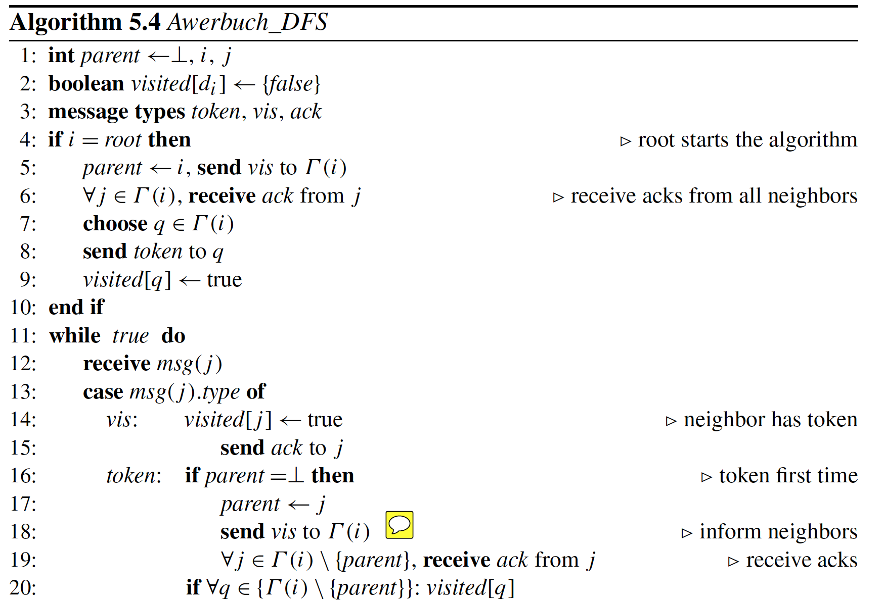

Slide 85
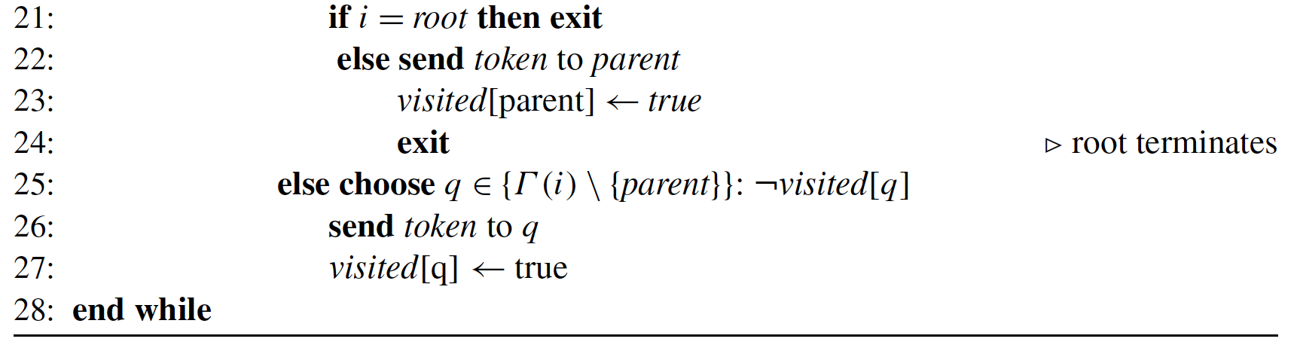

Slide 86
Awerbuch Analysis
Theorem 5.4 Awerbuch_DFS finds a DFS tree of an arbitrary graph G in 4n − 2 time using 4m messages.
A tree edge is traversed four times, twice for token in each direction plus one for vis and one for ack messages.
A nontree (frond) edge that is not included in the DFS will also be traversed four times as two vis messages and two ack messages in both directions. These yield 4m messages.
Notes:
n-1 --> Agaci root'tan leaf'a dogru forward gezinme
^{n-1 --> agaci backward gezinme}
2 --> Bir node'un visit gondermesi ve ack almasi.
^{Hepsini toplarsak:}
^{n-1+n-1+2n=4n-2}

Slide 87
Distributed DFS with Neighbor Knowledge
The DFS algorithm Neigh _DFS uses a token to traverse the nodes of the network in a sequential manner as in the previous algorithms.
The token includes the visited node list which is appended by the node identifier of a node that is visited for the first time.

Slide 88
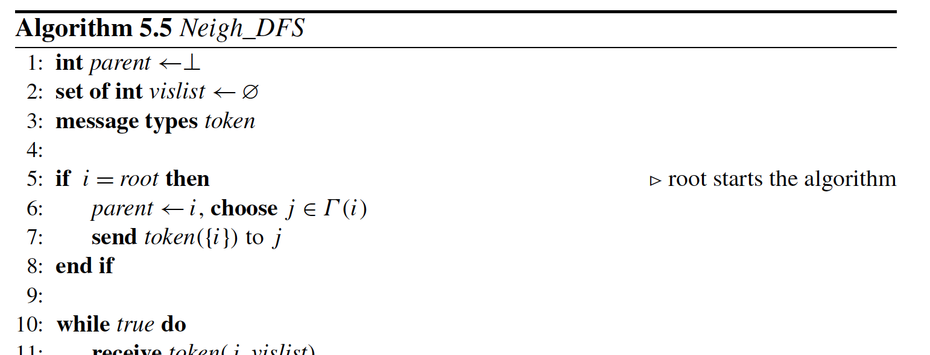

Slide 89
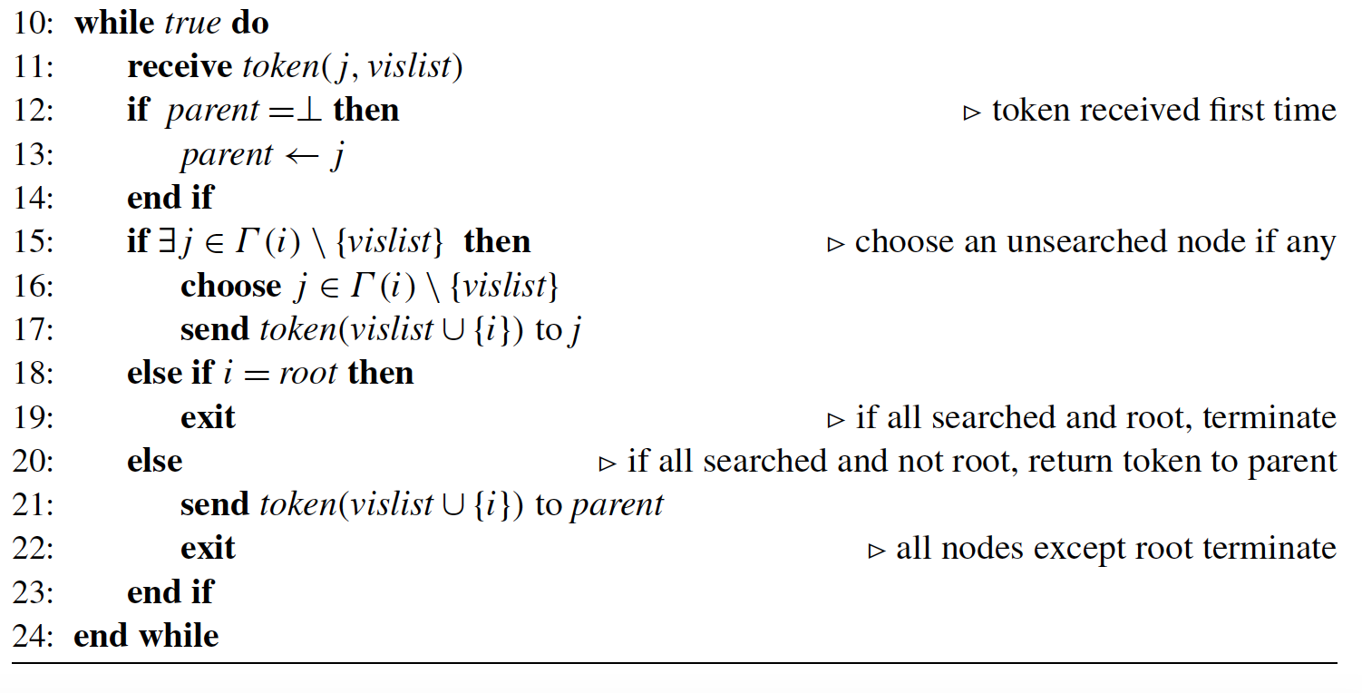

Slide 90
Theorem 5.5 Neigh_DFS algorithm constructs a DFS tree in 2n − 2 times using 2n−2 messages.
Proof. The final spanning tree will have n− 1 edges, and only the edges of this tree will have been traversed twice in each direction resulting in a total of 2n− 2 token transfers among the nodes resulting in 2n − 2 messages. Since there is a single activity at any time, each message delivery action corresponds to a time unit resulting in 2n− 2 times.

Slide 91
4
6
5
3
(4)
0
7
1
2

Slide 92
4
6
5
3
(4,7)
0
7
1
2

Slide 93
(4,7,6)
4
6
5
3
0
7
1
2

Slide 94
4
6
5
3
(4,7,6,5)
0
7
1
2

Slide 95
4
6
5
3
(4,7,6,5,2)
0
7
1
2

Slide 96
4
6
5
3
(4,7,6,5,2,3)
0
7
1
2

Slide 97
4
6
5
3
0
7
1
2
(4,7,6,5,2,3)

Slide 98
4
6
5
3
0
7
1
2
(4,7,6,5,2,3,1)

Slide 99
4
6
5
3
(4,7,6,5,2,3,1)
0
7
1
2

Slide 100
4
6
5
3
(4,7,6,5,2,3,1)
0
7
1
2

Slide 101
4
6
5
3
(4,7,6,5,2,3,1)
0
7
1
2

Slide 102
4
6
5
3
(4,7,6,5,2,3,1)
0
7
1
2

Slide 103
4
6
5
3
0
7
1
2
(4,7,6,5,2,3,1)

Slide 104
4
6
5
3
(4,7,6,5,2,3,1)
0
7
1
2

